Slide 1
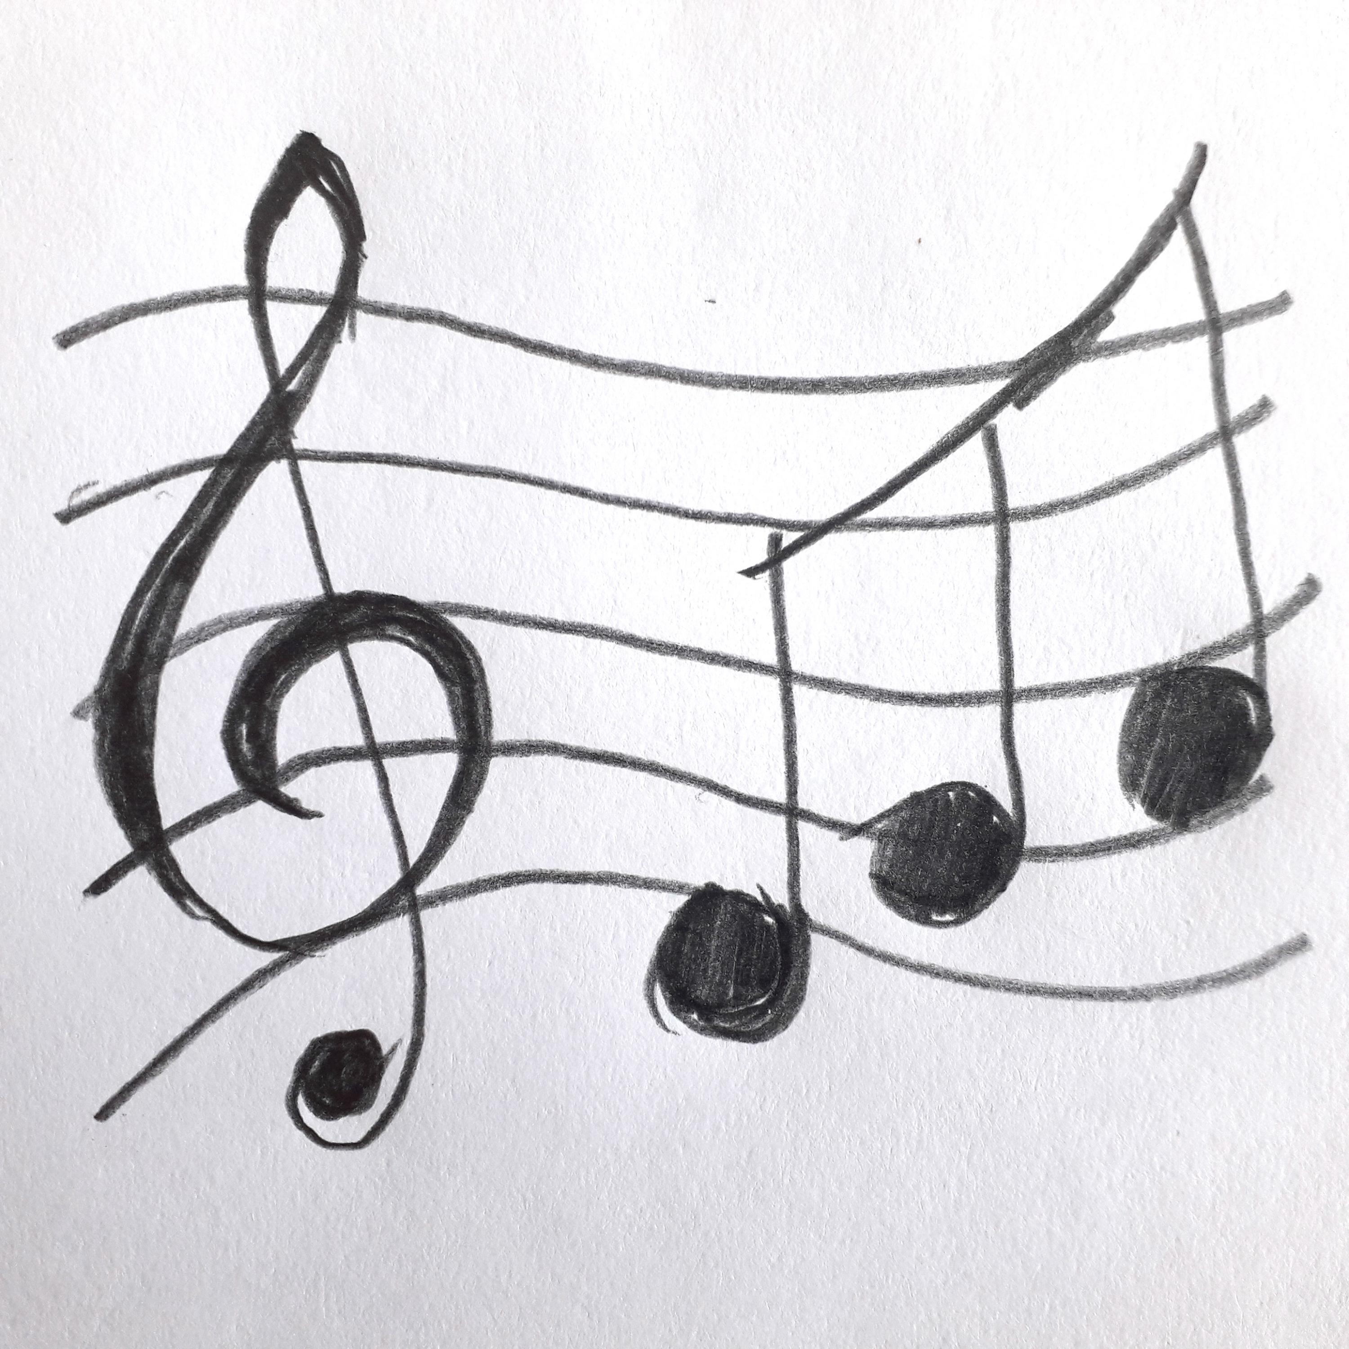
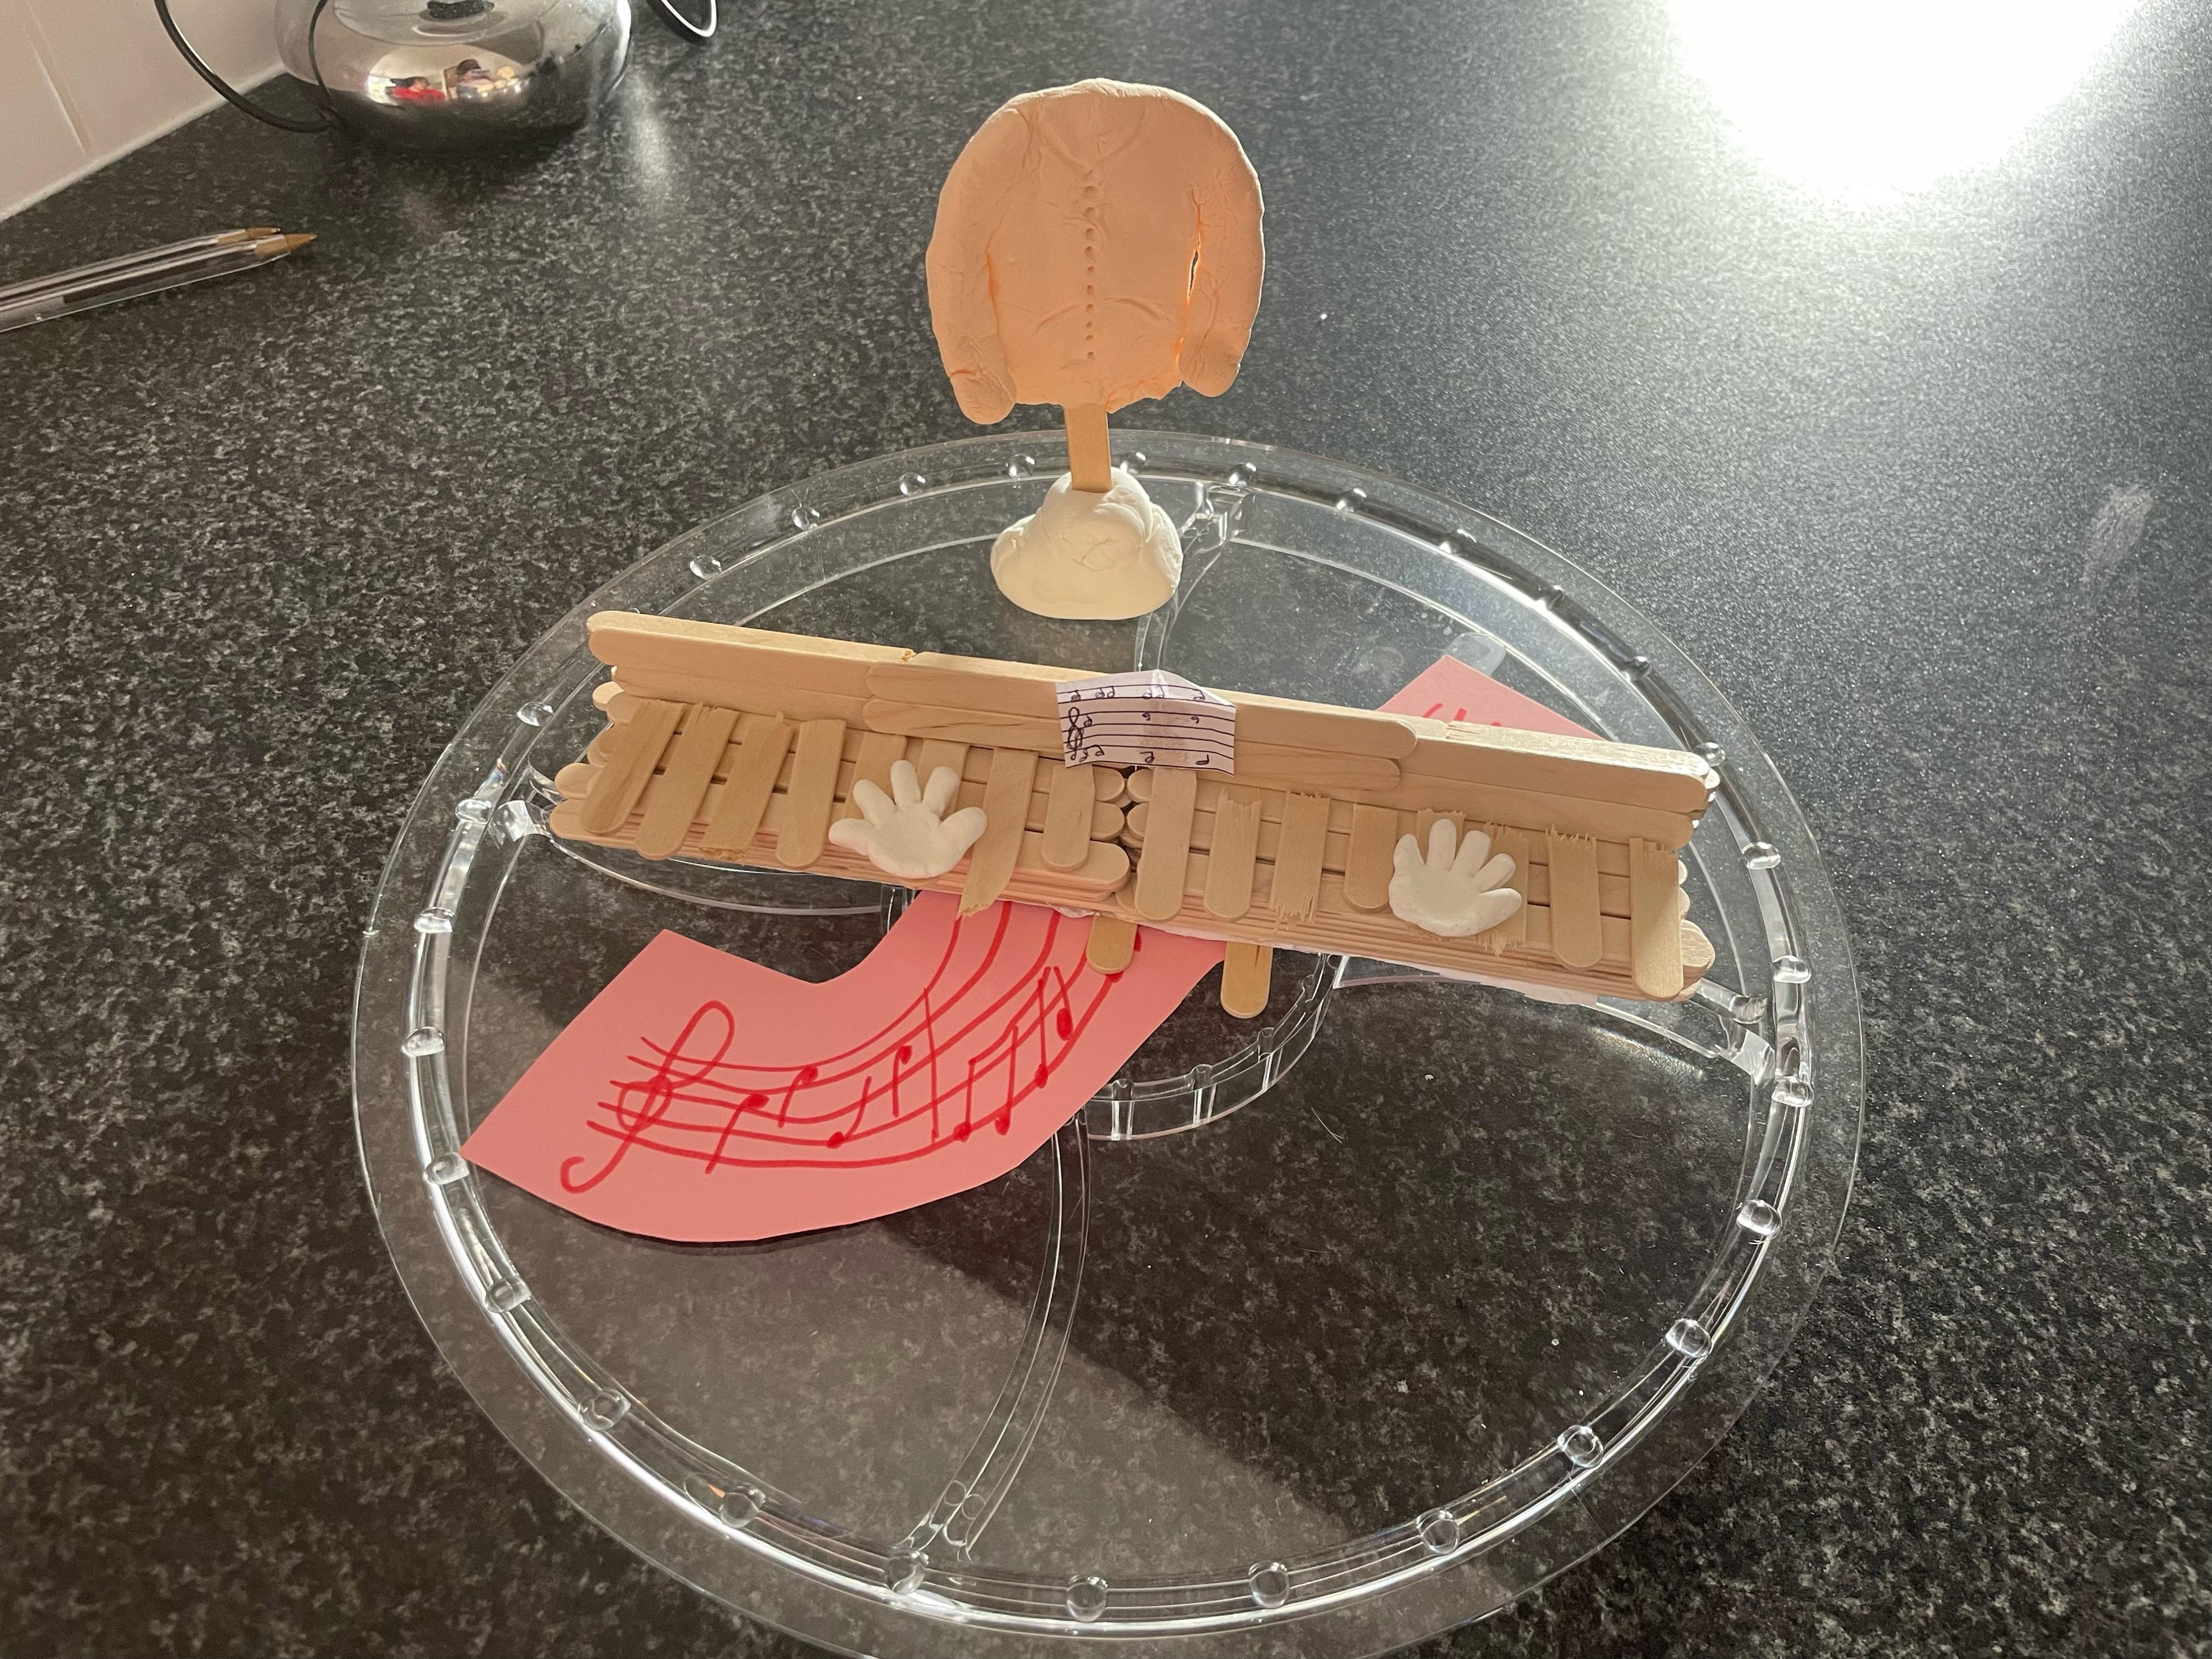
This Is Me !
By Helen Johnston -
‘’Music and fashion’’
This is my story of why I made a piano and my favourite jumper to describe myself.
I’m an artist and I like to make lots of different things to show who I am especially as part of Pamis online Art group every Monday with David Grigor of Blind Create.
It was obvious what I wanted to do for my project, I love music and listening to my favourite song by Abba. I also love going to shops to buy clothes and chose to make my favourite jumper. Let me tell you about how I made my proejct.

Slide 2
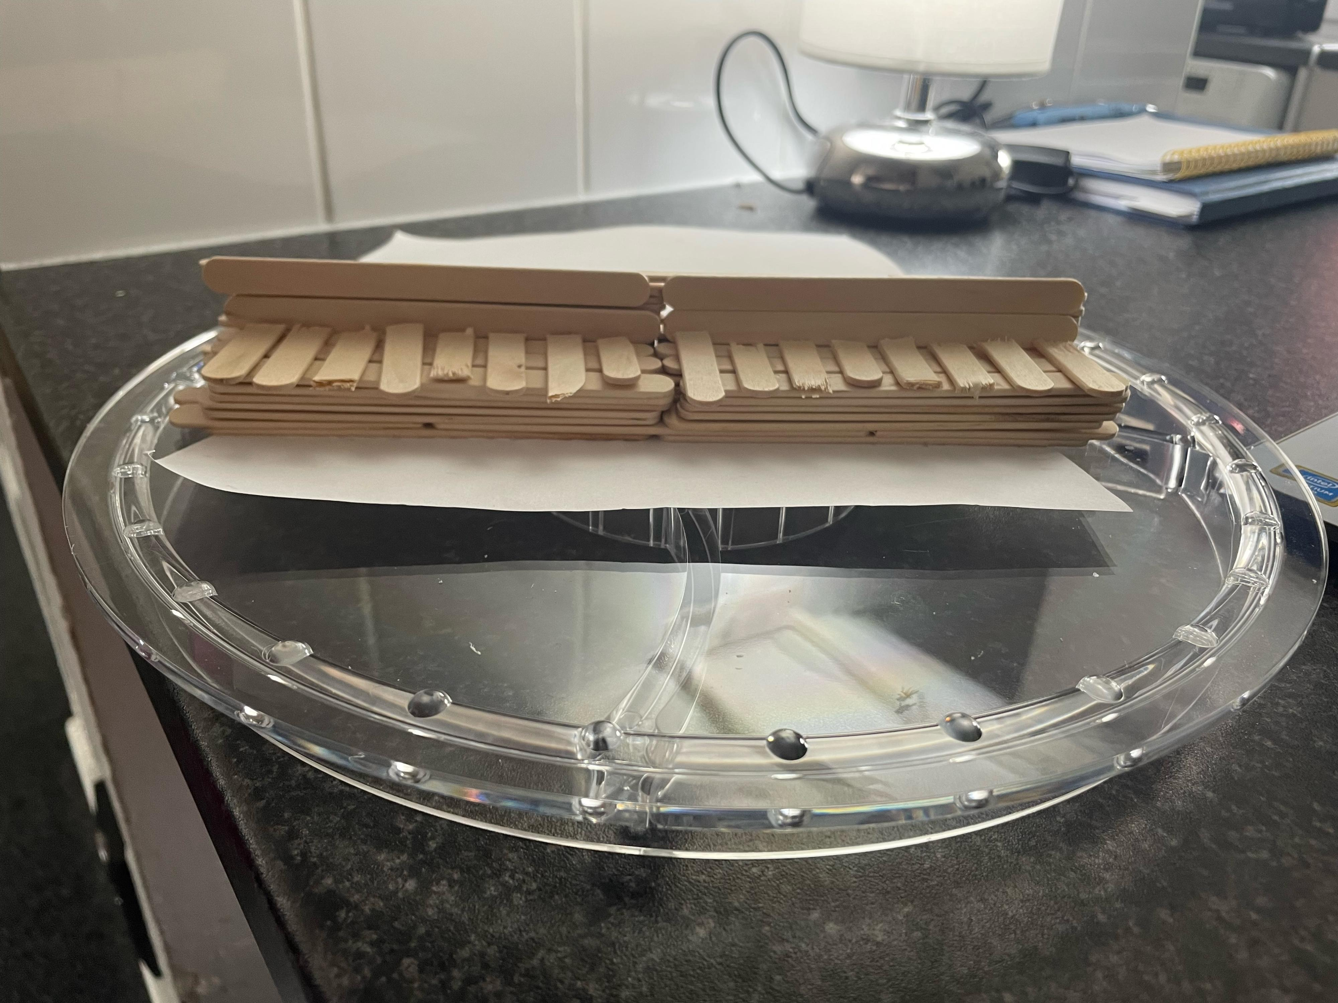
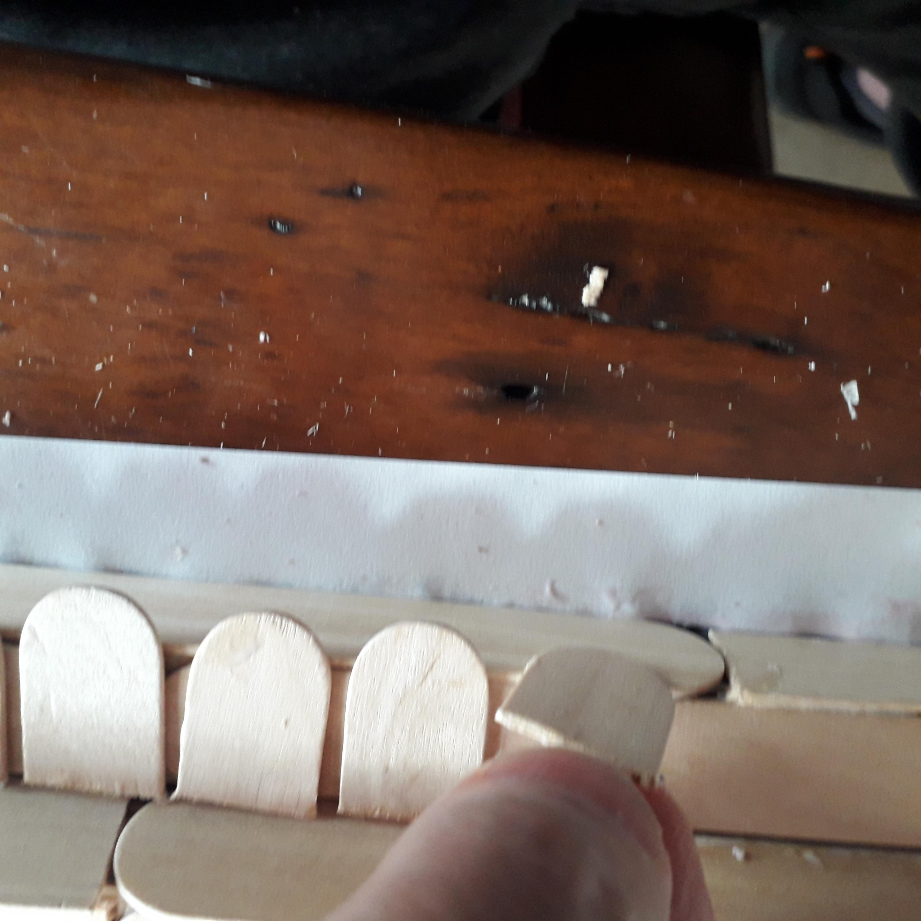
I used many lolly sticks to build the sculpture up to look like an upright piano. It took some time to do, but I was very happy when we used sticks to finish the sides and the ends to make it look really good.. We used PVA glue and scissors to cut the sticks to make the keys and the pedals and other parts.
It was like laying musical bricks but I did it listening to keyboard tunes that David was playing in the session,. This made me laugh, as it was funny to listen to piano music because I was making it as well.

Slide 3
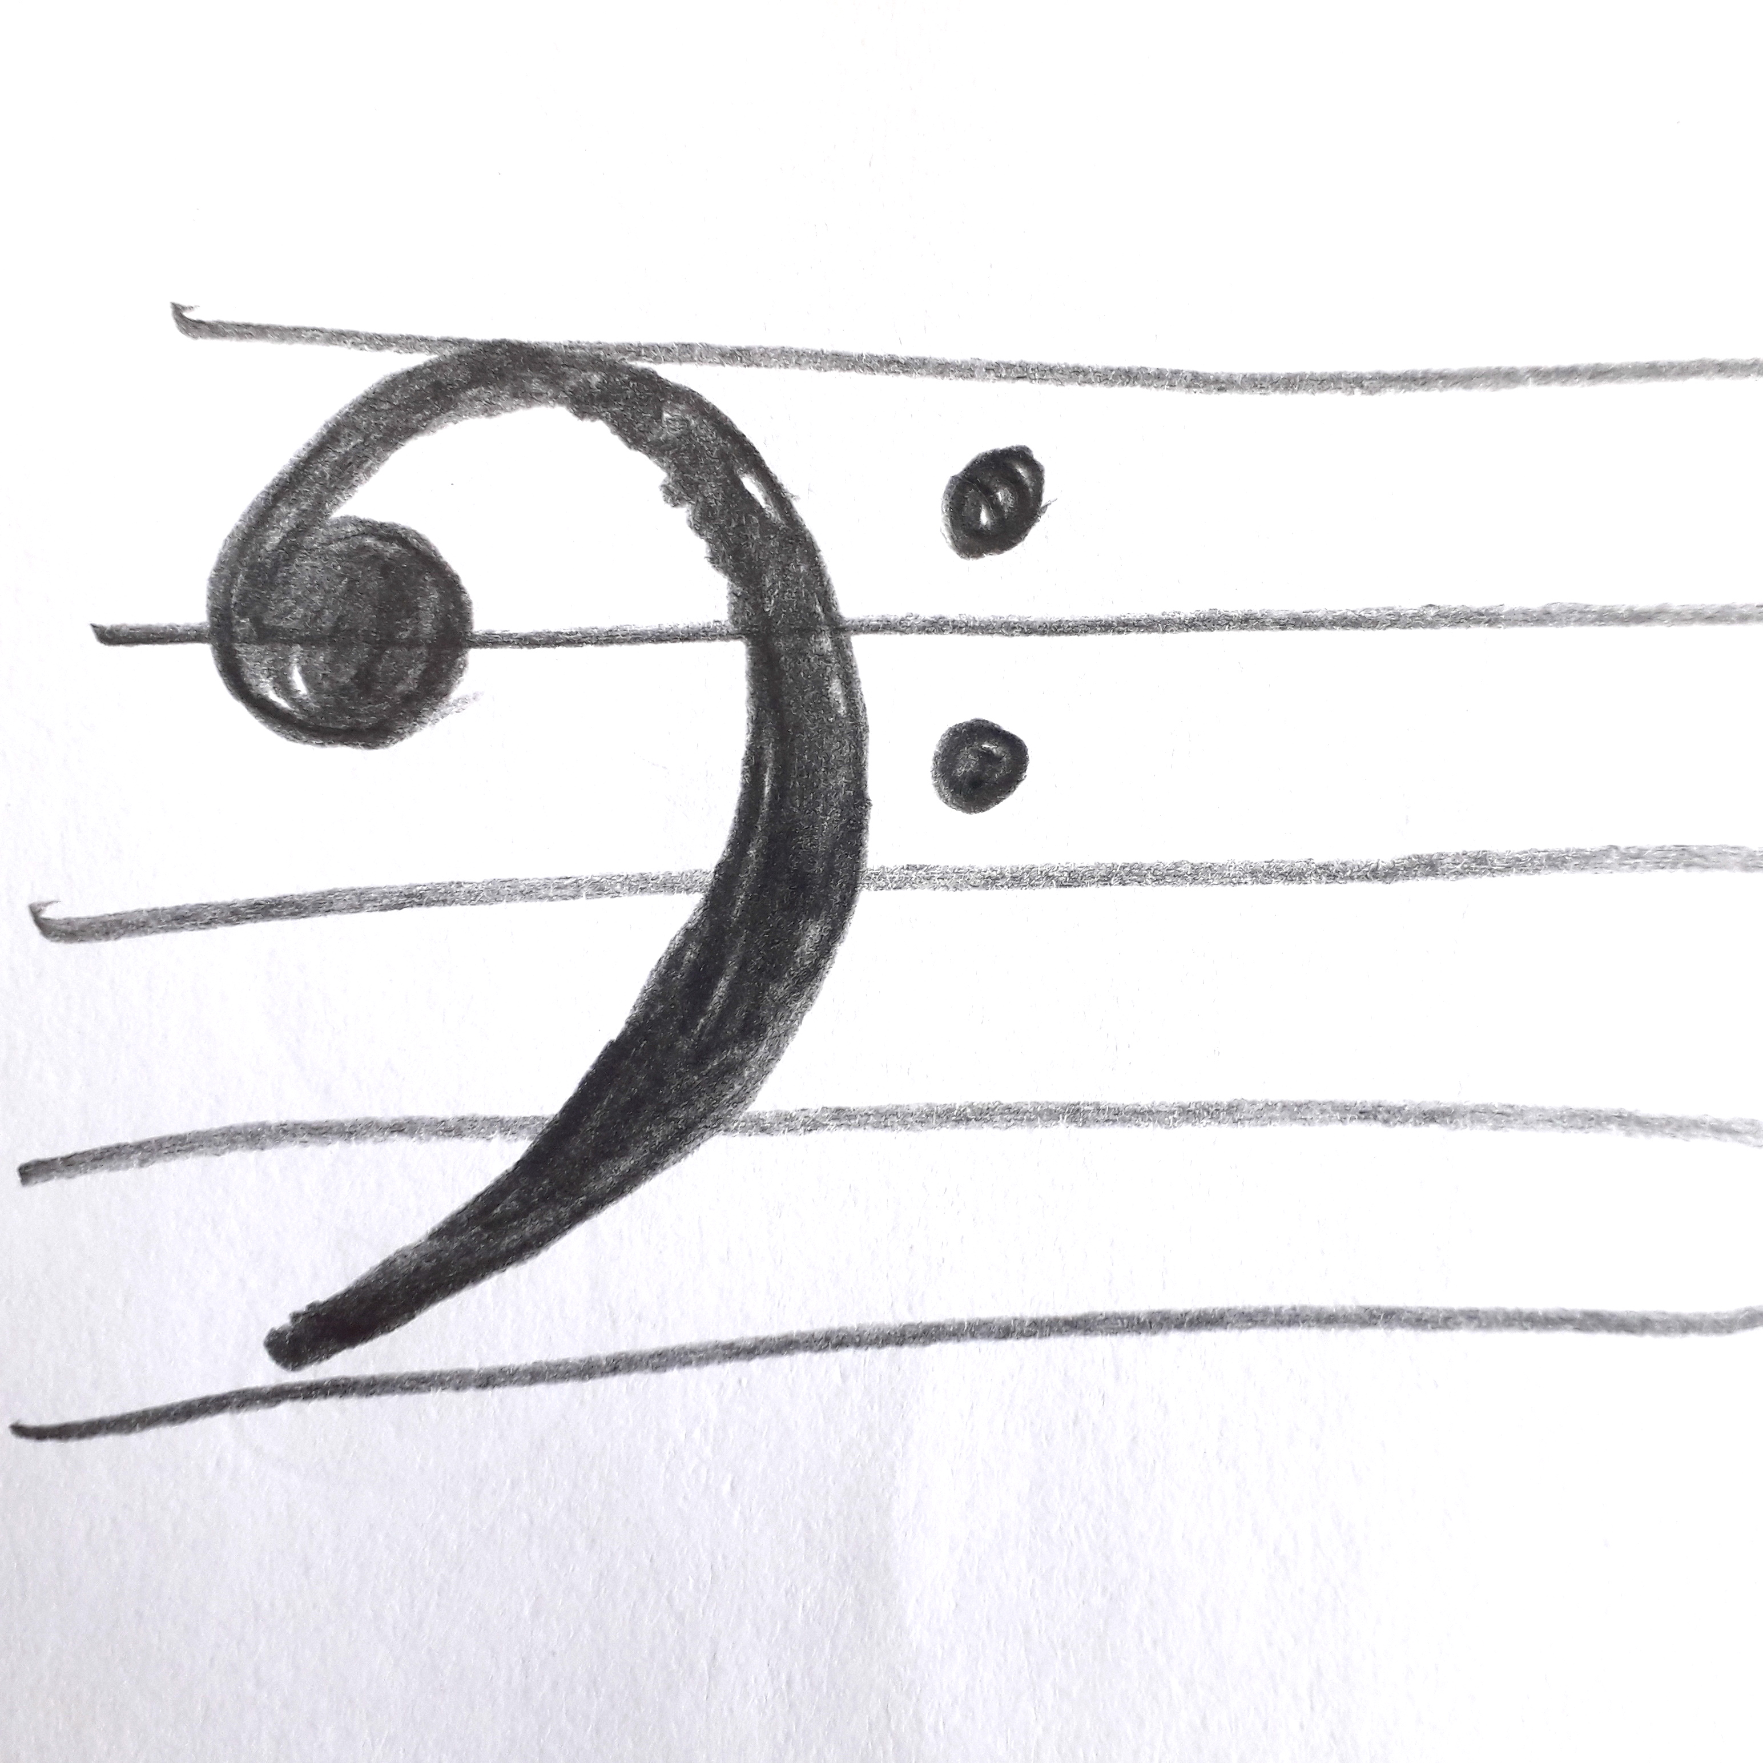
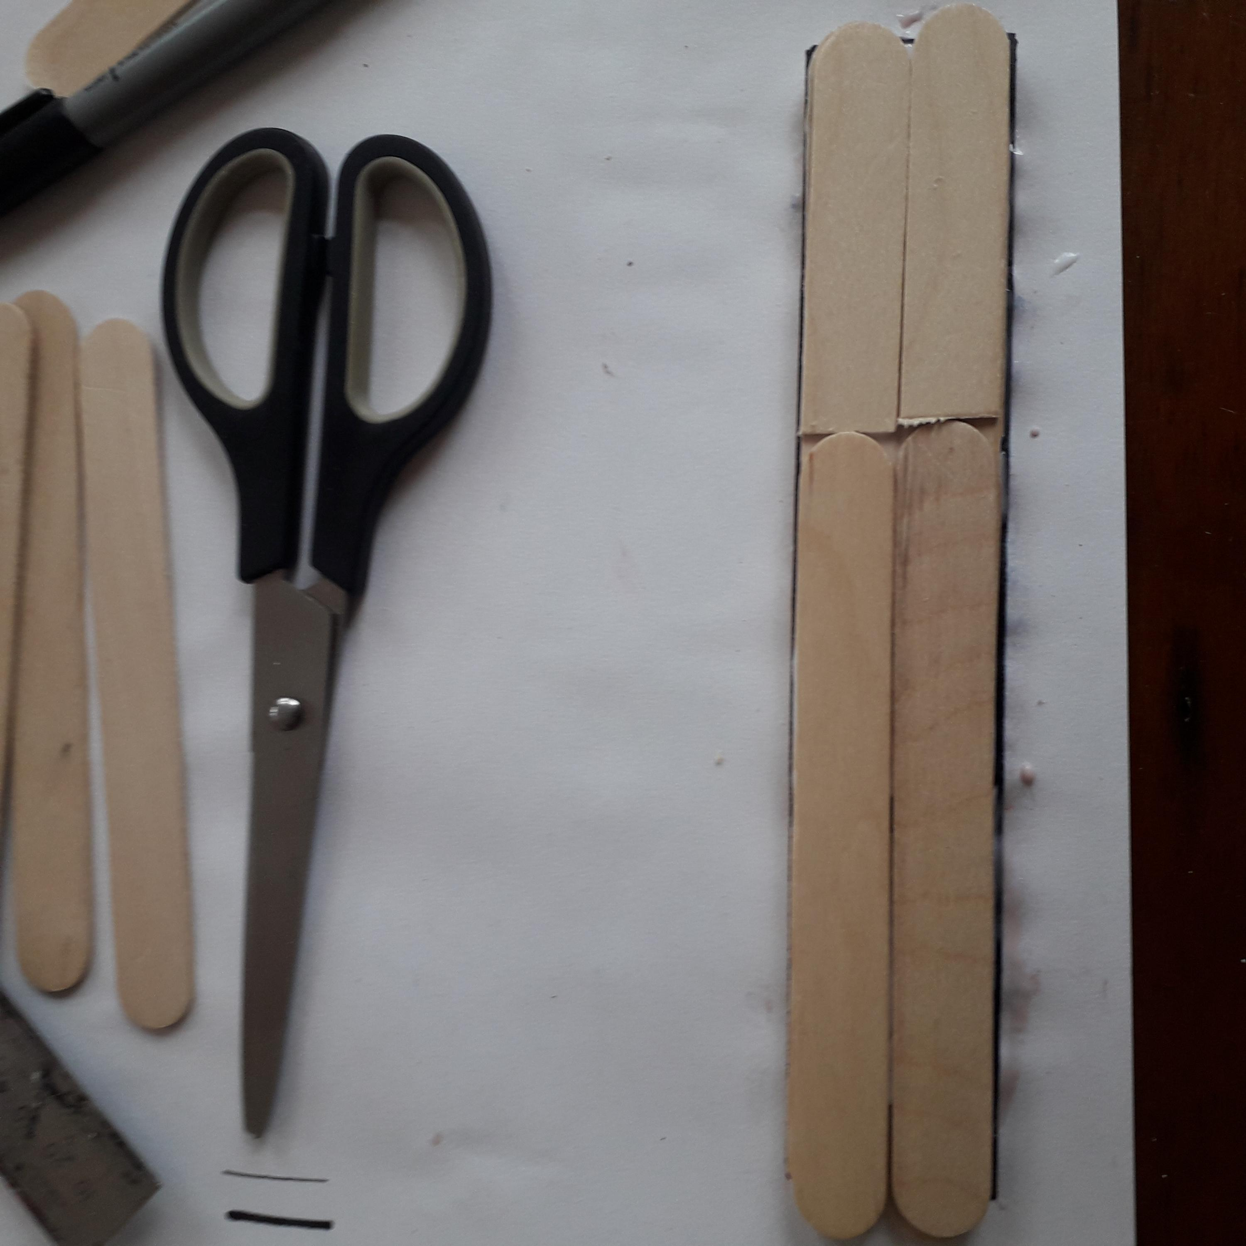
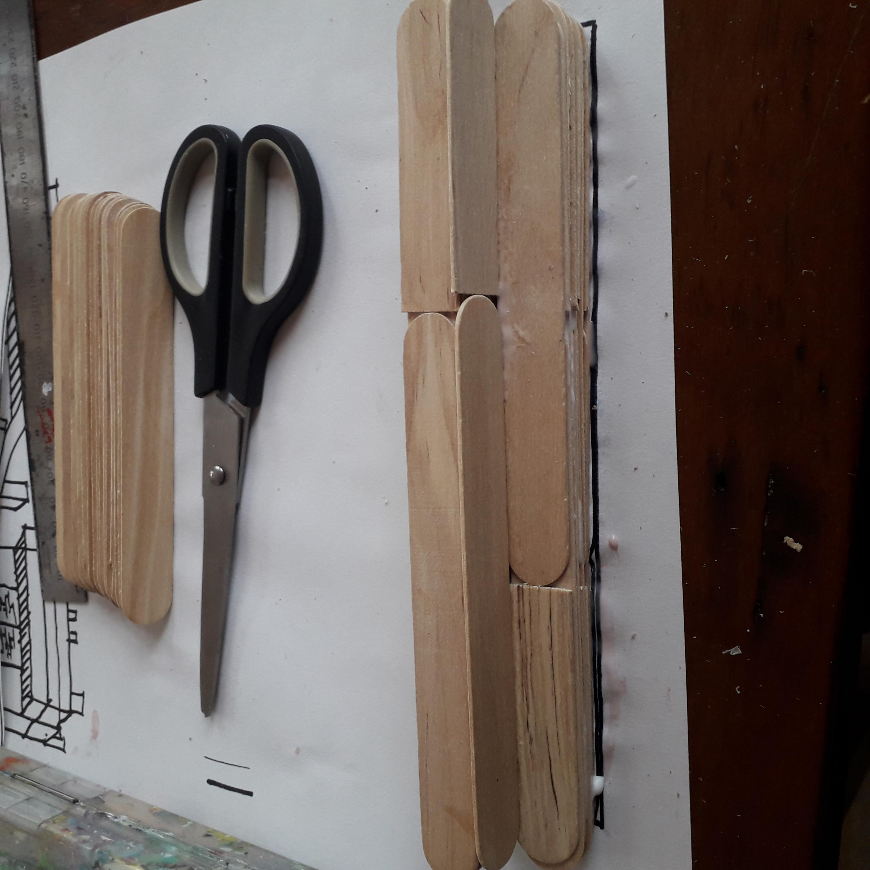
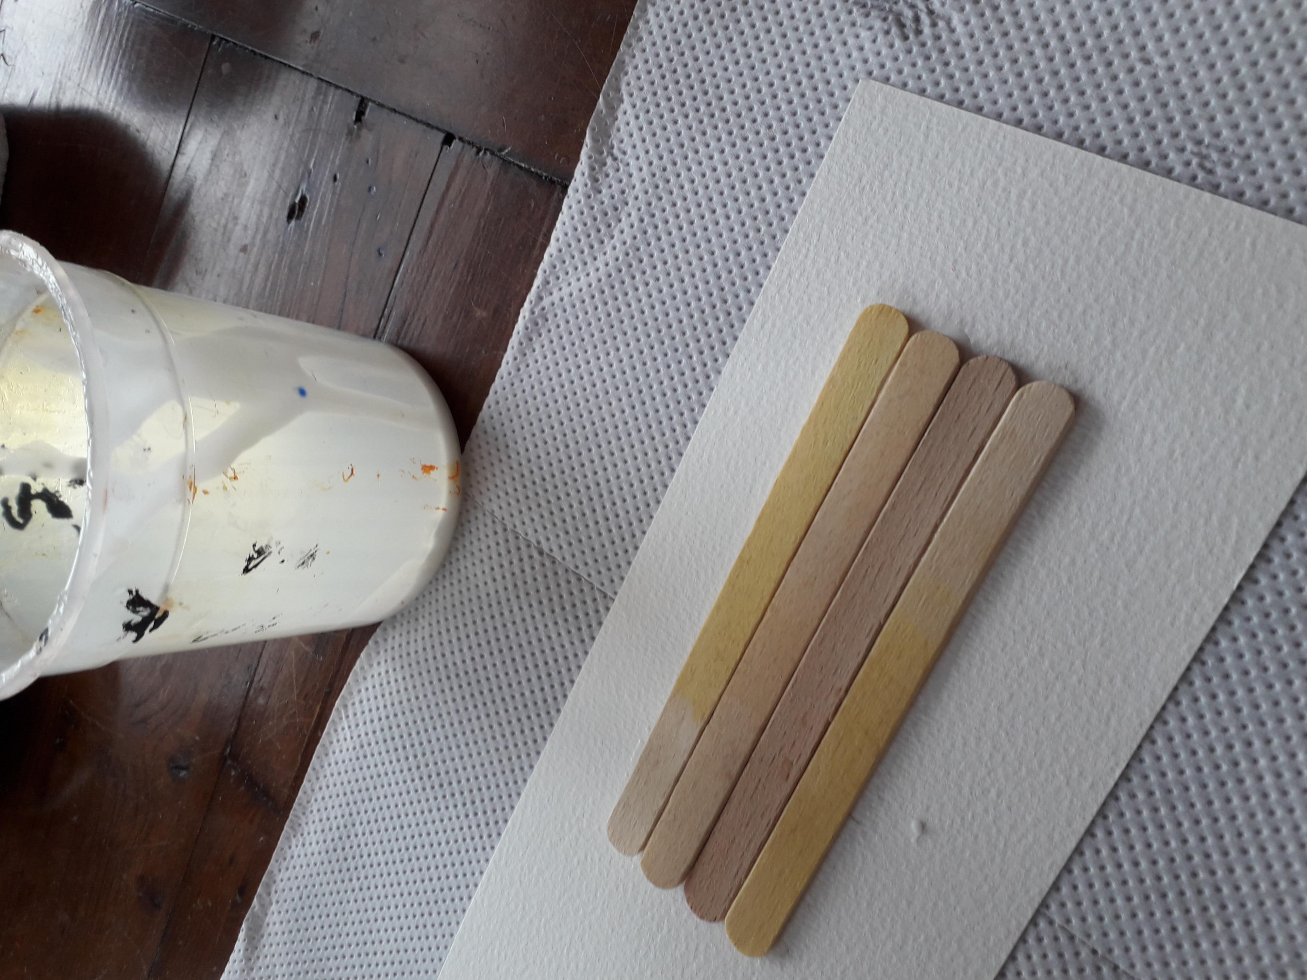
I wanted to make a piano because I love the sound of piano music and the keyboard, so to start with, David showed me an example of what I could make. With my support, I started to put the lolly sticks together with PVA glue on a card baselike brickwork.

Slide 4
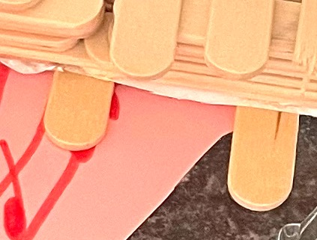
Then:
When the piano sculpture was complete , I used the curved end of lolly sticks to make the keys of the piano.
I also used the curved pieces to make the 2 pedals for the piano, and added music on a piece of paper.
I used clay to make the 2 hands for playing the piano.

Slide 5
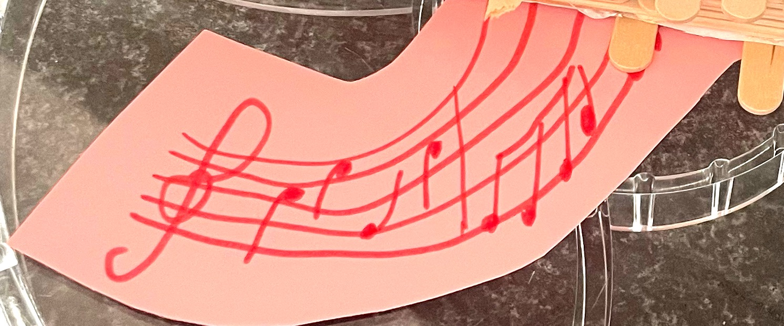
Then it was time to do the back ground I decided to make a floor panel showing musical notes to my favourite Abba song - Super Trouper !
The panel is a curve shape to show how music and piano makes me happy and has a movement to it.

Slide 6
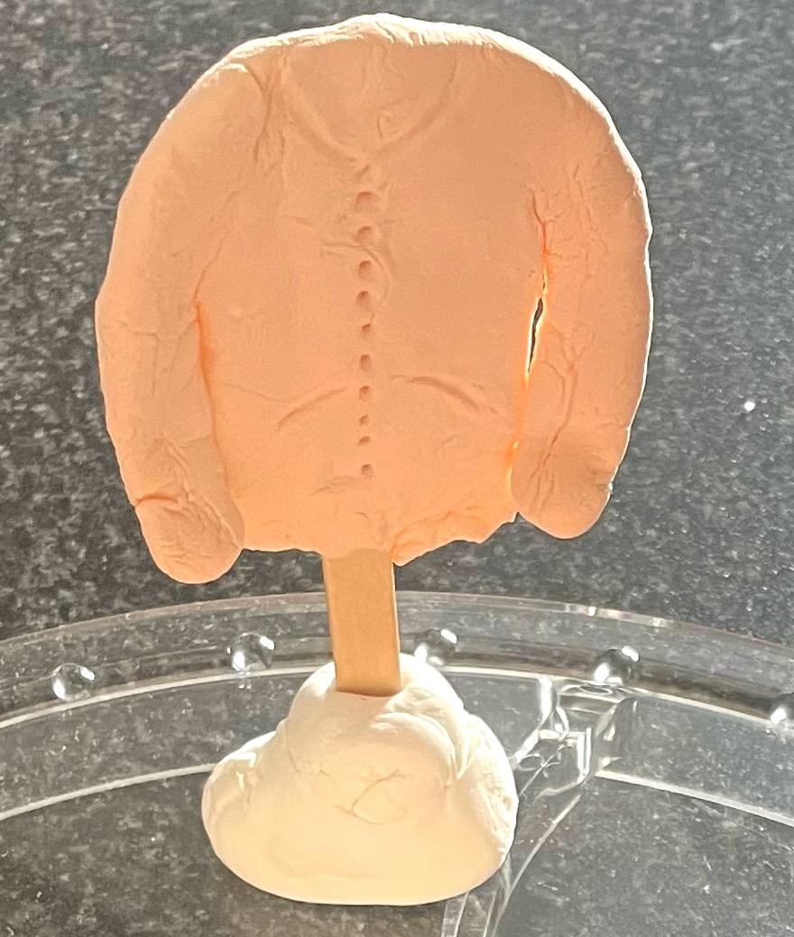
Then - with clay I started to make my favourite jumpe. This was great too because I made the stand first using a cube of clay with a lolly stick as the stand.
With support I made the fashion piece by squeezing, and making the clay into a shape like my favourite jumper. I chose colours to complete it.

Slide 7
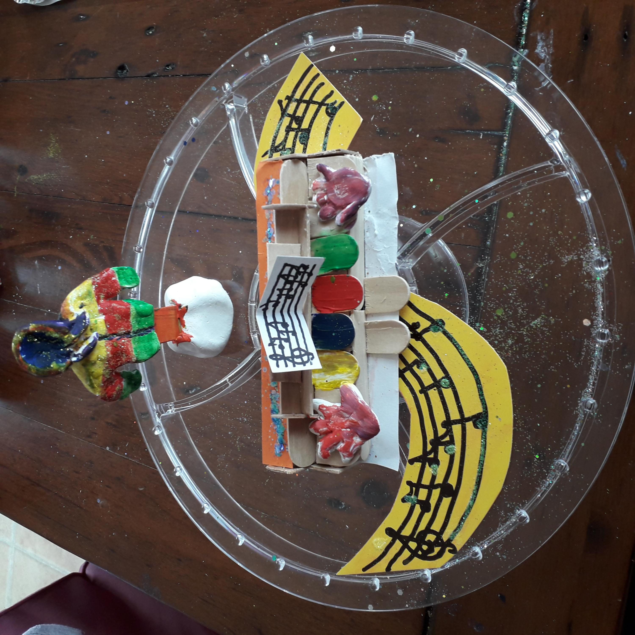
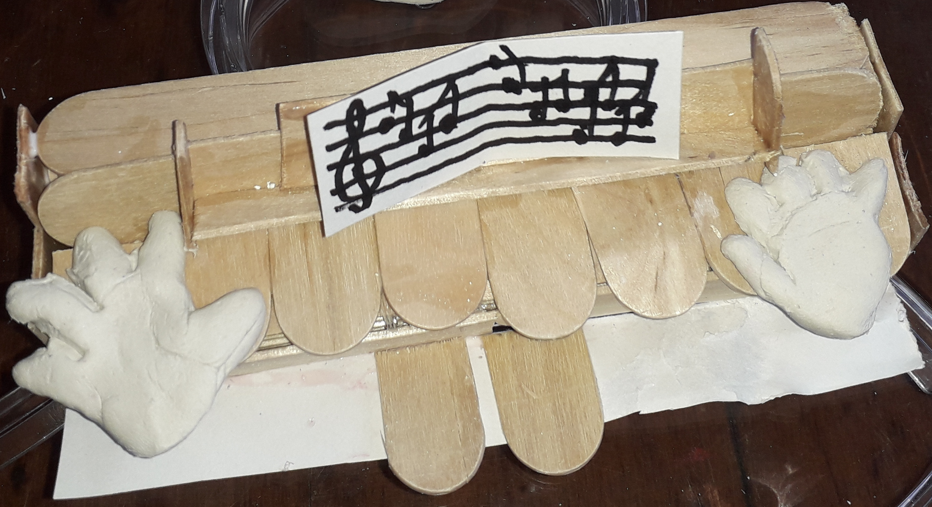
Then I put the clay jumper with the msuical notes and piano together to make my display.
I used a lot of different materials to make this whole project and chose colours, materials and where to put them. I really enjoyed putting them all together and hope you like this as much as i do.

Slide 8
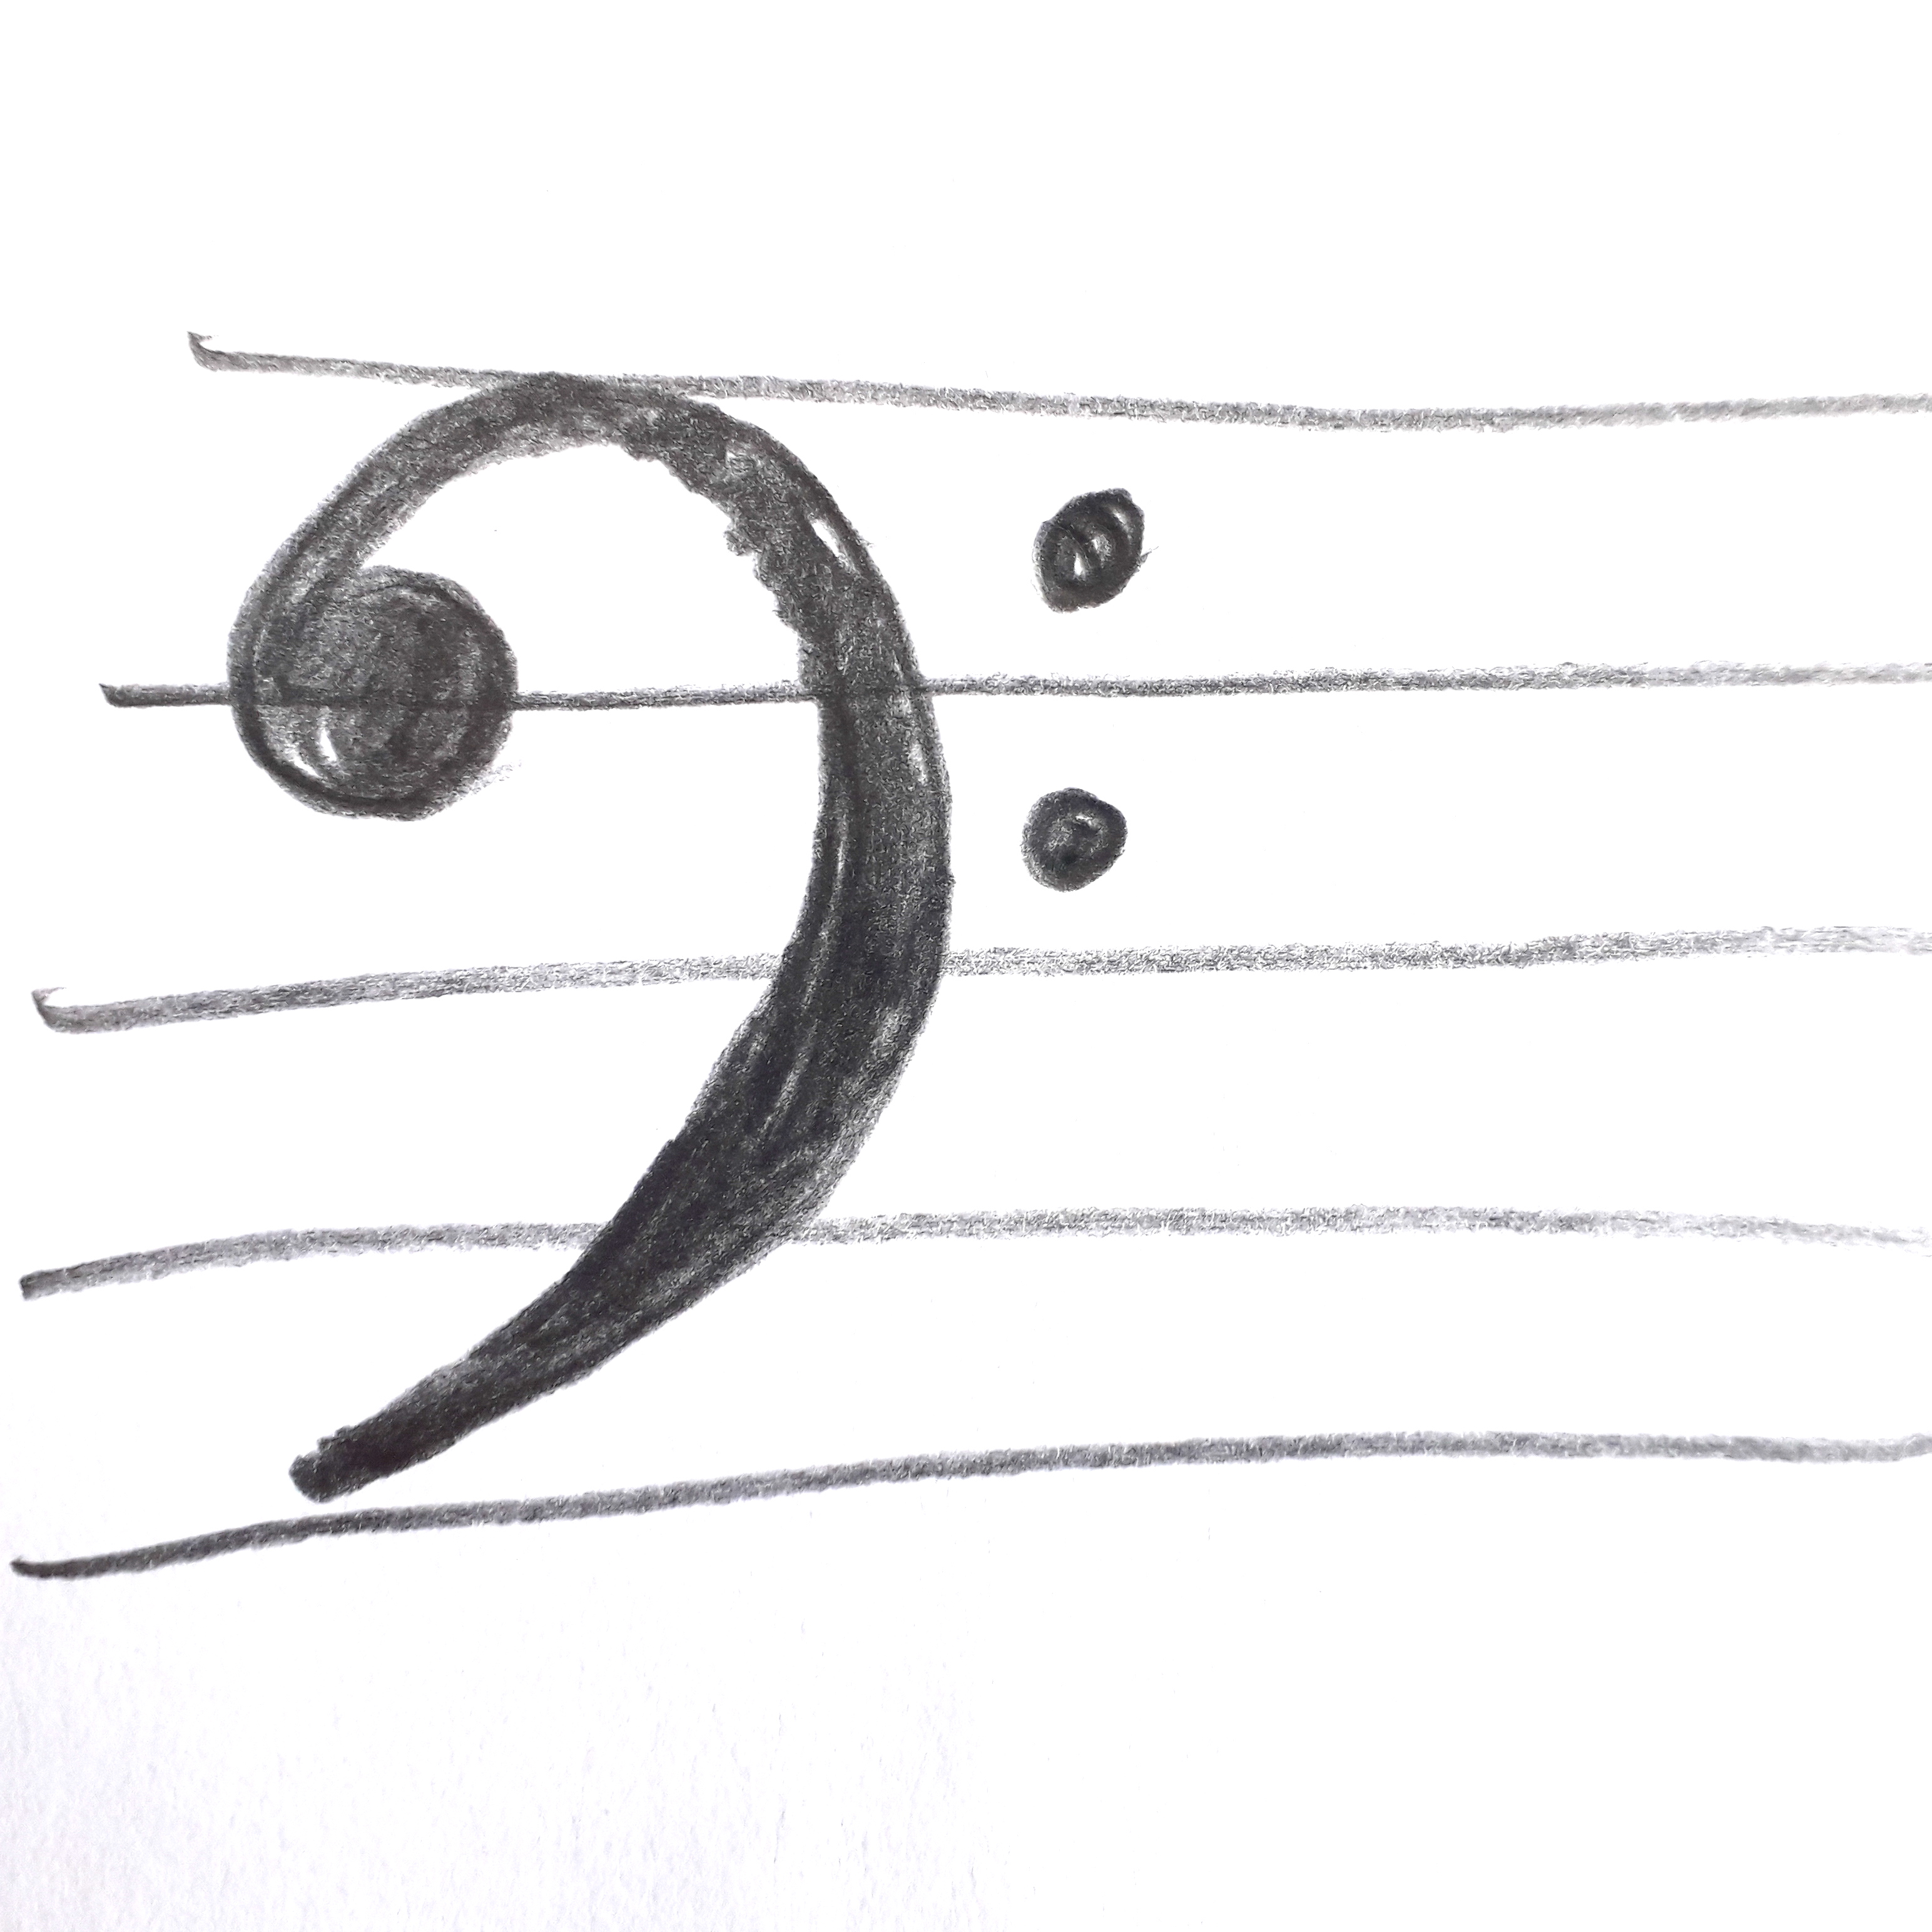
My finished work

