Slide 1
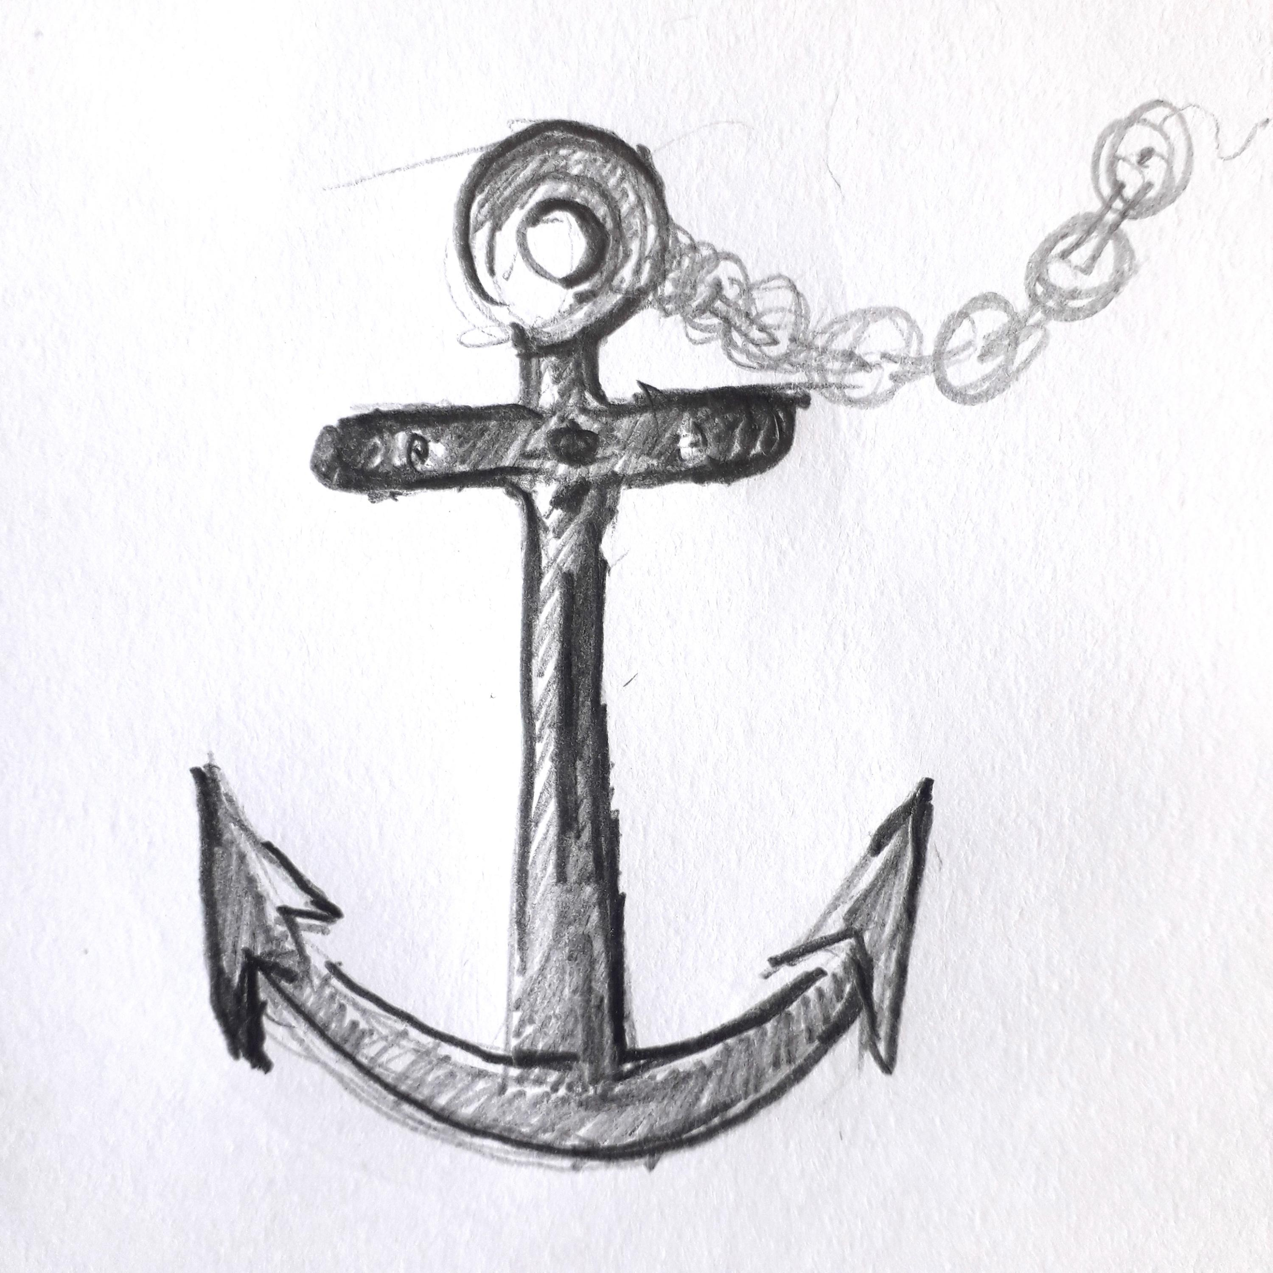
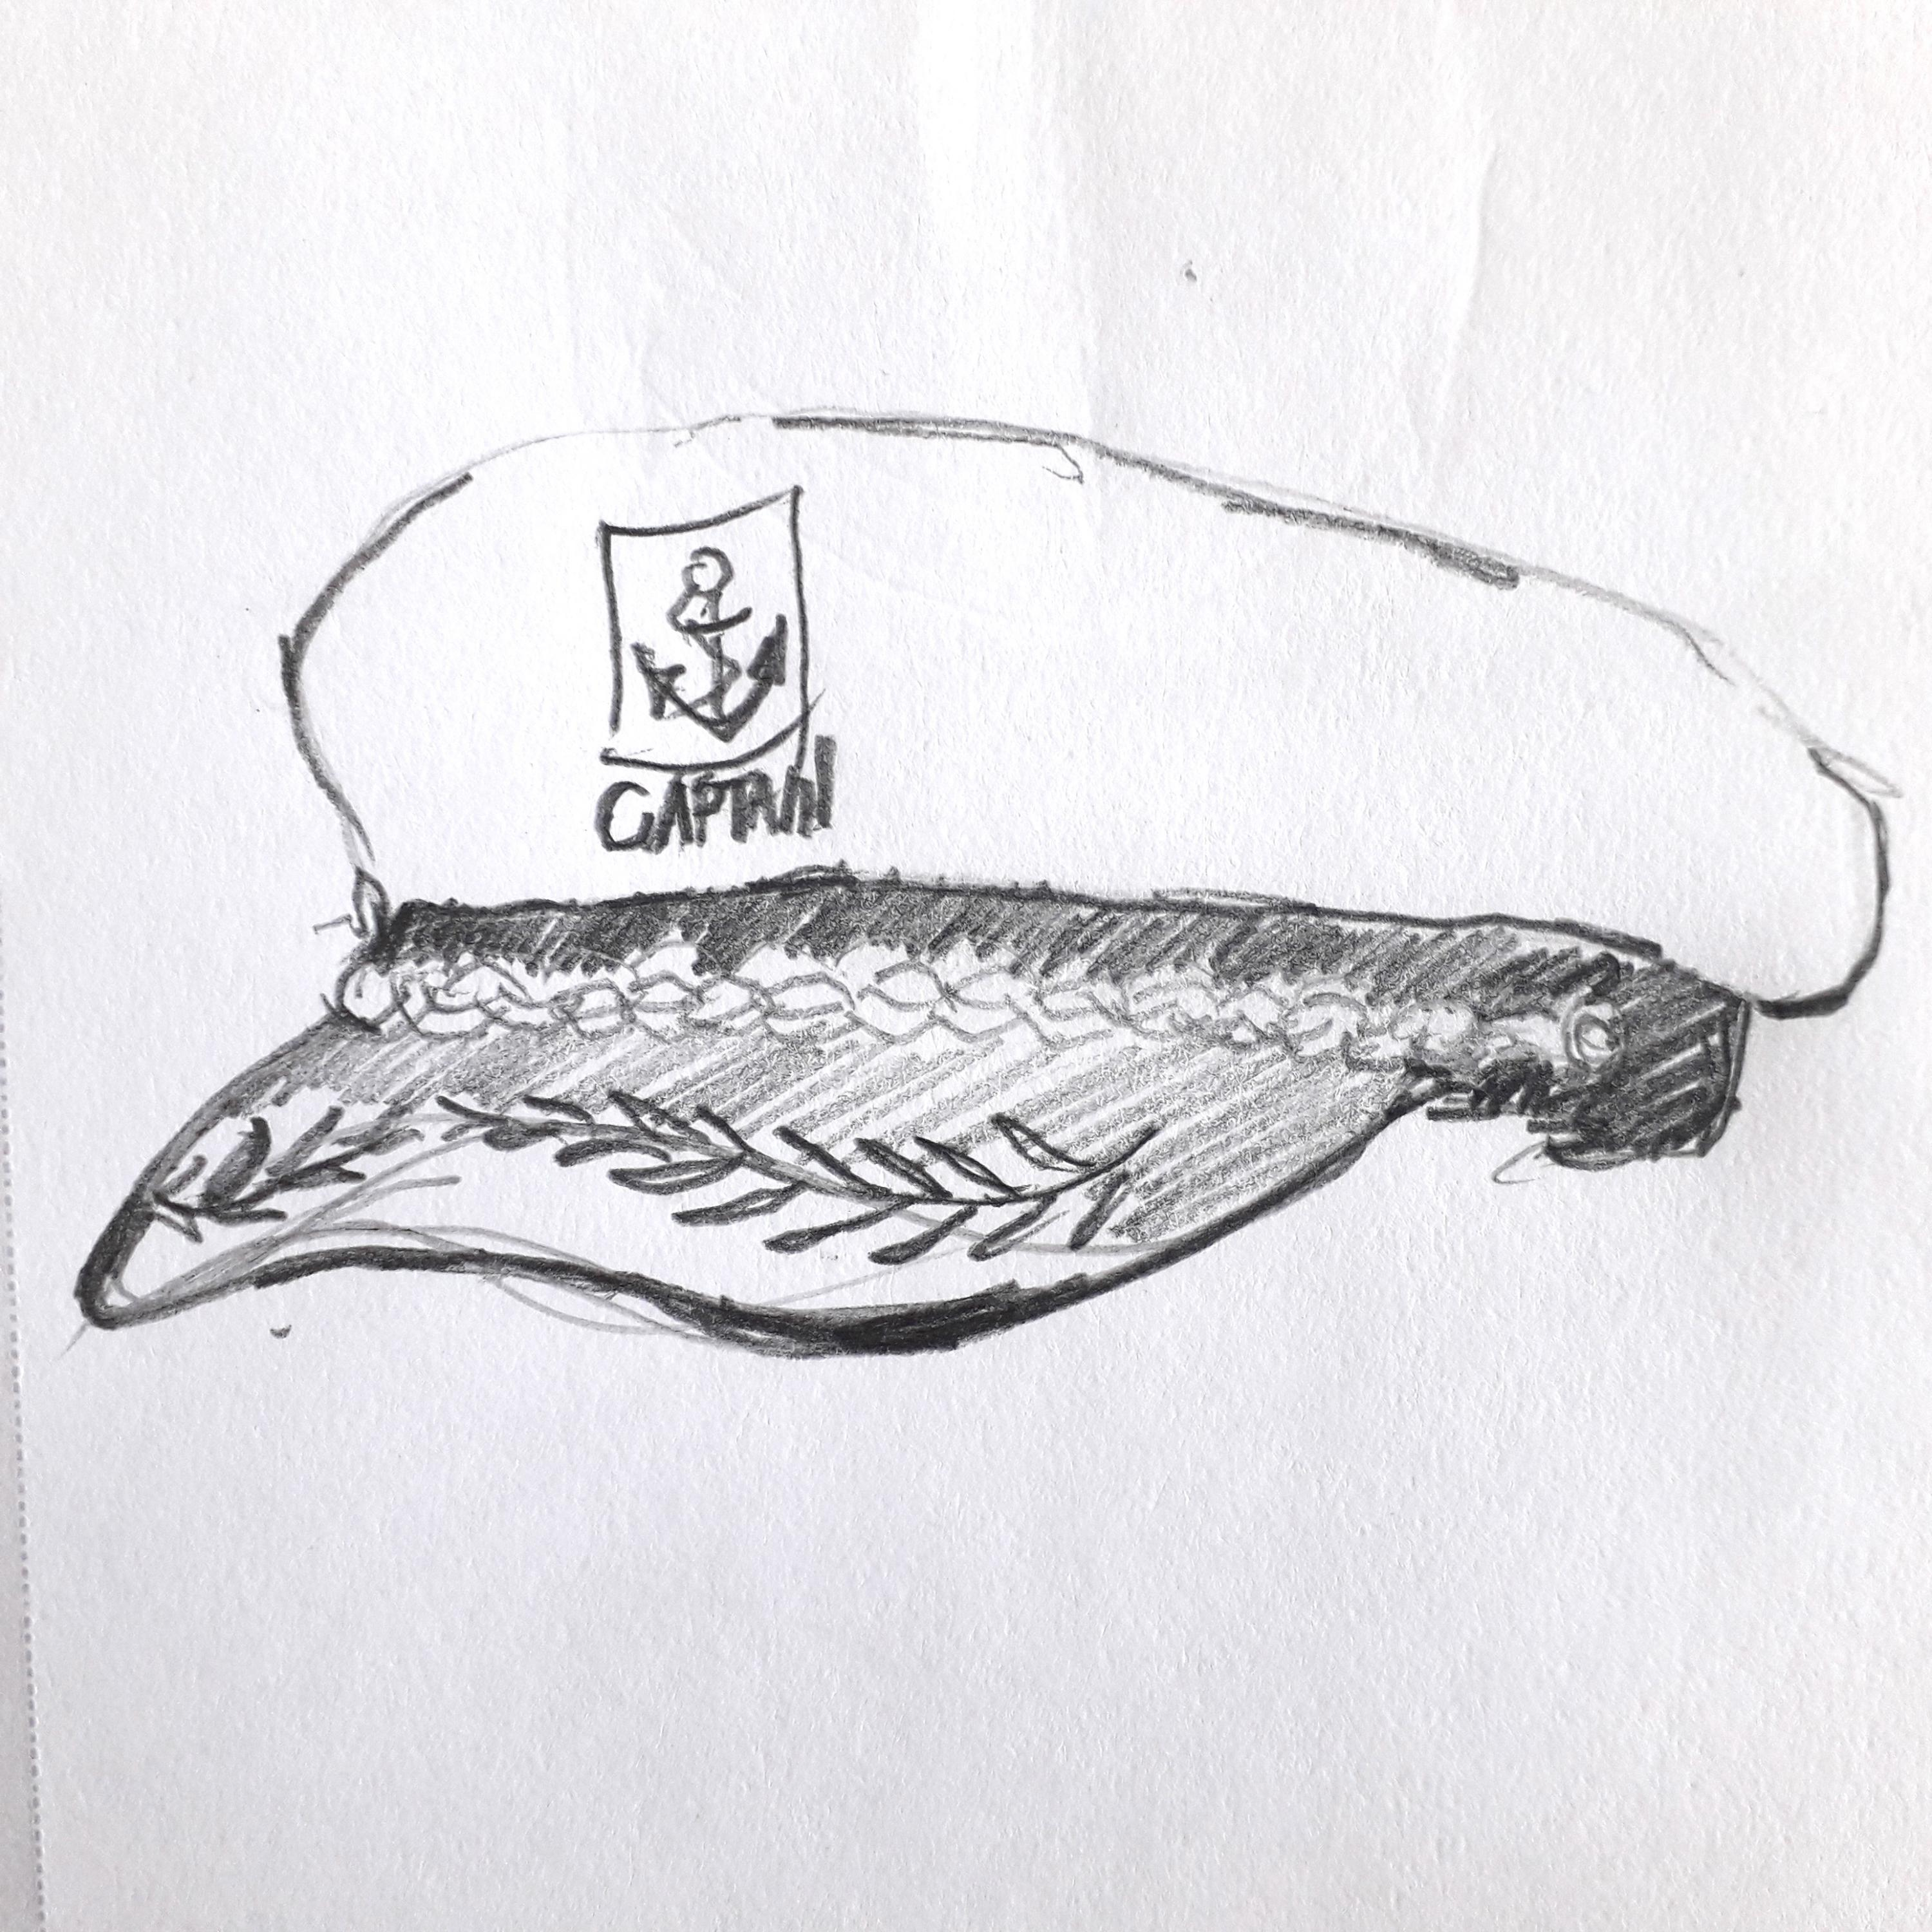
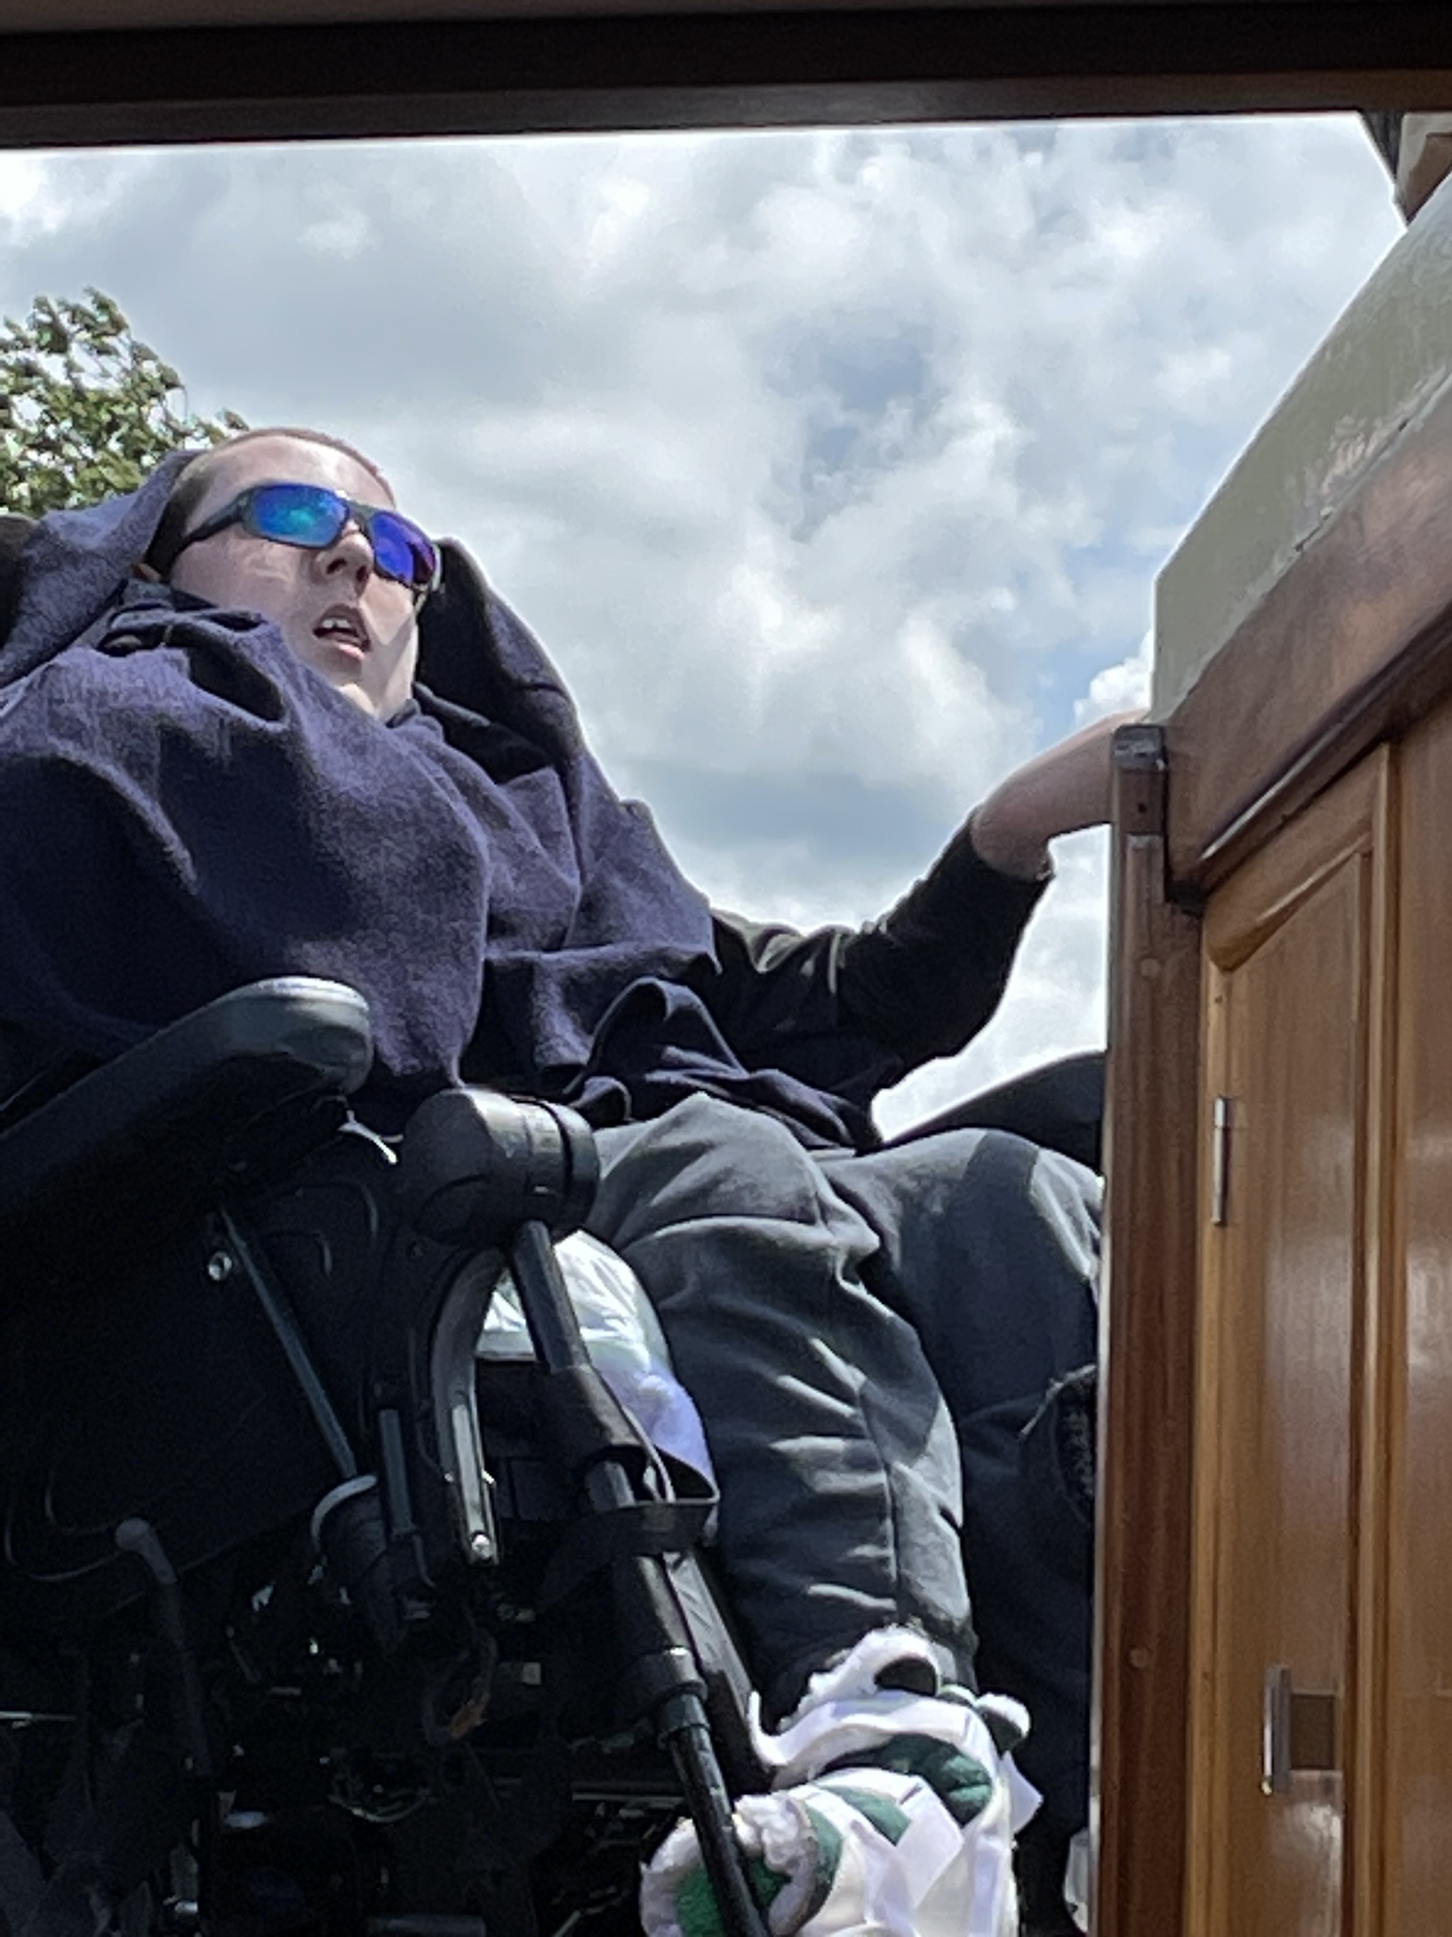
This Is Me !
By Jack McBride -
‘’Captian Jack’’
This is my story of why I made a canal boat on the canal to describe myself. I’m an artist and I like to make lots of different things to show who I am especially as part of Pamis online Art group every Monday with David Grigor of Blind Create.
It was obvious what I wanted to do for my project, I’m called Captain Jack because I steer a special canal boat on the Lancashire canal every July for over 10 years and I love it. Let me tell you about how I made my proejct.

Slide 2
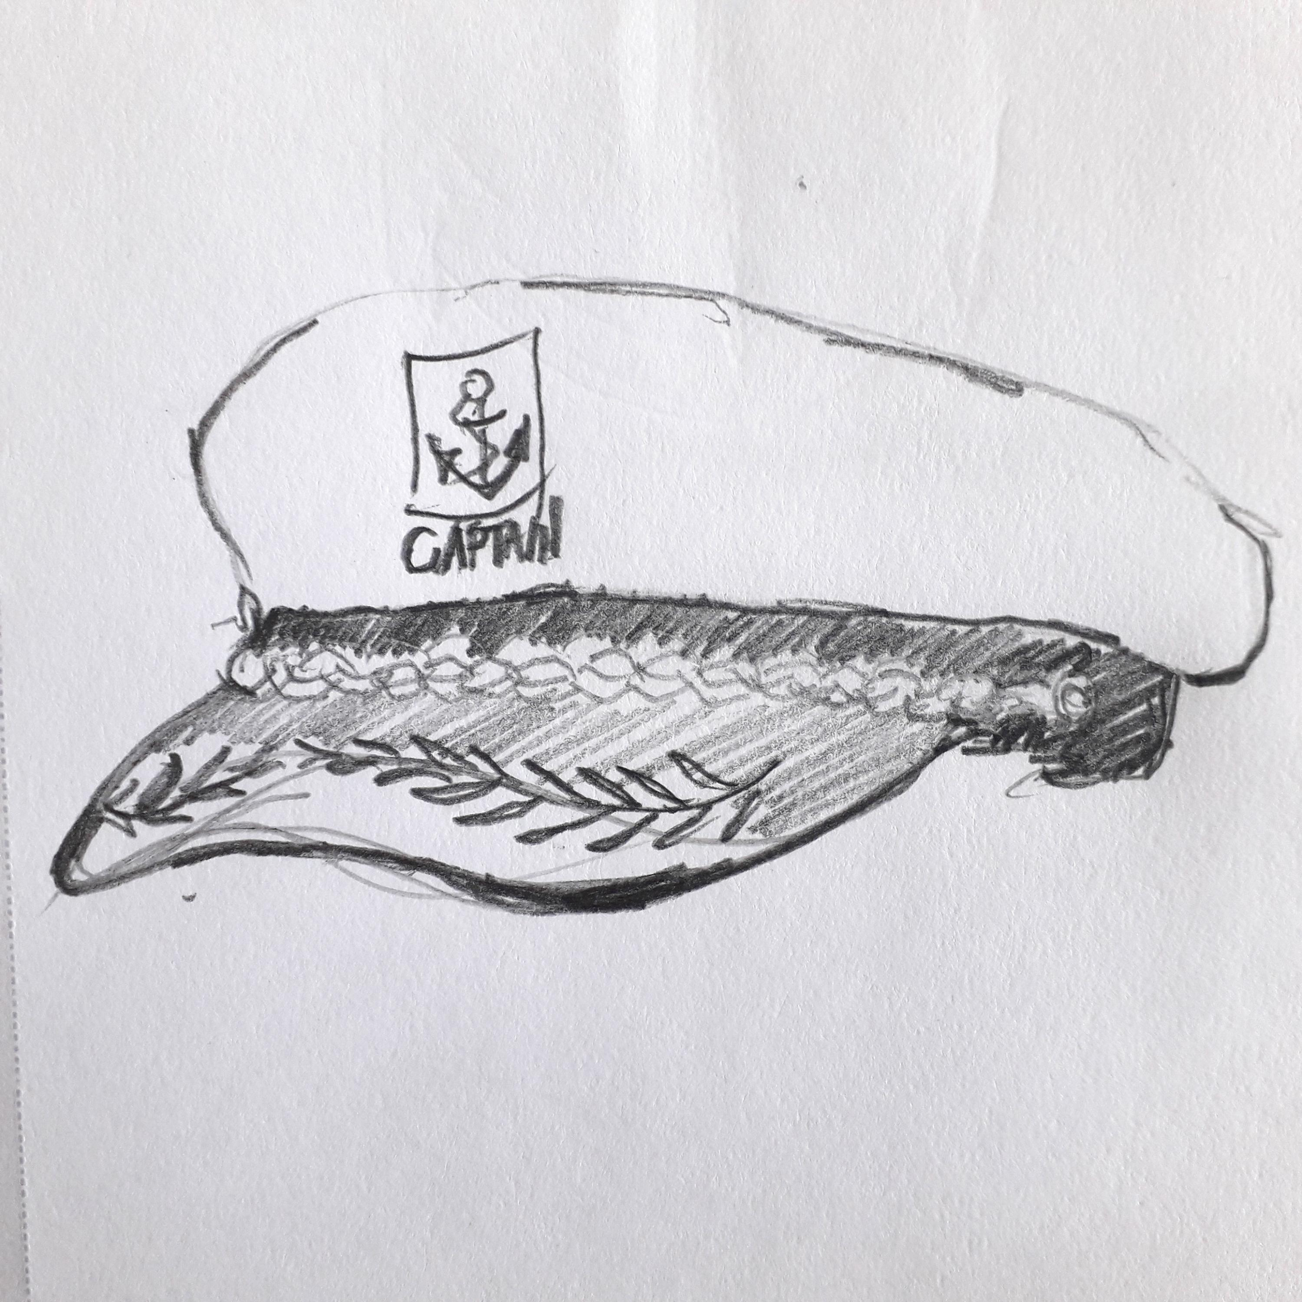
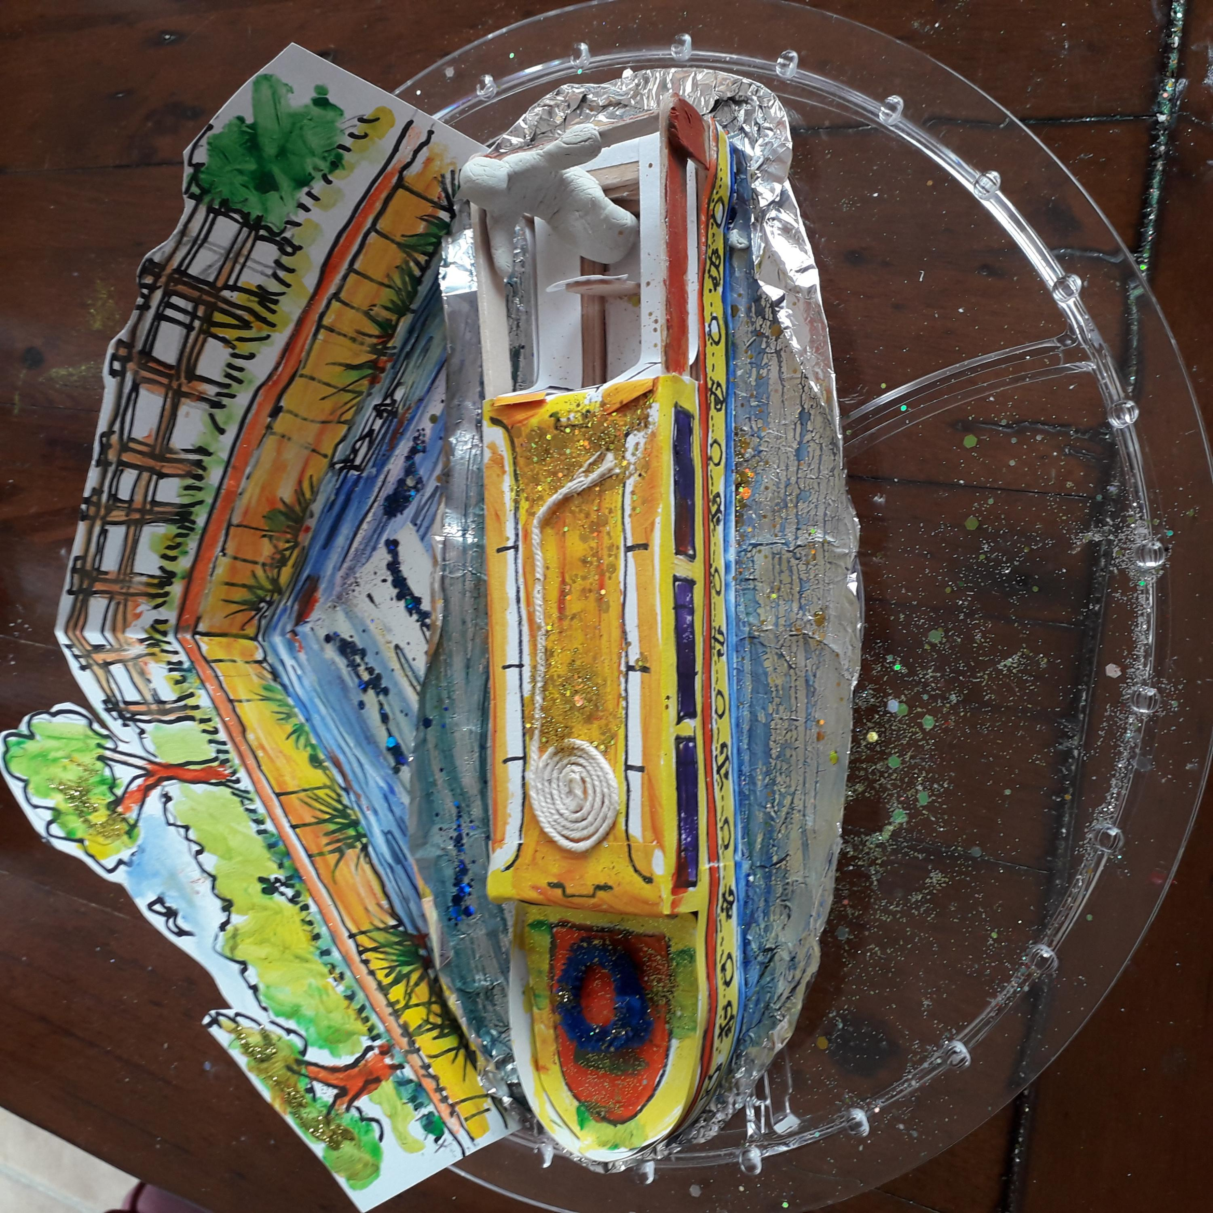
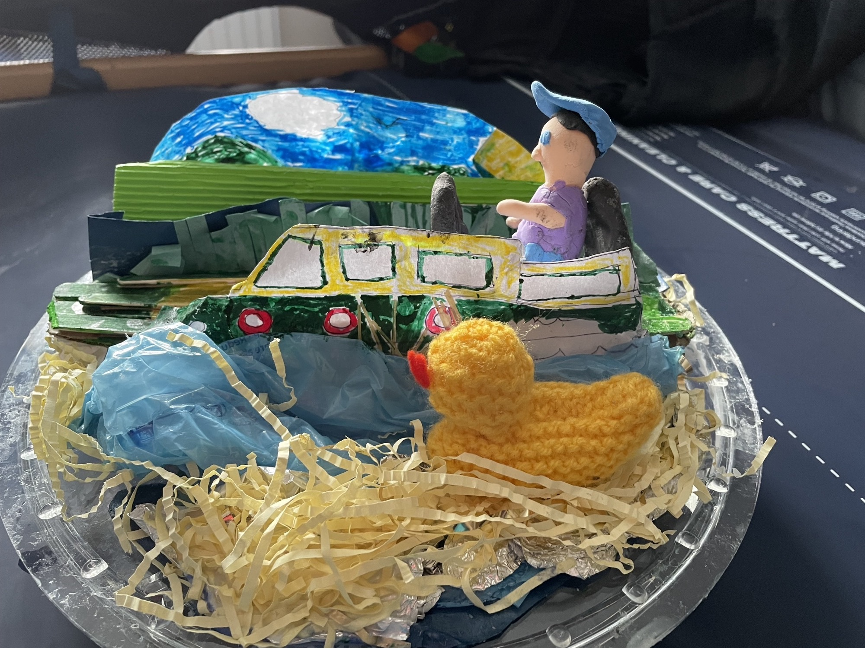
I wanted to make a canal boat on the canal with me steering the boat, so to start with David showed me examples of what I could make. With support from mum I then needed to make a boat.

Slide 3
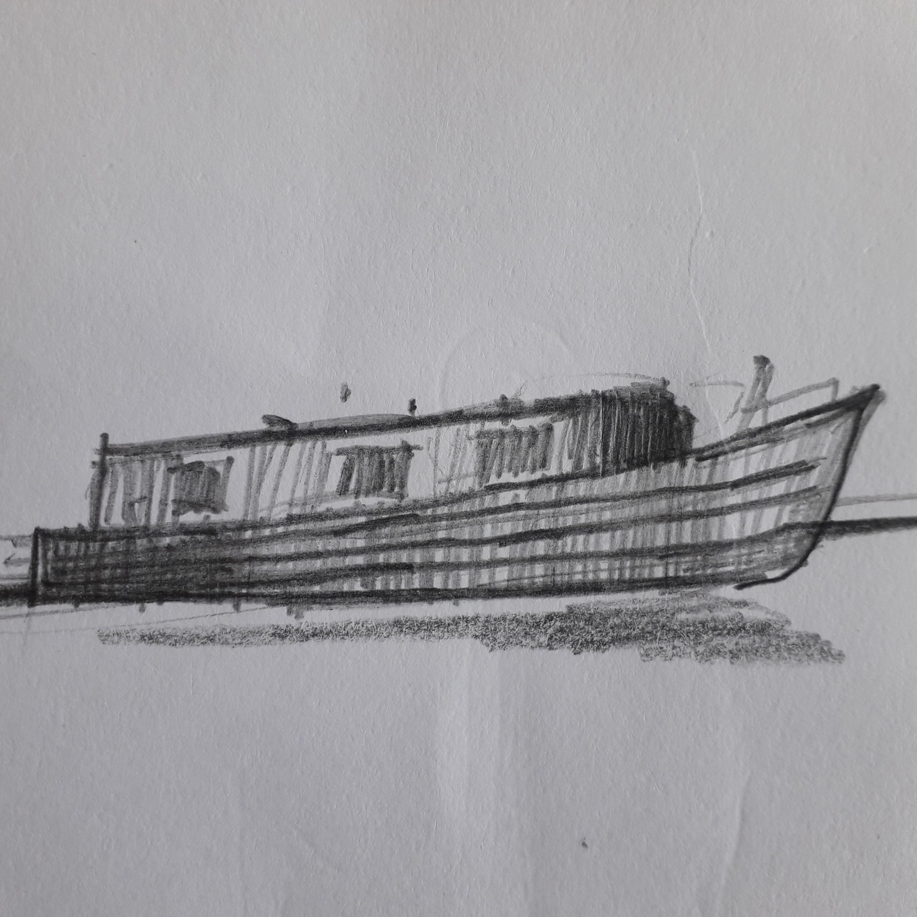
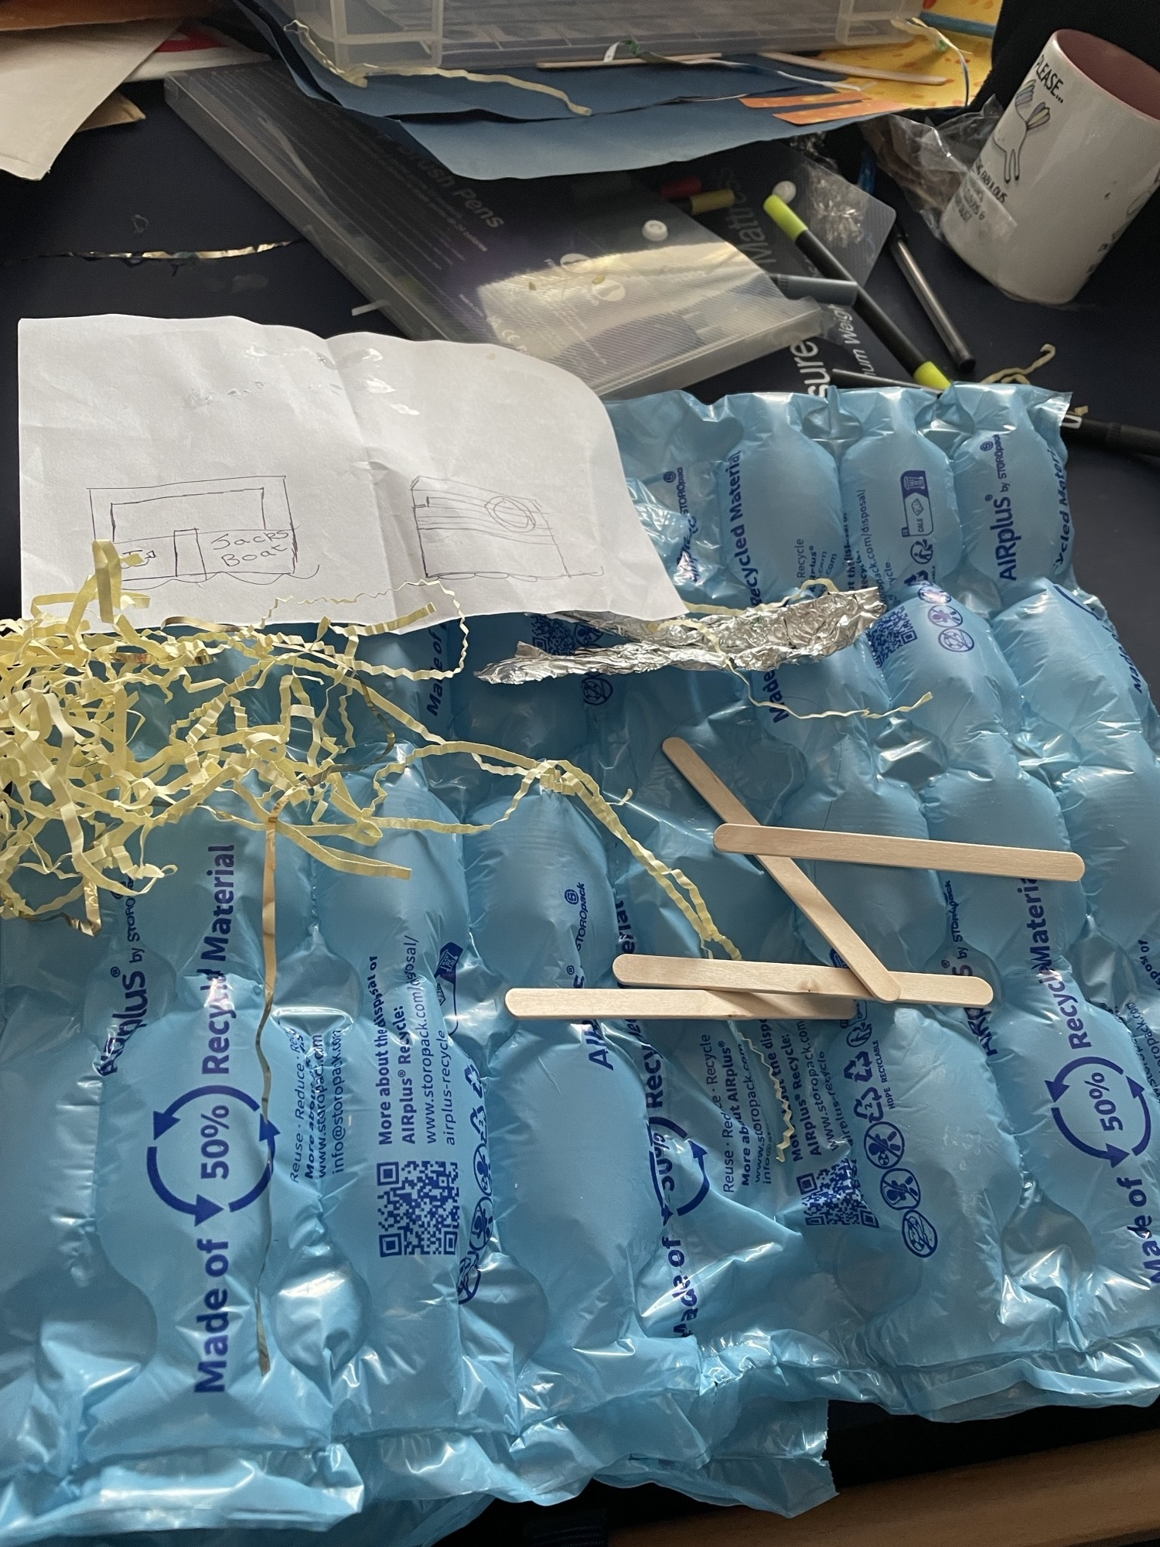
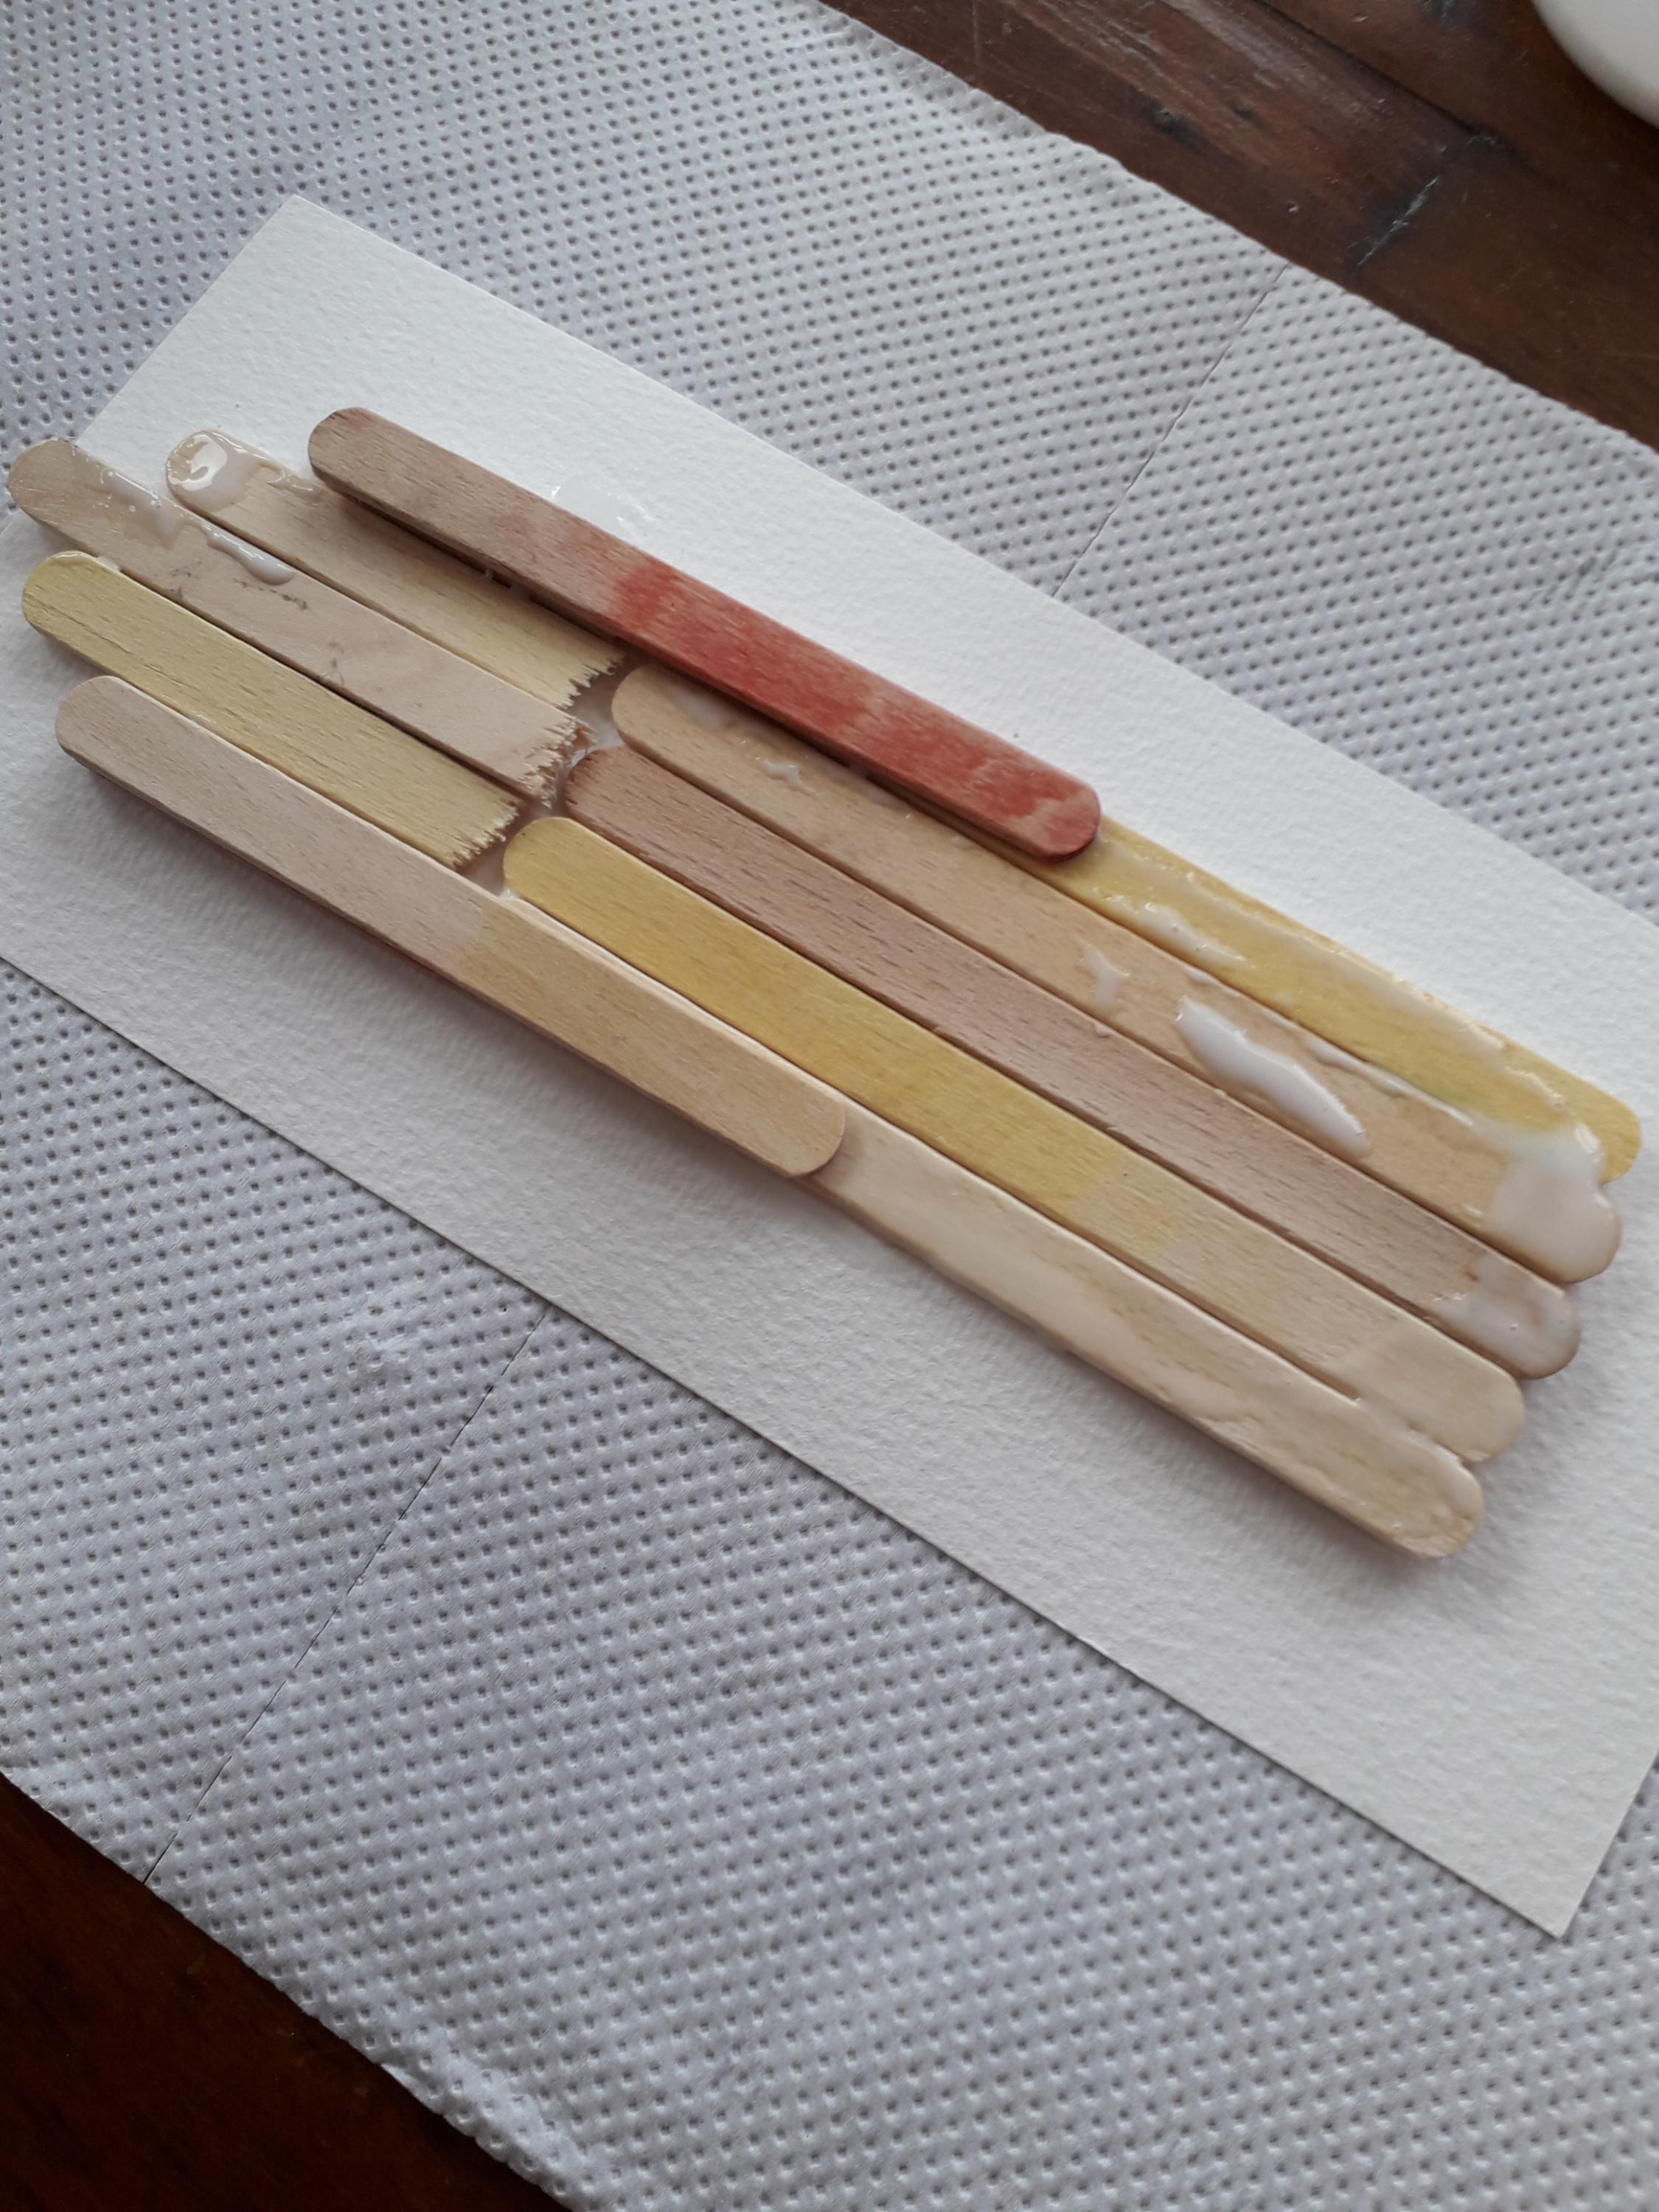
To start with I used lolly sticks to begin the canal boat. We used PVA glue and put several lolly sticks together in a row and 2 infront. We then cut some sticks to make the sides like laying bricks to build the boat. Just like this:

Slide 4
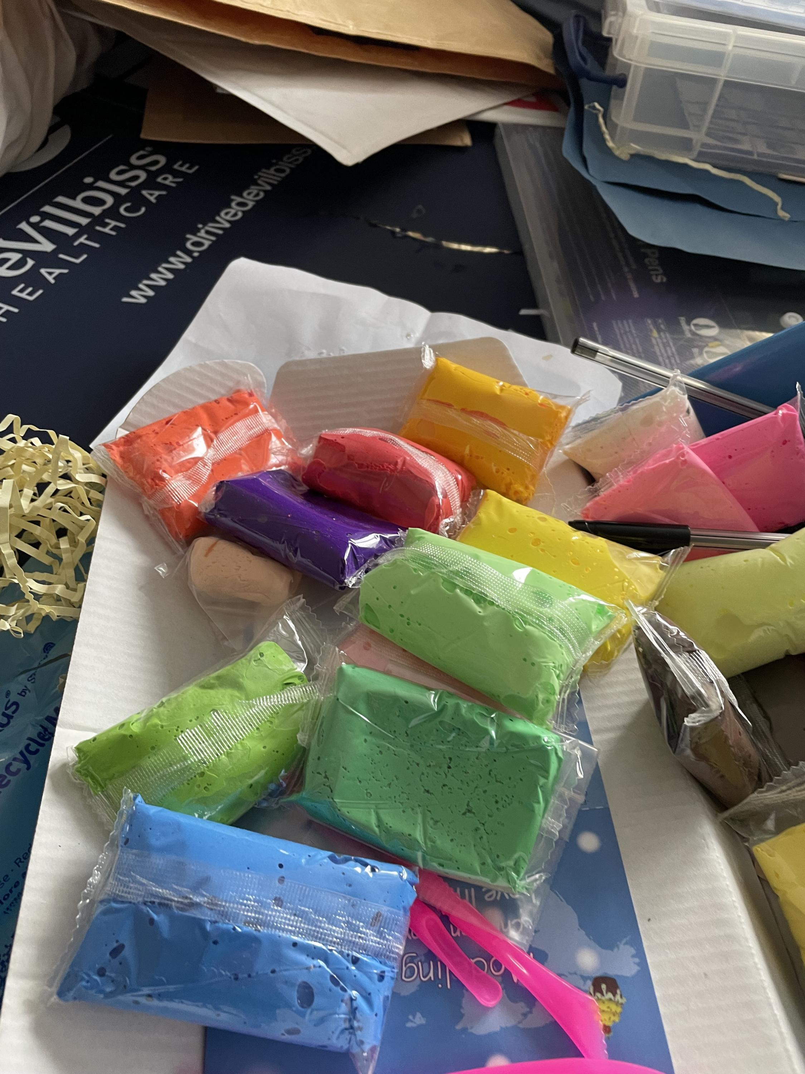
Then:
When the canal boat was dry after glueing I started making some of the features for the boat and used different things to make them such as colour clay shown here:
I chose particular colours and different textures for the boat.

Slide 5
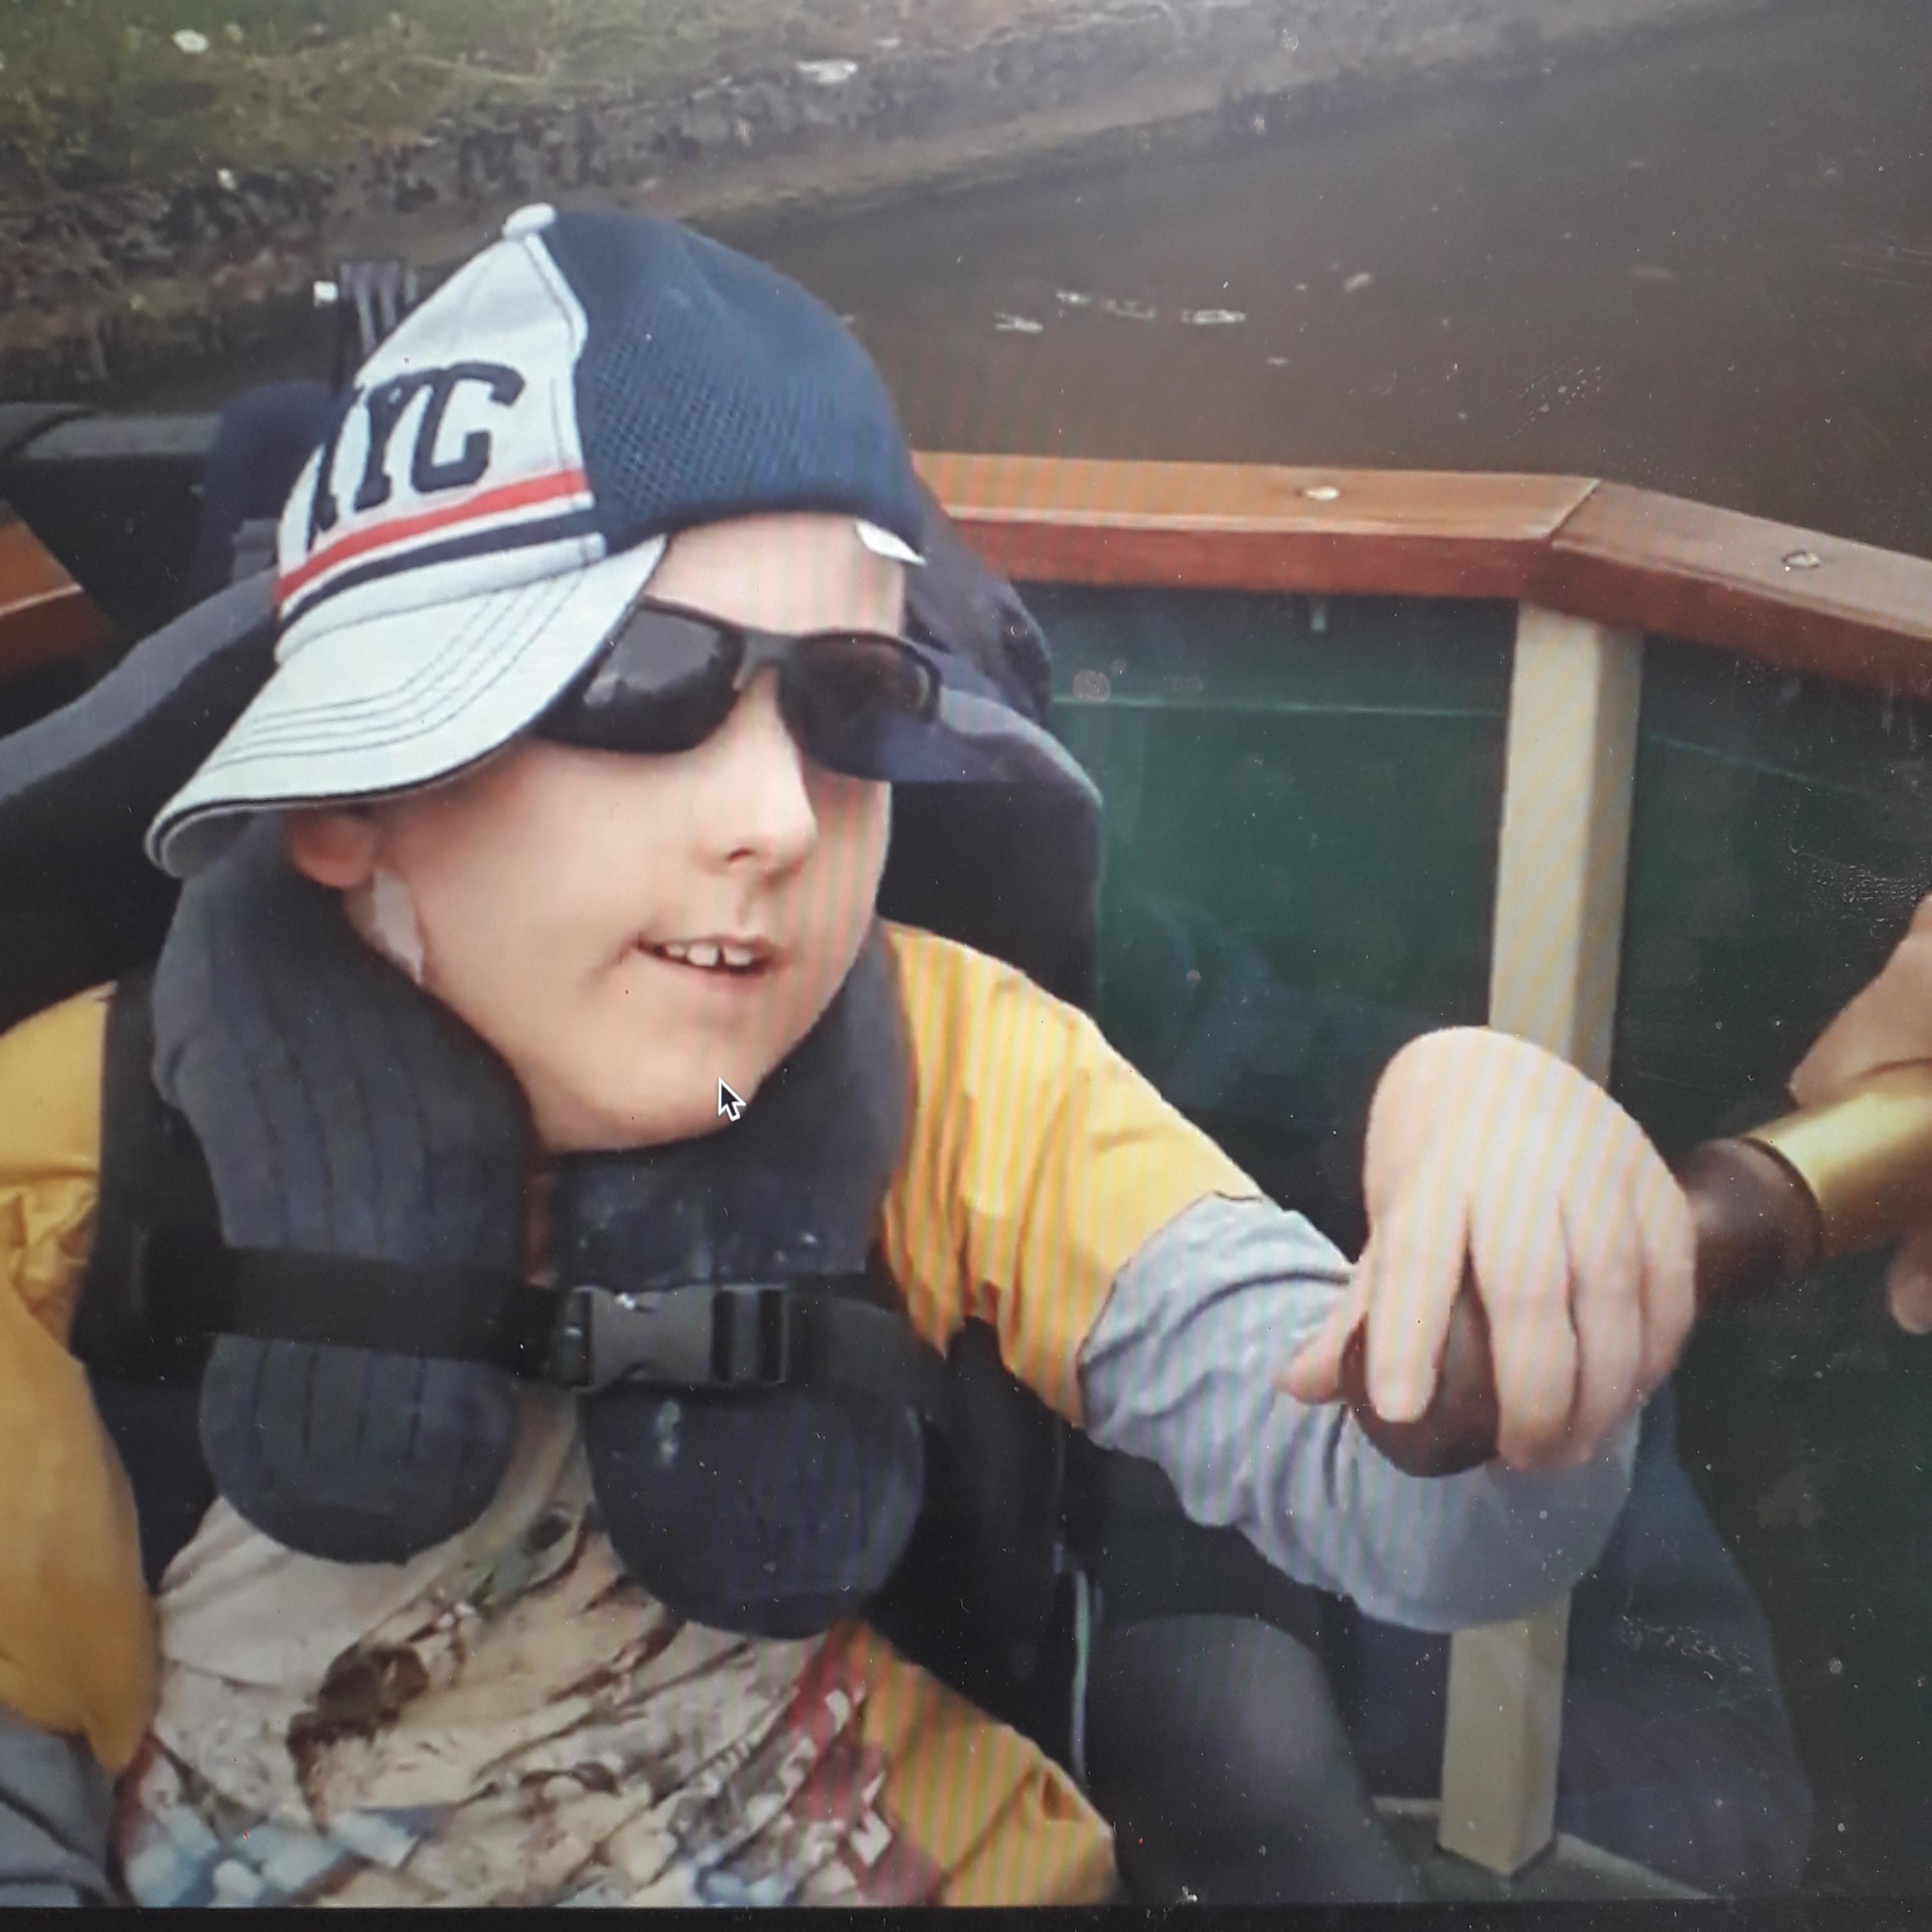
Then it was time to do the back ground and make the canal. I used silver foil, bubble wrap and shredded paper to look like water and the canal boat moving through the water (just like the words in this sentence!

Slide 6
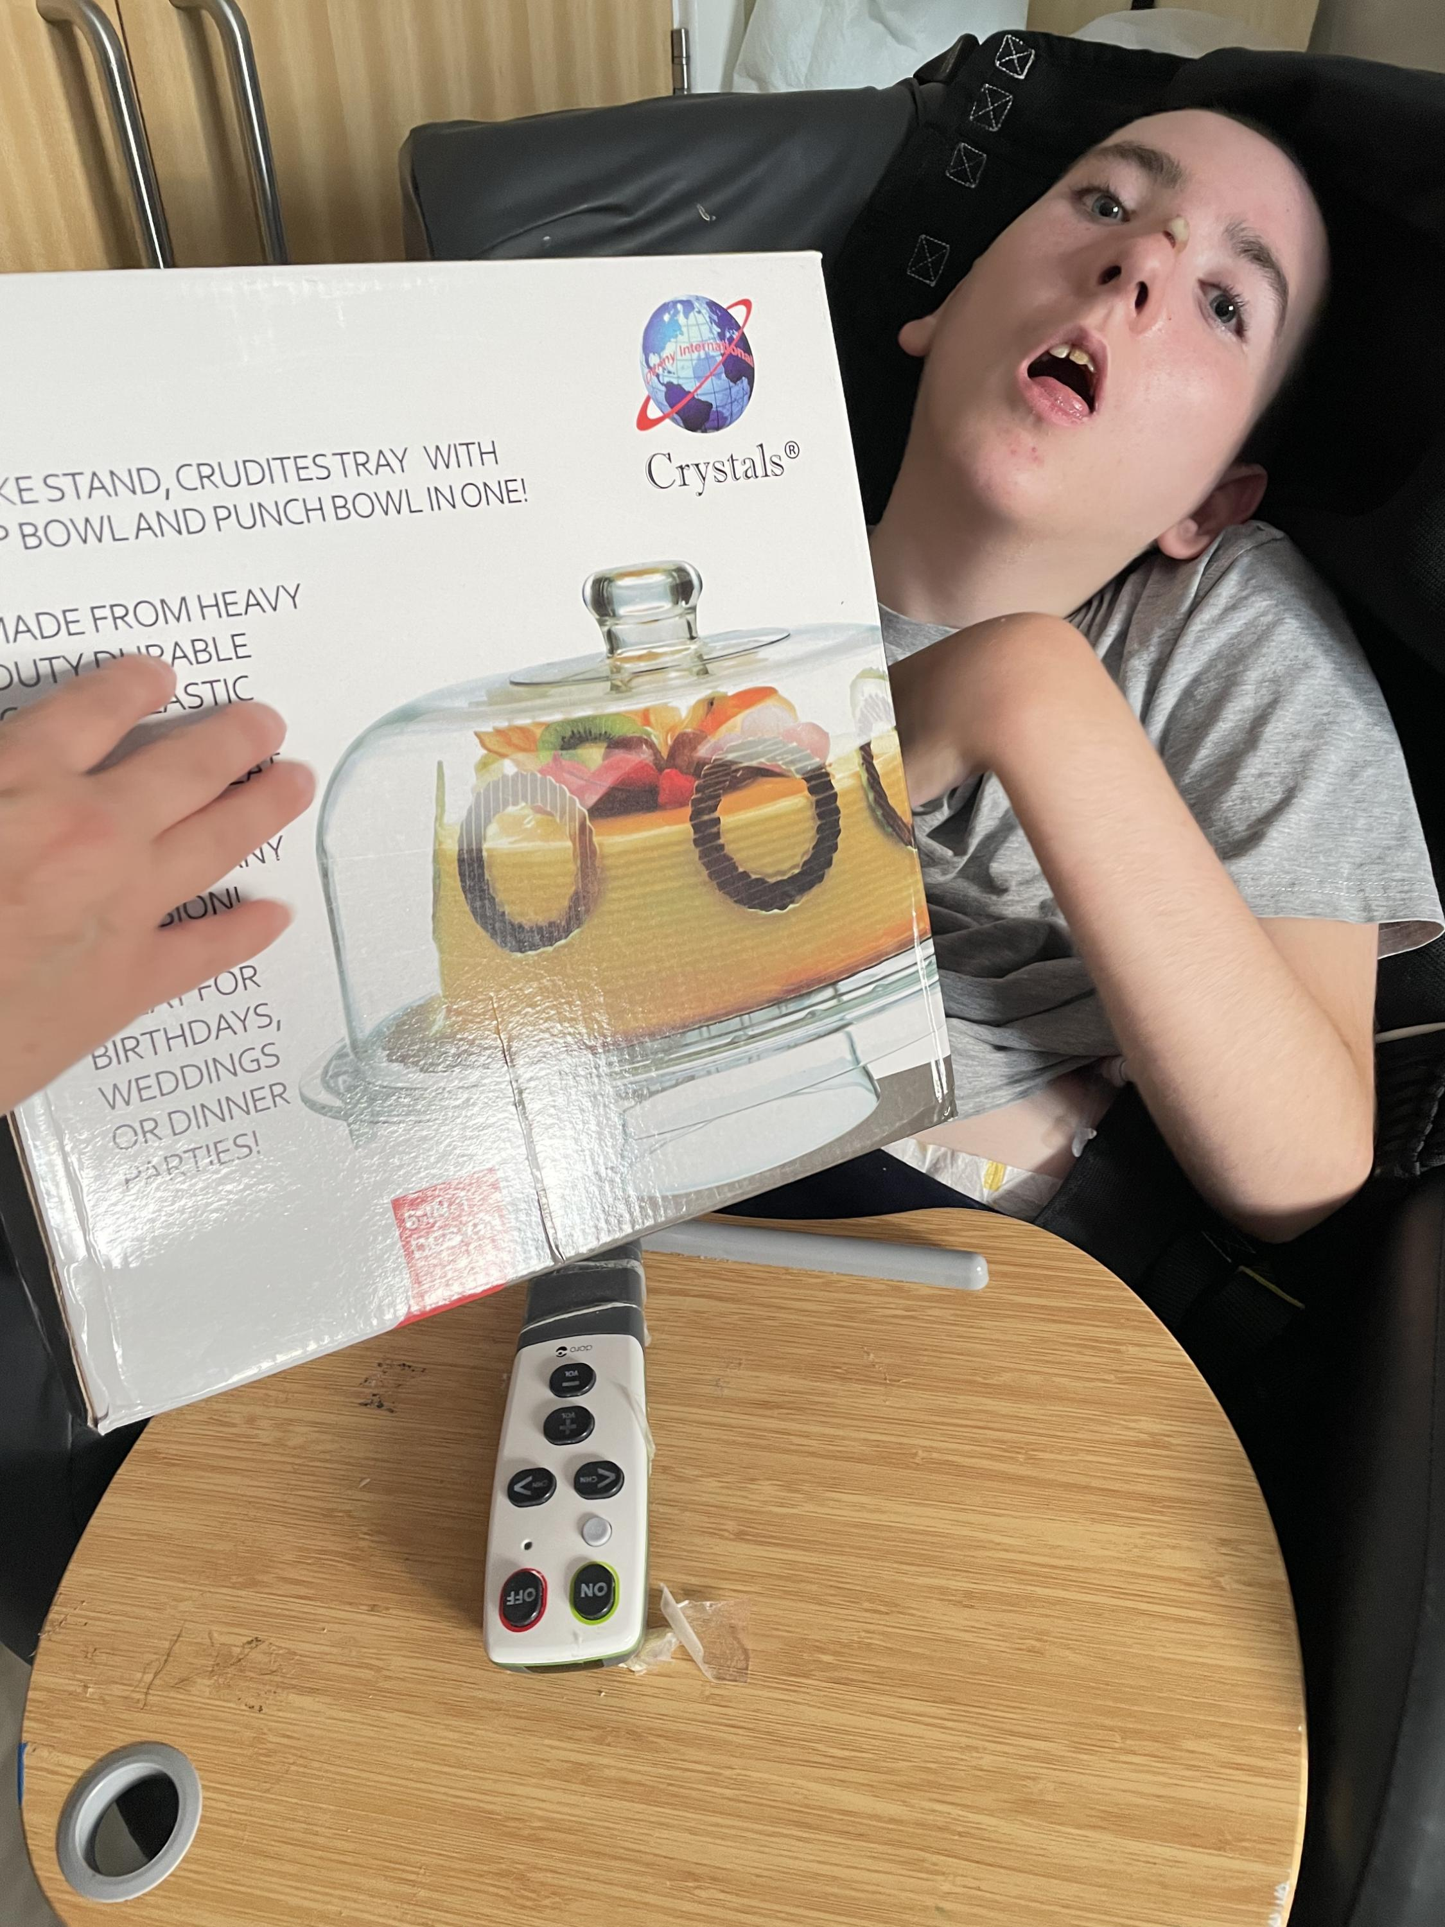
Then I finished my display by putting corrugated card at the back and paper with a picture of the canal bank and a landscape.
I used a lot of different materials to make this whole project and chose colours, materials. I also chose where to put them. I really enjoyed putting them all together and hope you like this as much as i do.
I’m holding the box for the cake stand that my artwork is proudly sitting on:

Slide 7
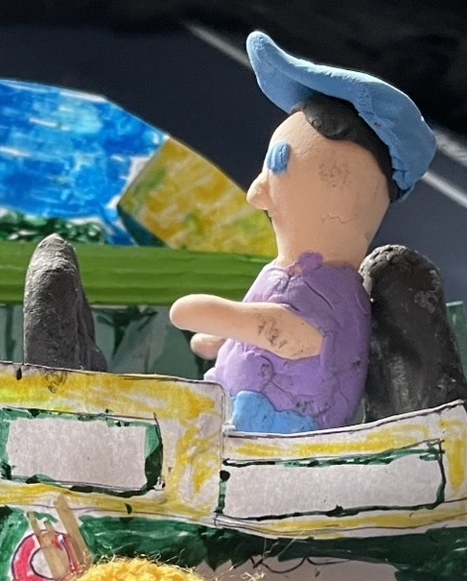
Then - with clay I made a sculpture of myself on the boat with my Captain’s hat on. This was fun, especially because I look forward to steering and being boss!
With support I put on different colour materials to make me look like a bit like me.

Slide 8
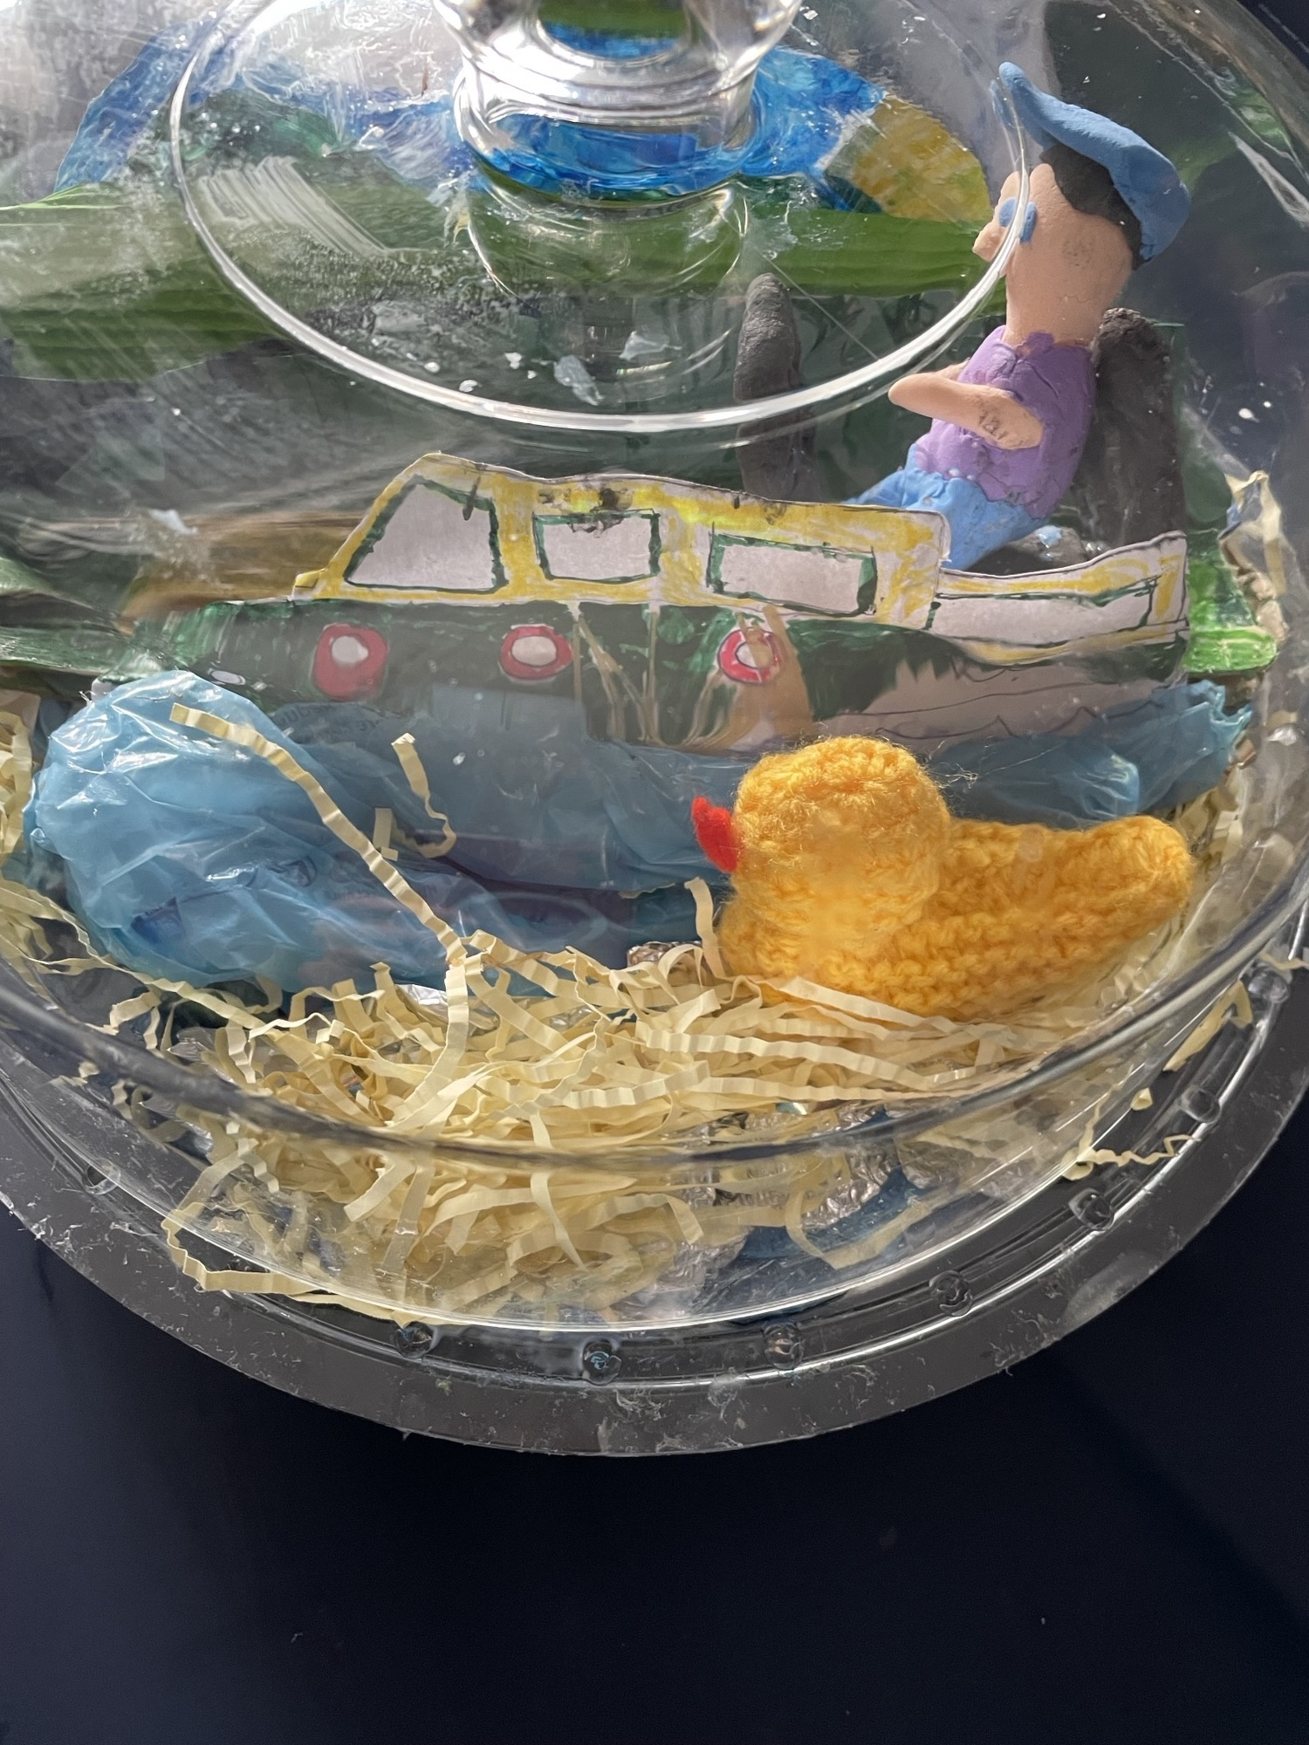
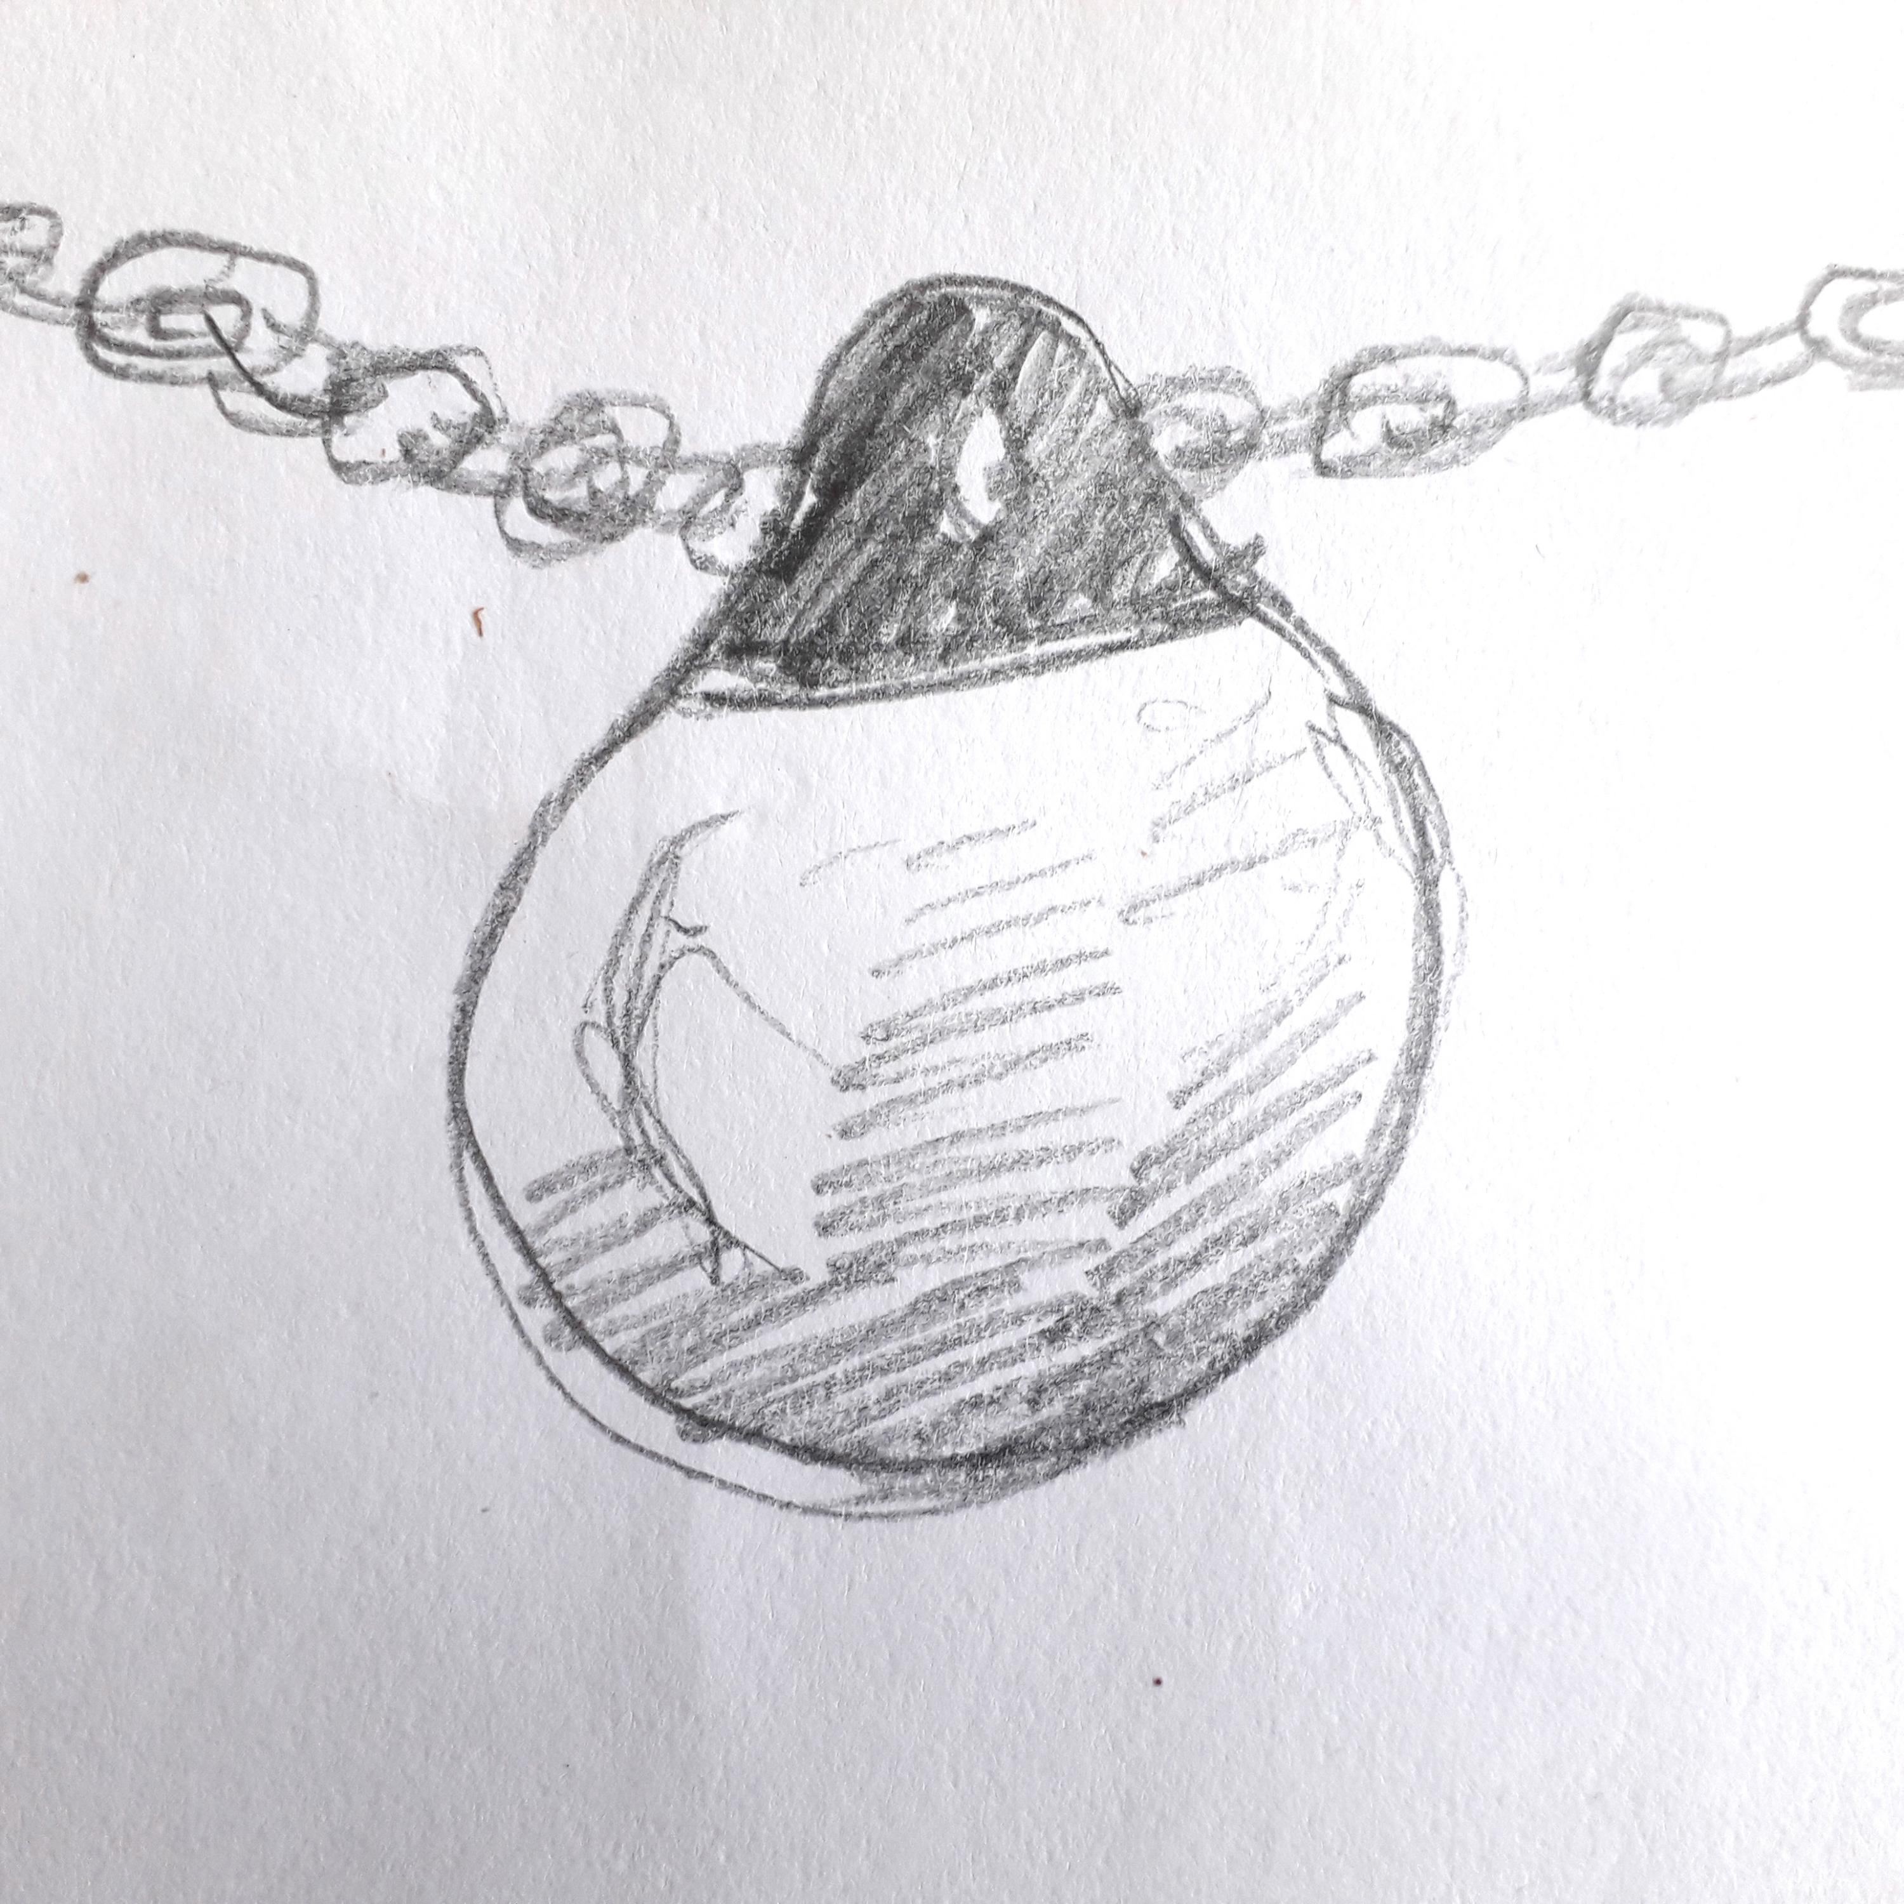
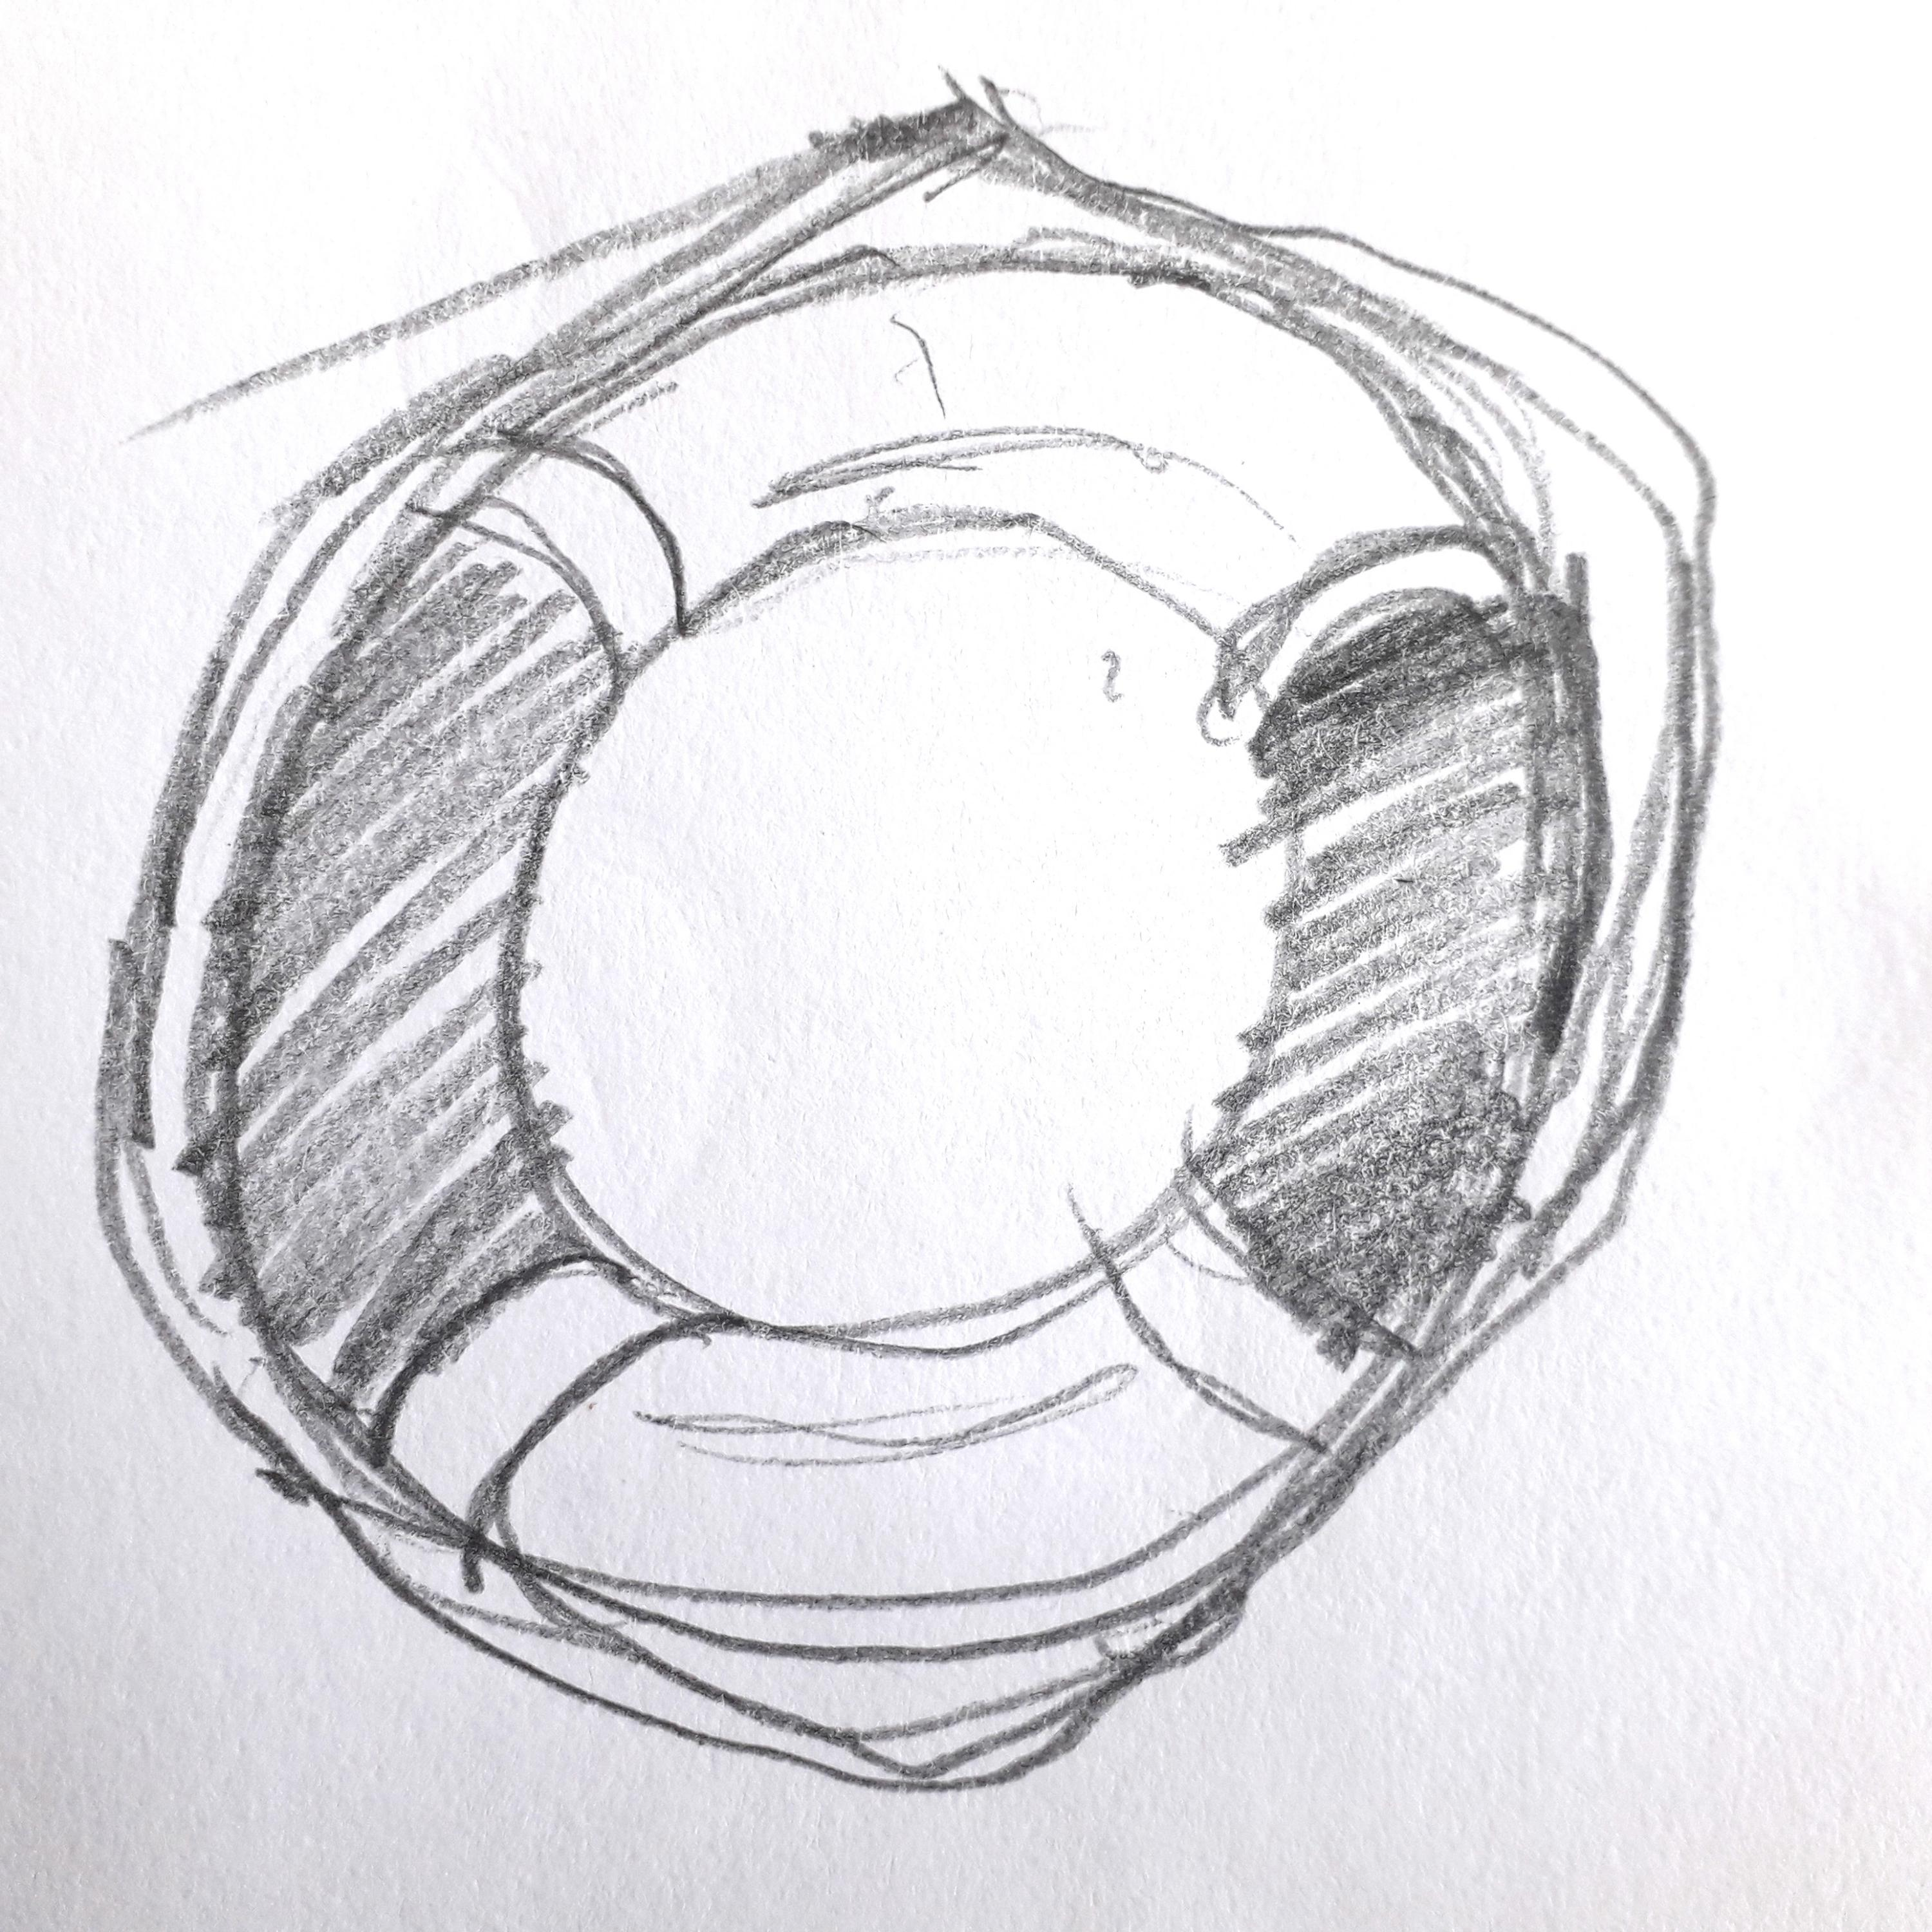
My finished artwork on display on the cake stand.

