Slide 1
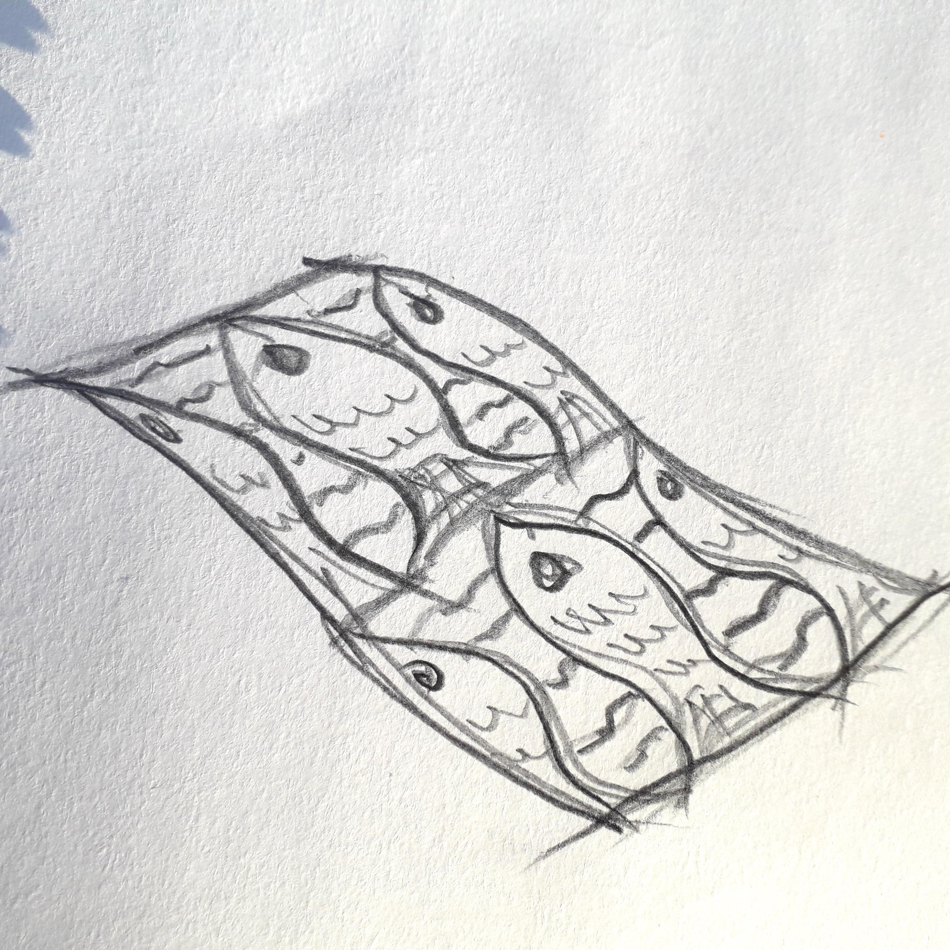
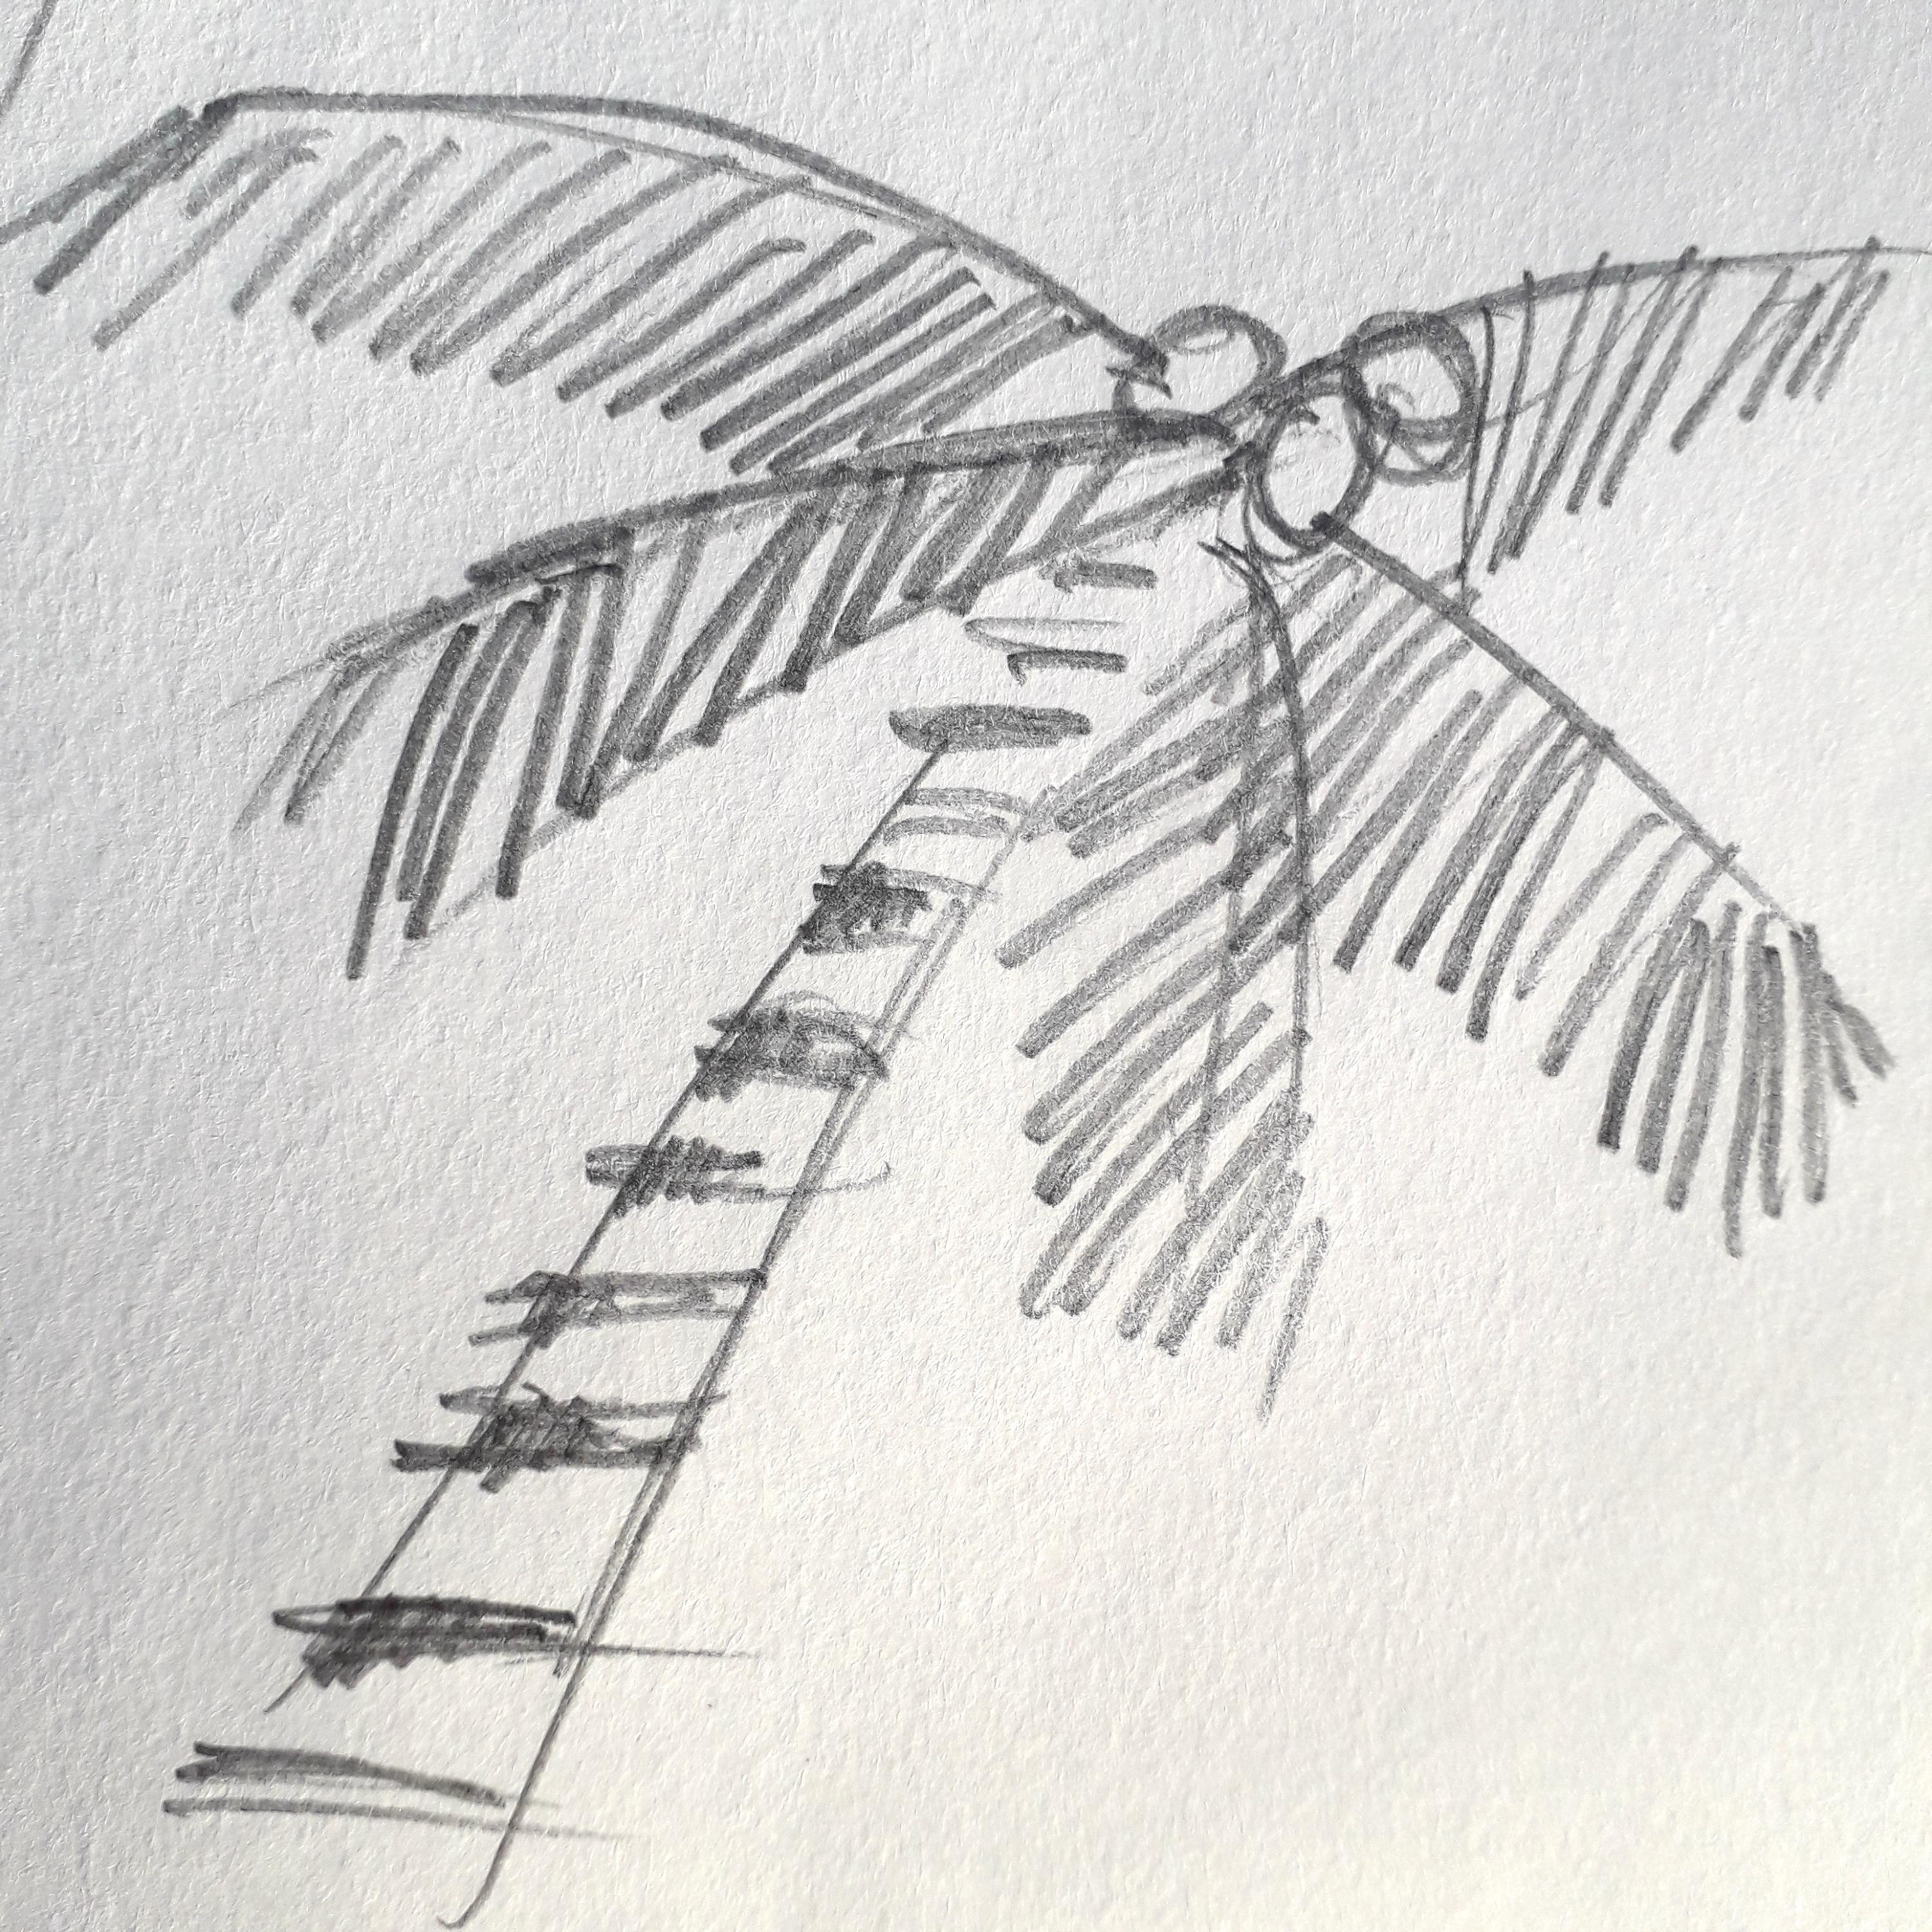
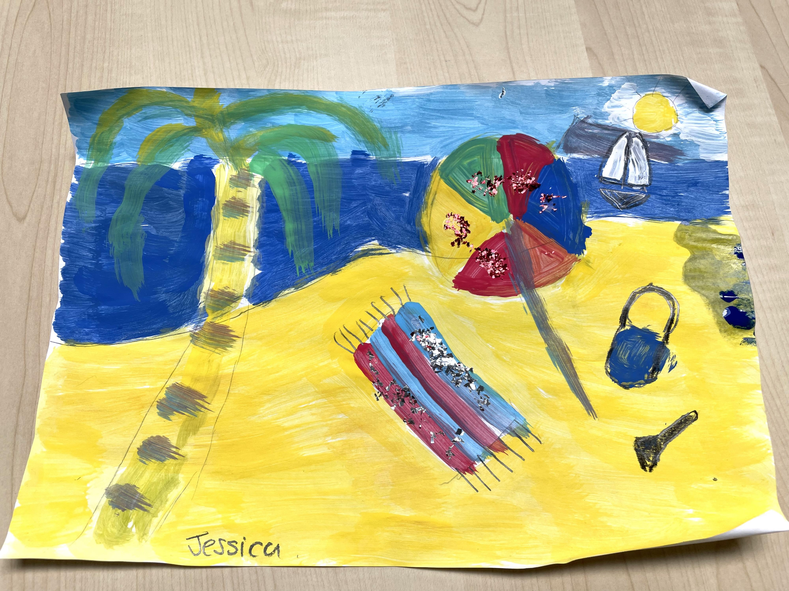
This Is Me !
By Jessica -
‘’Summer by the beach””
This is my story of why I made a painting of the beach in summer.
I’m an artist and I like to make lots of different things to show who I am especially as part of Pamis online Art group every Monday with David Grigor of Blind Create.
I love to visit the beach with my friends. I visited Aberdour beach with my classmates but it was very cold the day I went!
Let me tell you about how I made my proejct.

Slide 2
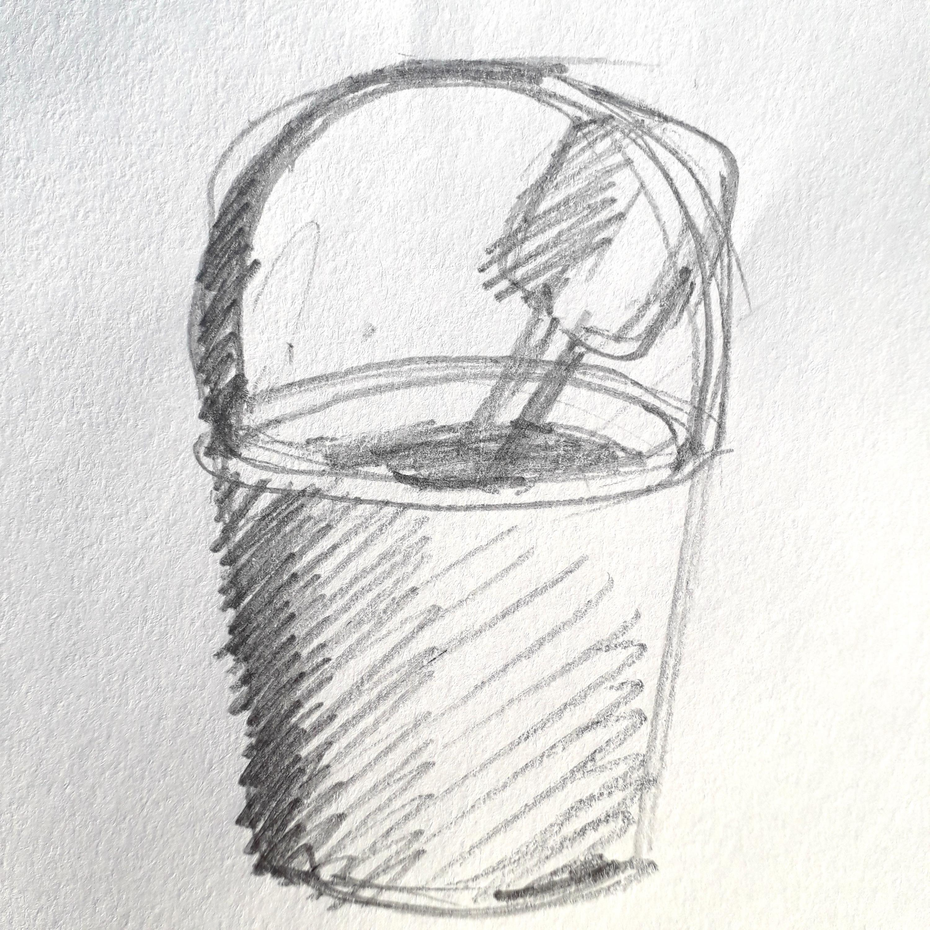
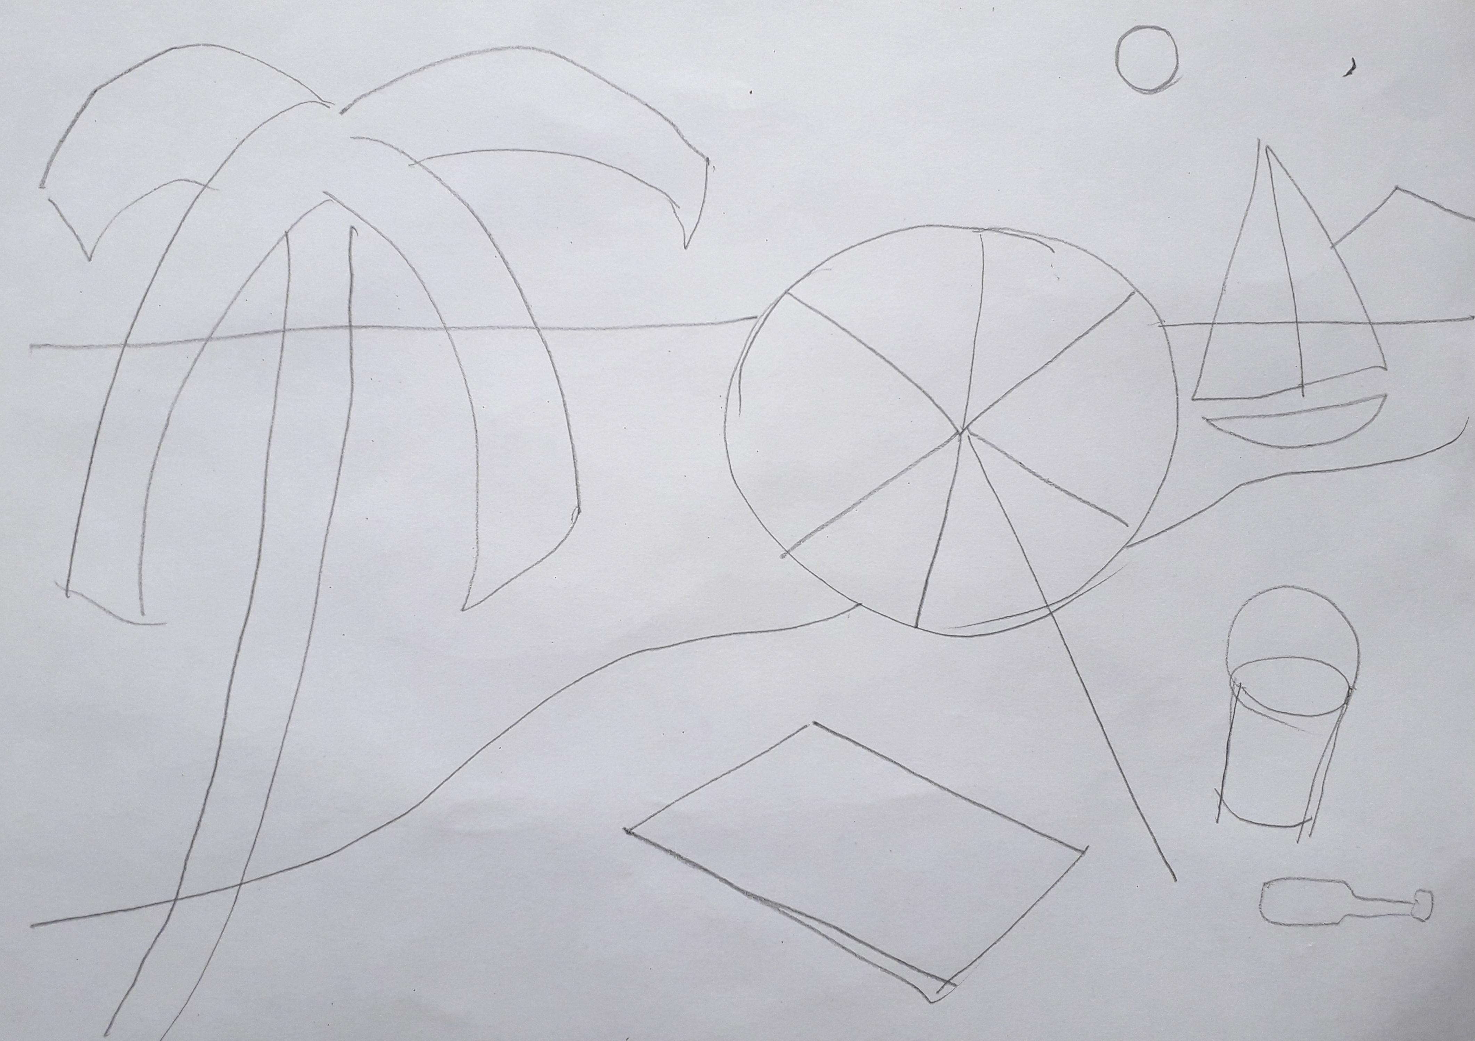
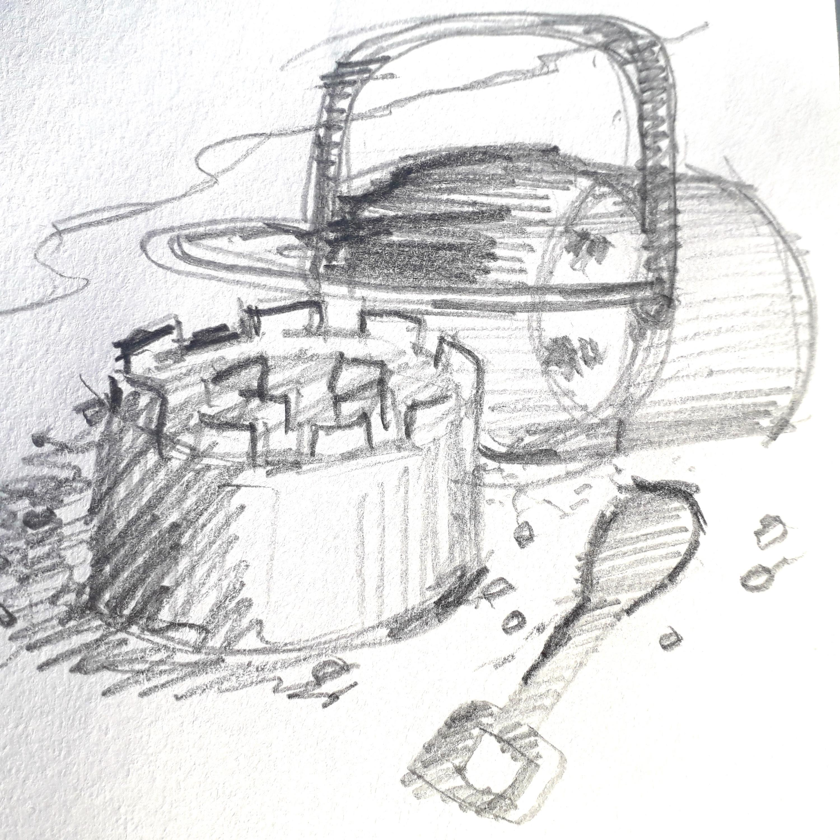
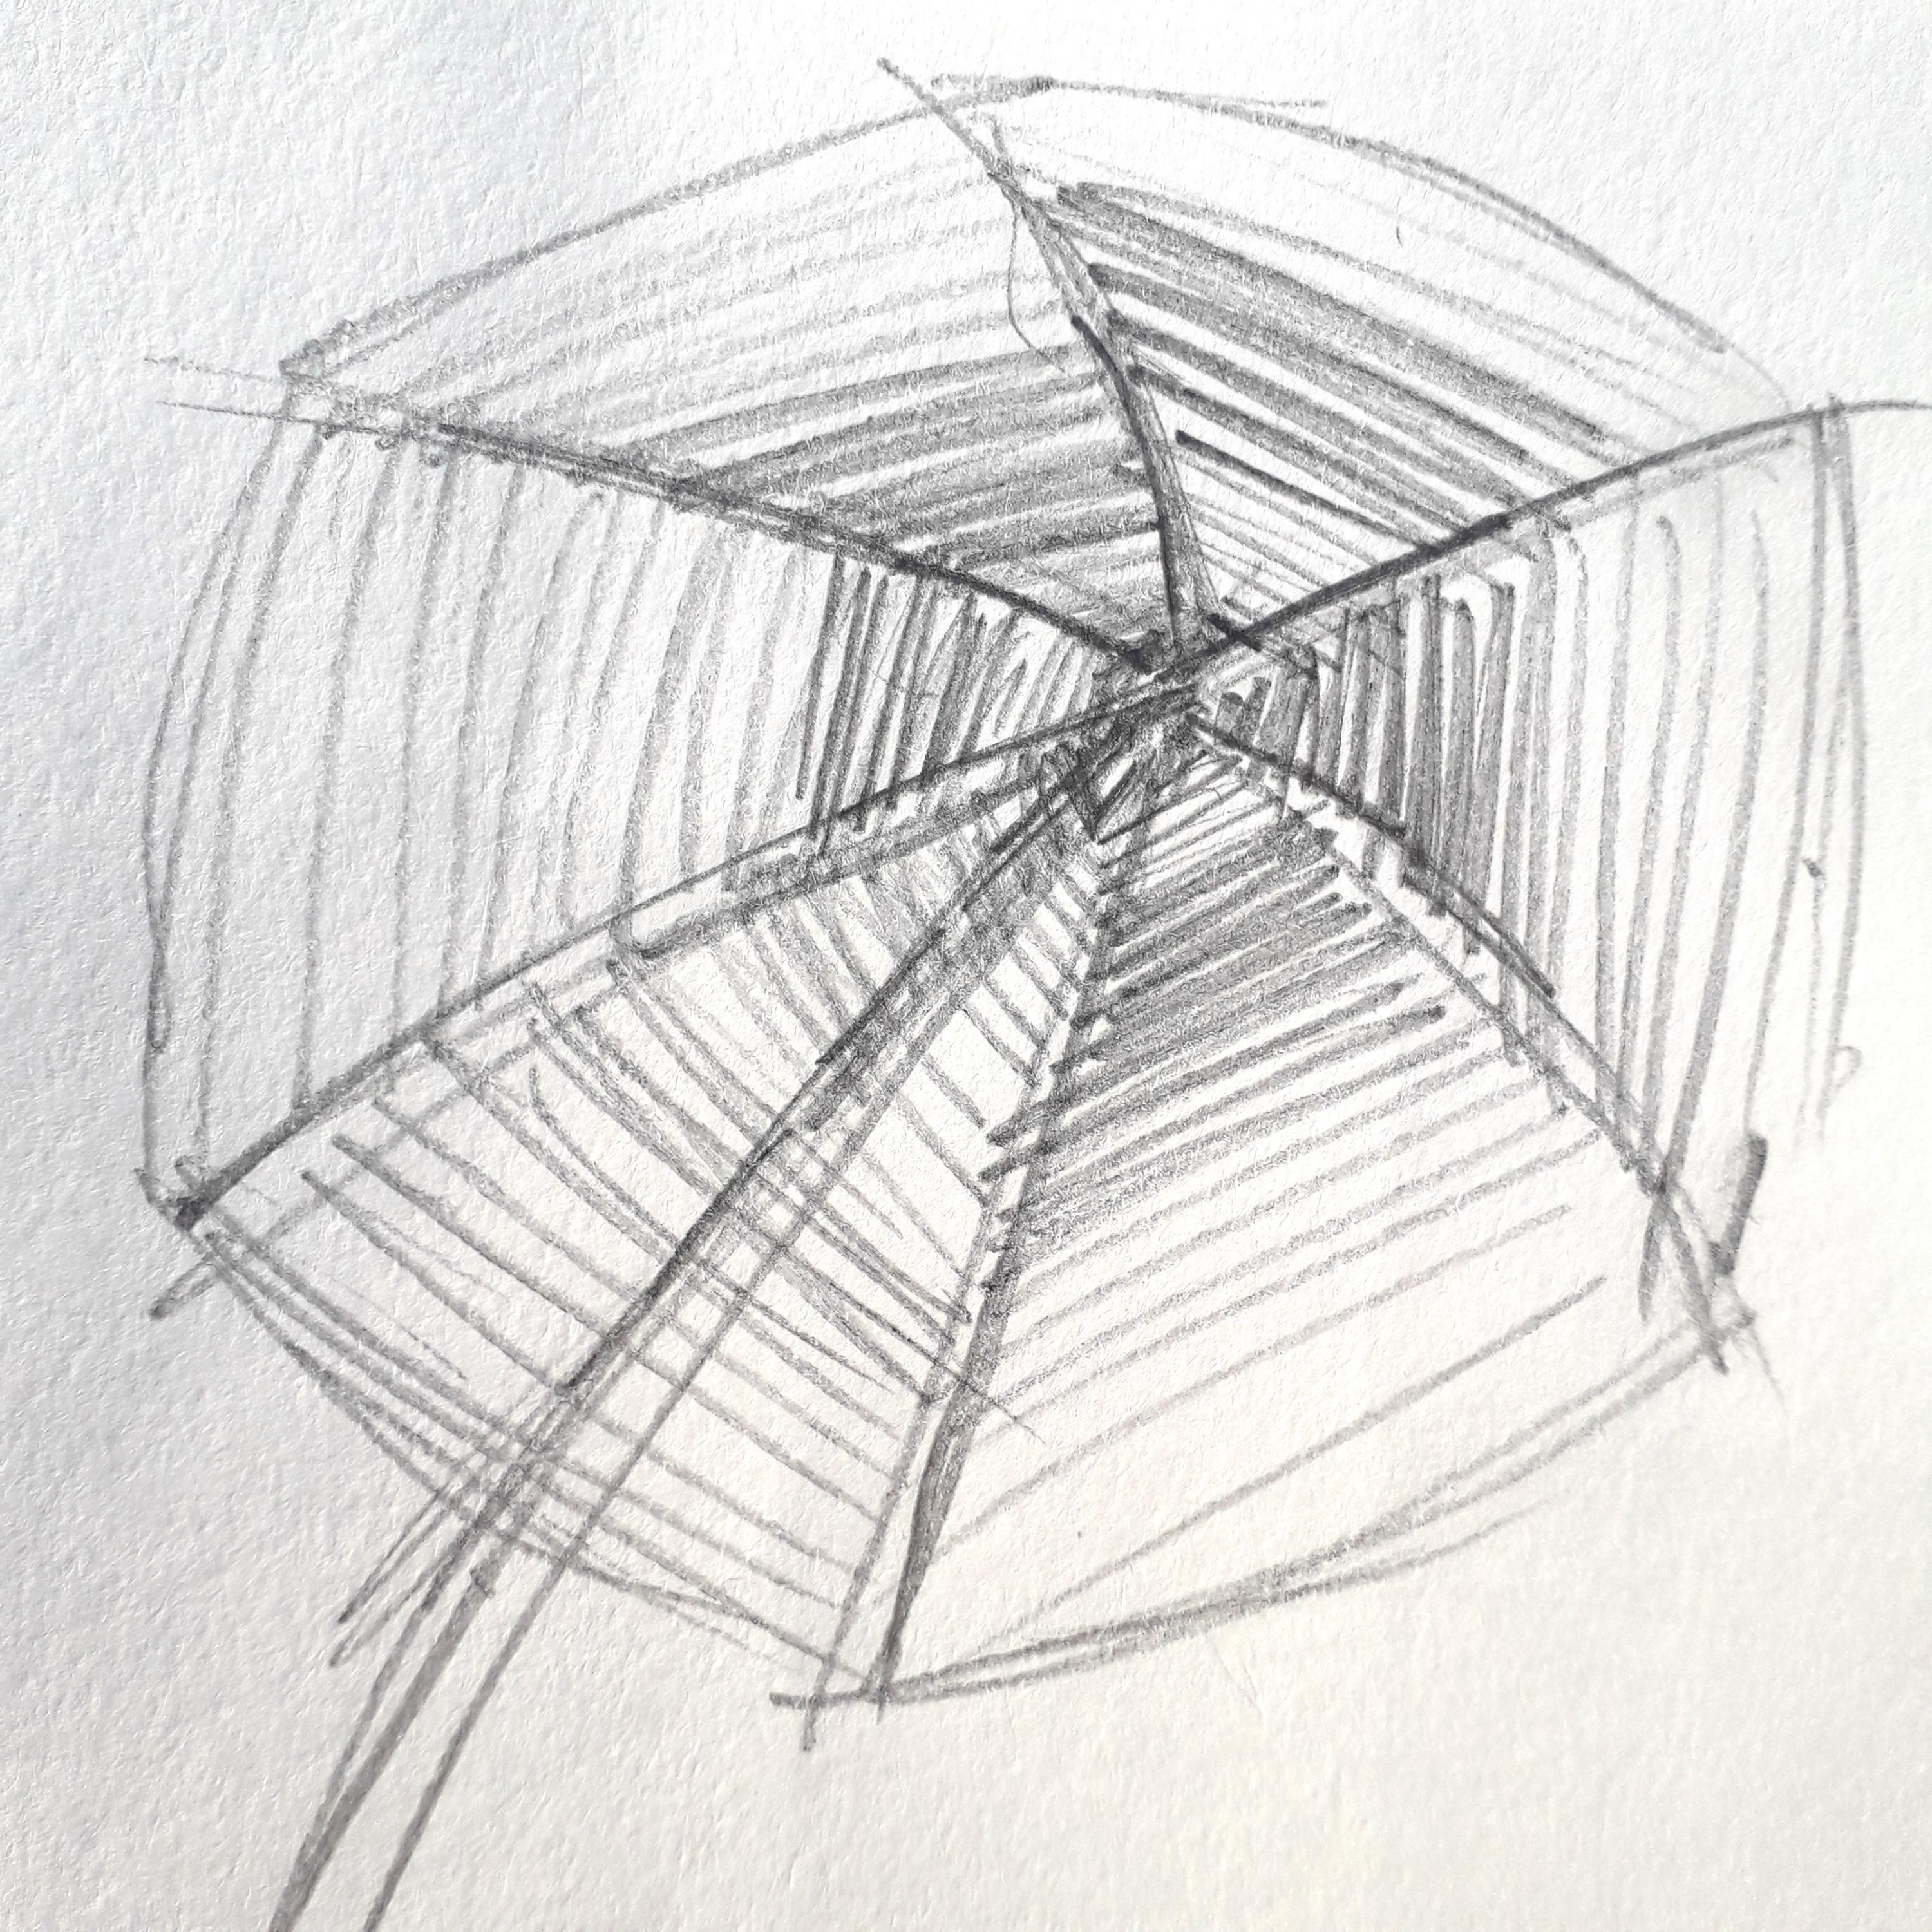
I wanted to make a painting of Aberdour Beach in Fife in the summer, because that’s my favourite beach. so to start with David showed me examples of what I could make. With support I started to put the scene together starting with a pencil drawing of the beach:

Slide 3
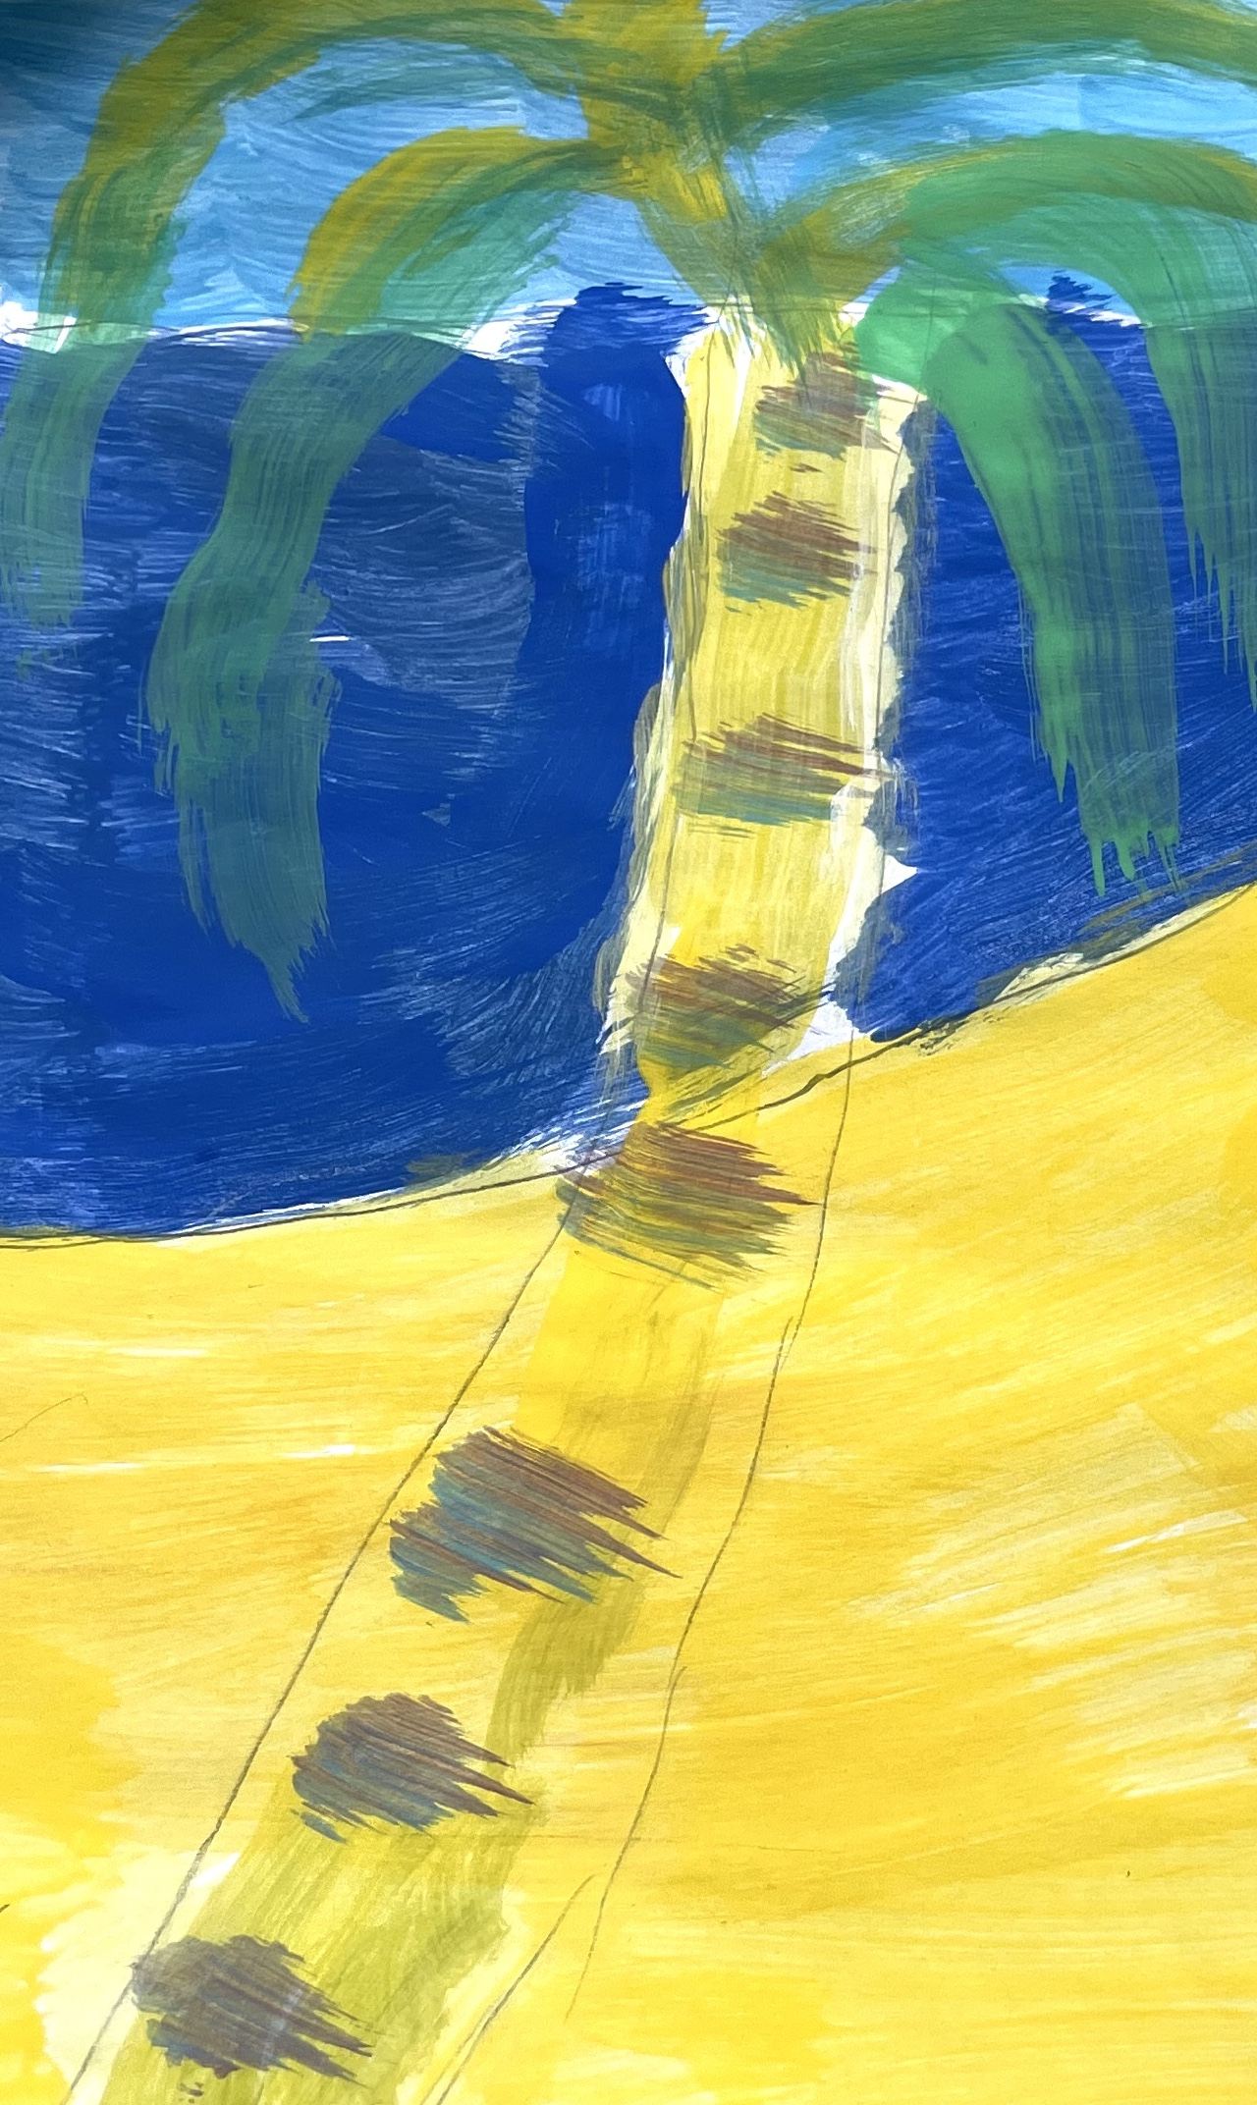
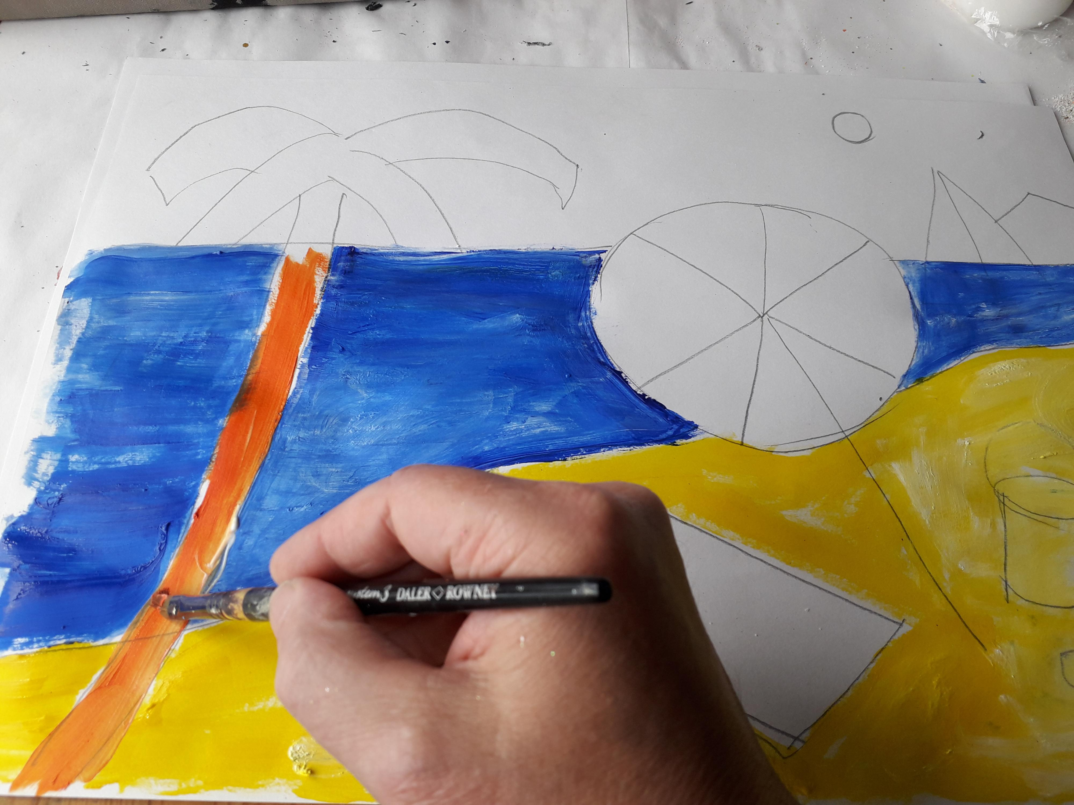
To start with the beach scene was drawn out with pencil.
I started to paint the beach, then the sea and then the palm tree with long leaves.

Slide 4
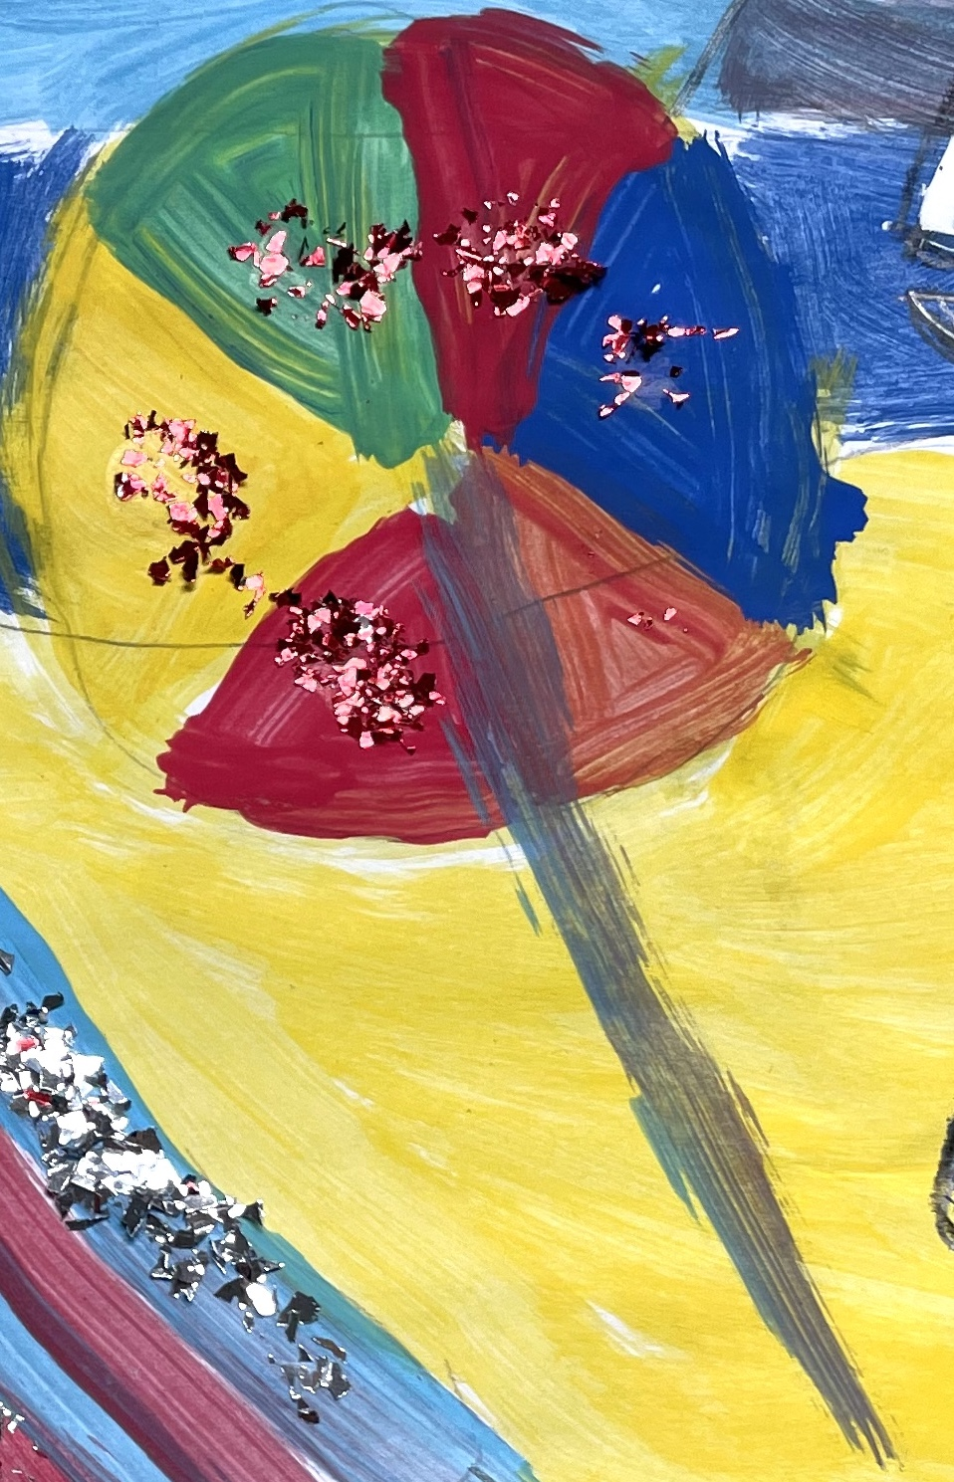
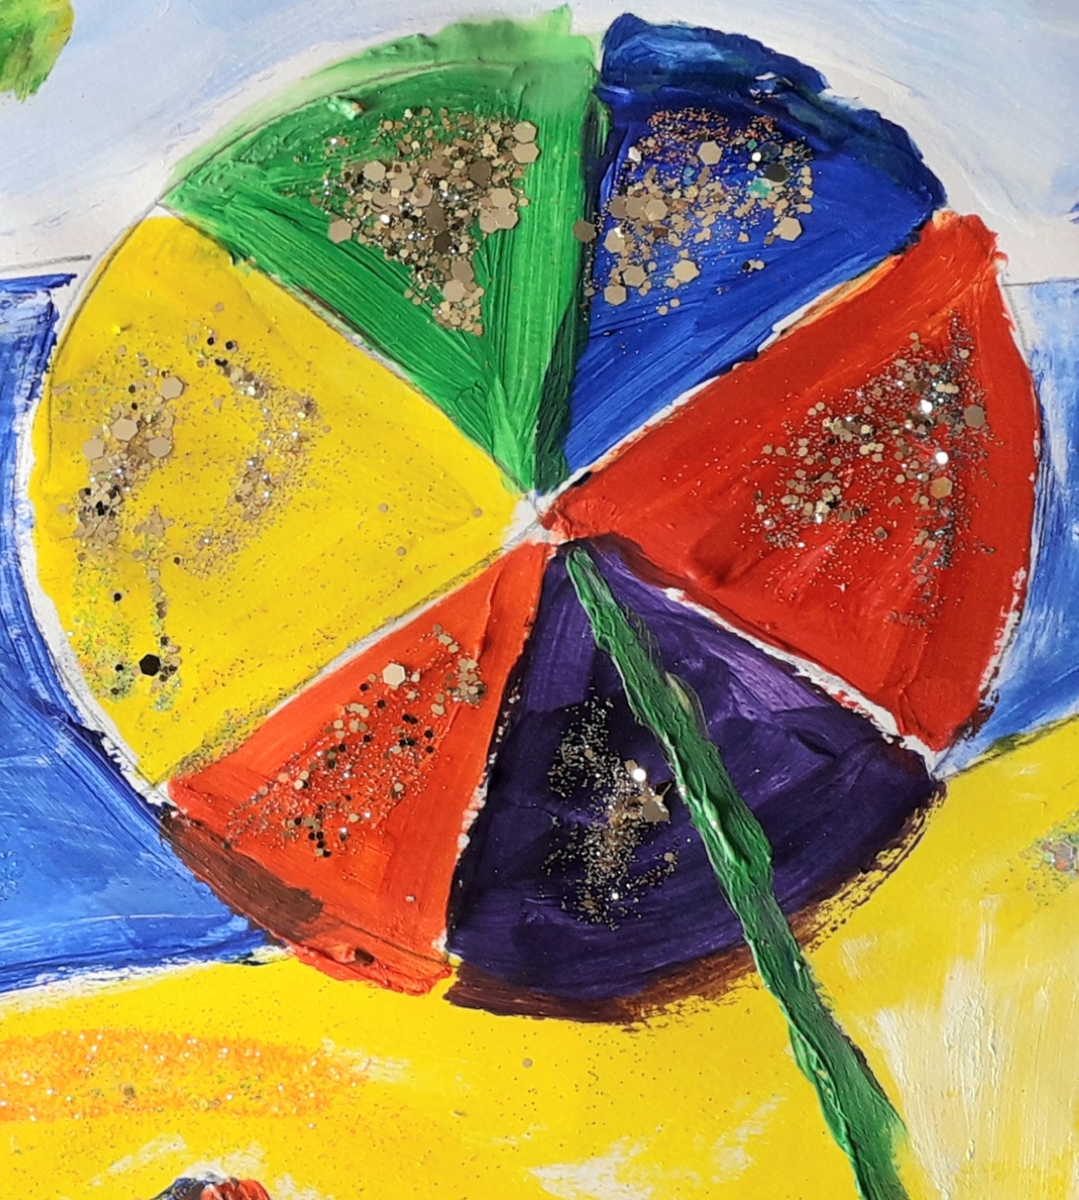
Then I painted the parasol in 6 different colours: 3 primary colours- red, blue and yellow. Then 3 secondary colours- orange, green and purple. I was asked to choose between 2 colours for various parts of the beach scene. I chose the colours for the towels and parasol.

Slide 5
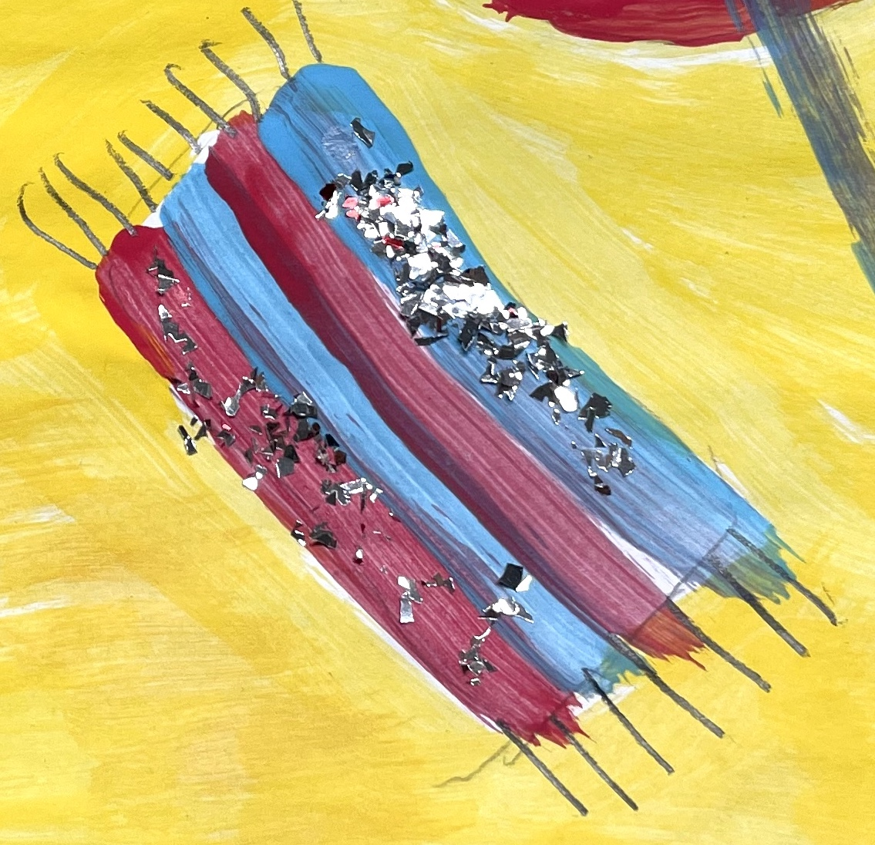
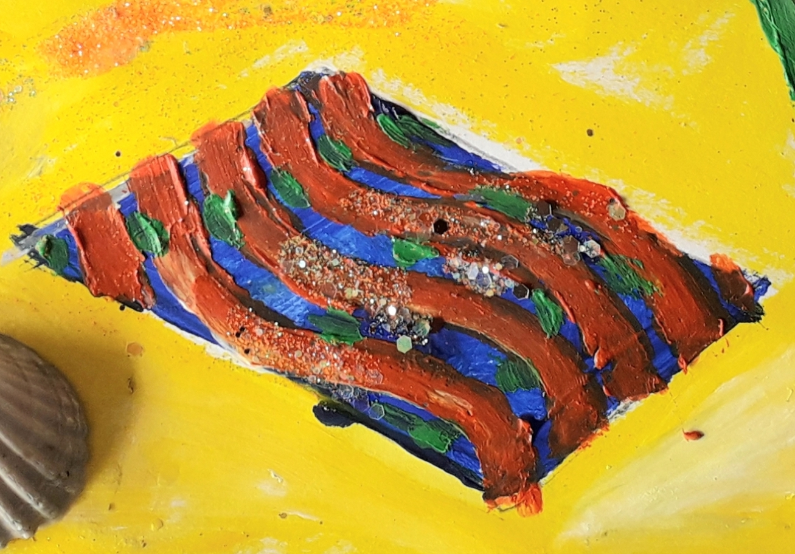
Then with support I put on different colours for the beach towel and painted on a colourful design.
I used paint, paper and crepe paper.

Slide 6
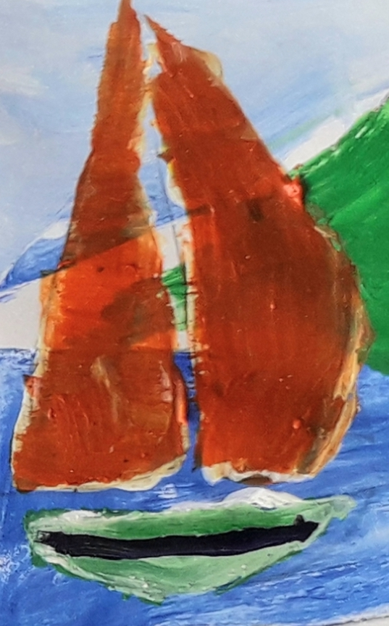
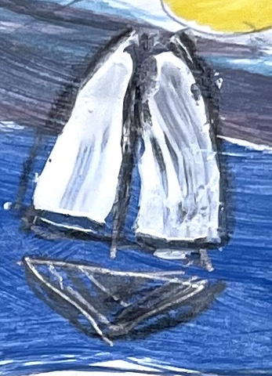
Then it was time to do the background and paint the coast and the sailing boat in the background with the sun in the sky and clouds.

Slide 7
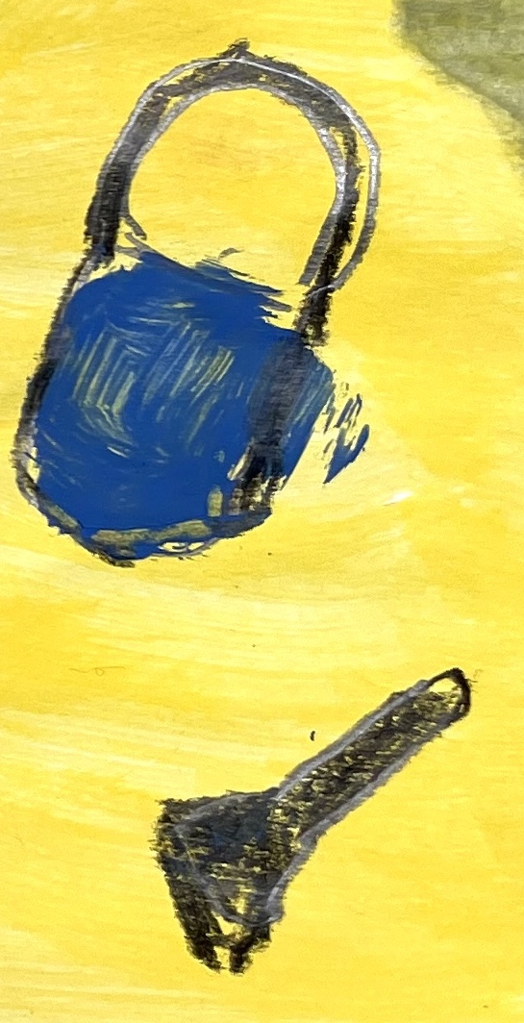
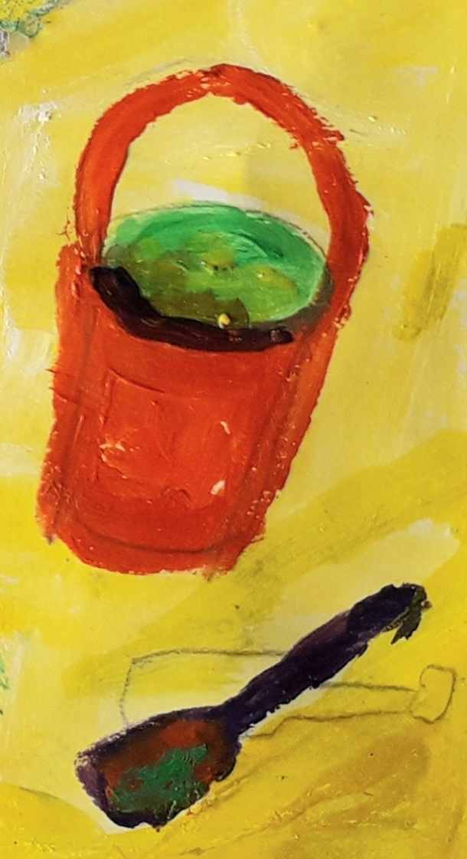
Then I painted in my bucket and spade and chose bright colours for these.
I used a lot of different materials to make this whole project and chose colours, materials and chose where to put them. I really enjoyed putting them all together and hope you like this as much as i do.

Slide 8
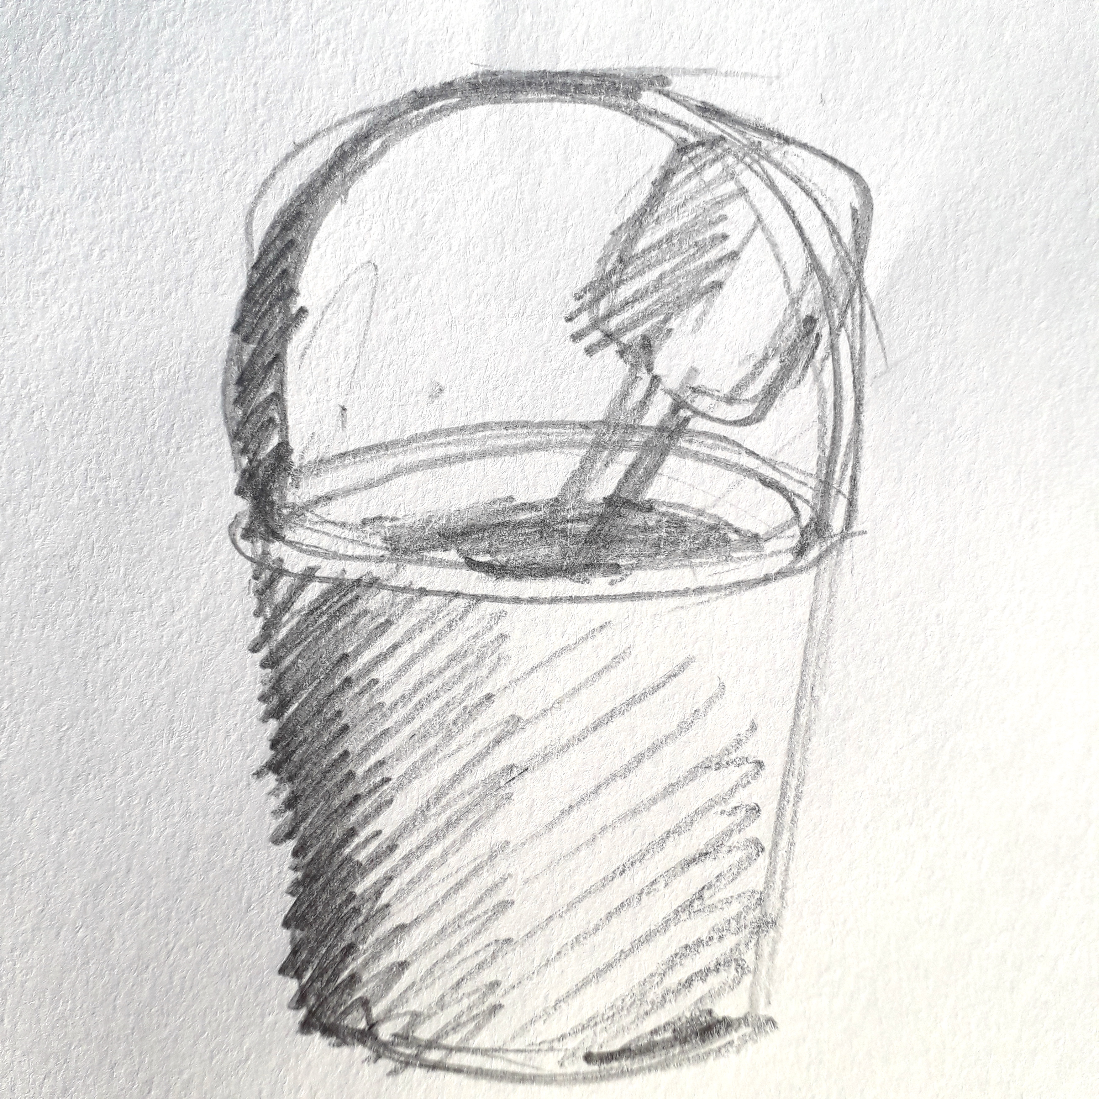
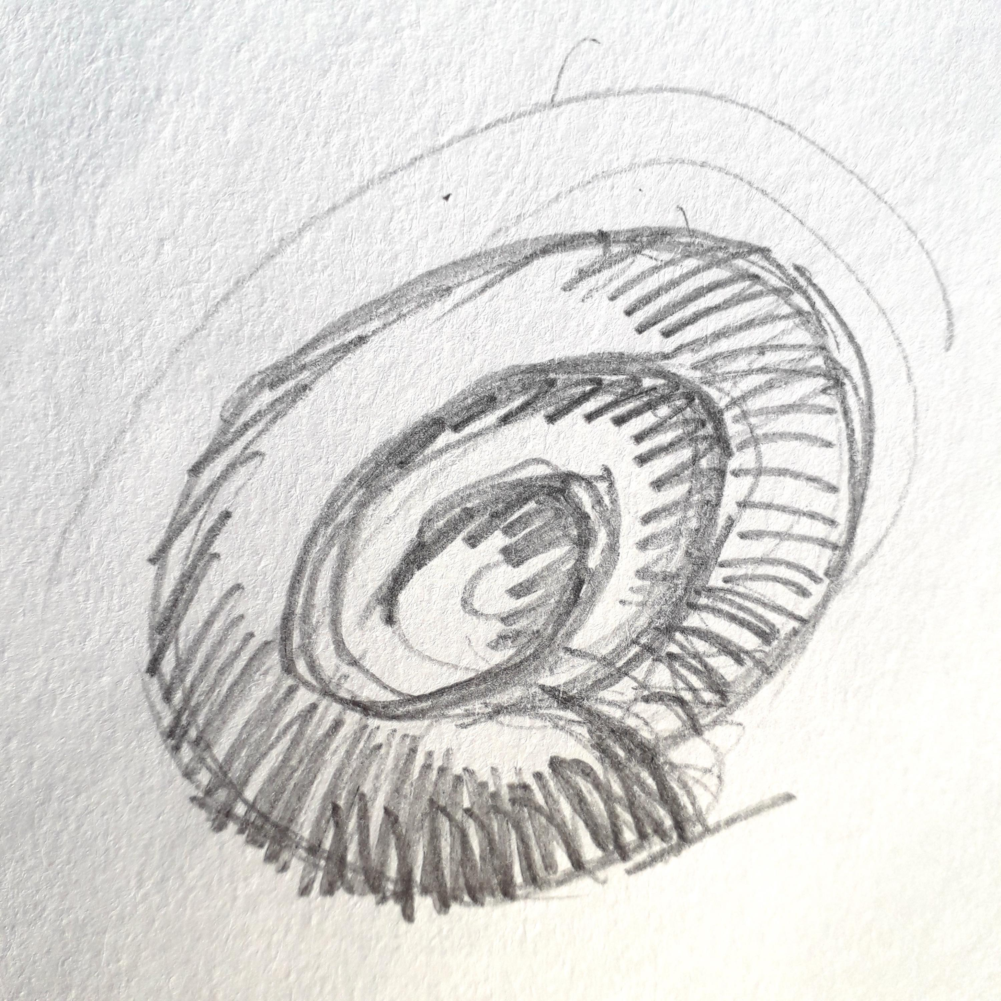
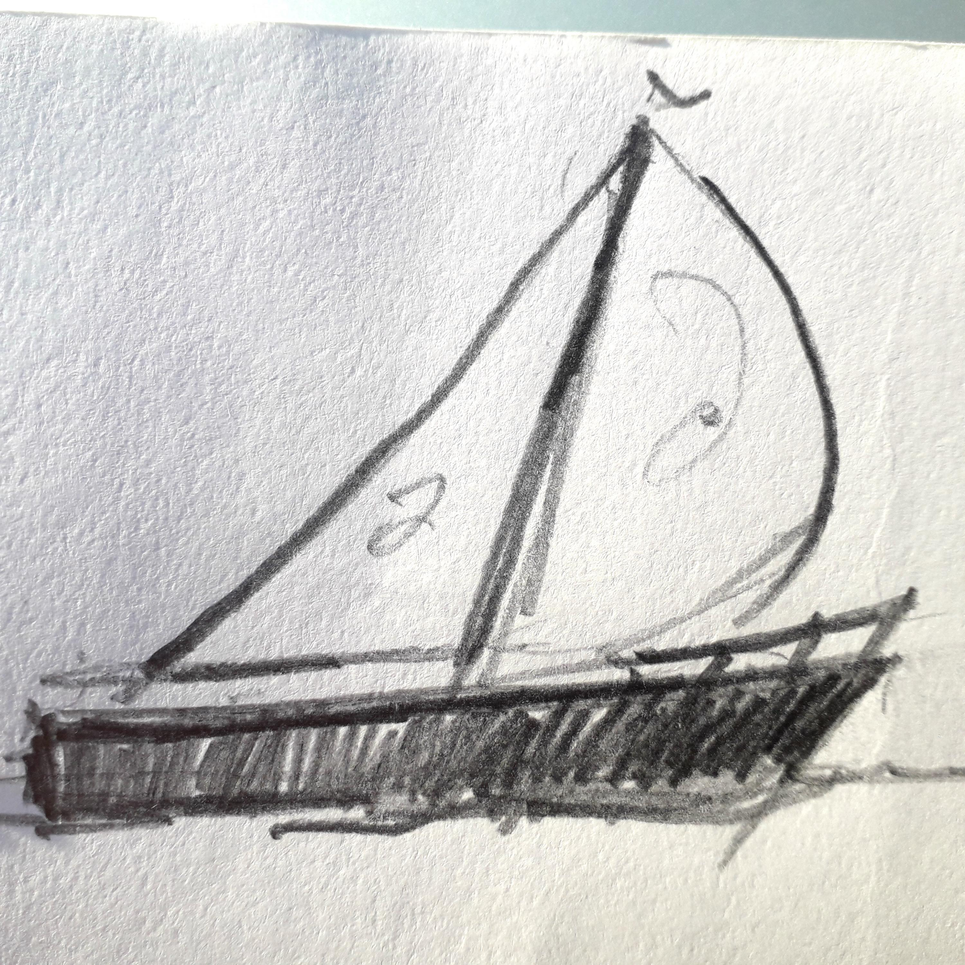
To finish,
I put PVA glue on my painting to make fish in the sea and added different colour glitter sparkles to this, as well as the sea, sand, umbrella and other features.
I also put shells on the beach to add to the seaside with glue.
I worked on my beach scene over 3 sessions, so it took me about 3 hours and I enjoyed making the painting.

